Slide 1
How to use this deck
L100: aka.ms/AISearch-L100
What is it: introductory product deck for Azure AI Search
What it’s for: business-level introduction to product
How to use it: use this deck to introduce Azure AI Search and RAG to customers
Optional to include some slides from the one-sliders deck.
L300: aka.ms/AISearch-L300
What is it: complete deck and introductory technical overview for AI Search
What it’s for: Present end to end to tech decision makers and managers
How to use it: Present end to end. Optional to include some slides from the L400 or one-sliders deck.
One-slider announcements deck: aka.ms/AISearch-releases
What is it: Repository of the latest product announcements, each summarized into one slide
What it’s for: To highlight a recent AI Search announcement with customer
How to use it: Copy specific slides from this deck, paste into your L100 or L300 deck version.
L400: Sea
What is it: Large repository of specific features and code samples for Azure AI Search.
What it’s for: Deep dive into a specific capability, provide code for customers to try for themselves
How to use it: copy specific slides from this deck, paste into your L300 version.

Slide 2
Azure AI Search
L400 pitch deck

Slide 3

Announcement slide with secondary announcements (dark)
Azure AI Search
Revolutionary RAG
Battle-tested retrieval
Streamlined data pipeline
Developer
integrations
Enterprise-ready
foundation
Notes:
Today we are going to talk about how Azure AI Search helps you run superior, advanced RAG for better GenAI applications.
Azure AI search provides customers with a feature rich vector database built on an enterprise ready foundation, so you can focus on exponential growth and scale.
Its integrations offer an end-to-end data management pipeline for all types of data, a full-stack RAG solution available where and how you want to build.
Your retrieval strategy matters. Our comprehensive search technology goes beyond vector search, we ensure you have the capabilities you need to retrieve accurate information for every question, regardless of your use case or data.

Slide 4







RAG Framework
Retrieval system
Data Sources
Retrieval
Indexing
User question
Answer
App UX
Agent
Large Language Model
Notes:
Today we are going to talk about how Azure AI Search helps you run superior, advanced RAG for better GenAI applications.
Azure AI search provides customers with a feature rich vector database built on an enterprise ready foundation, so you can focus on exponential growth and scale.
Its integrations offer an end-to-end data management pipeline for all types of data, a full-stack RAG solution available where and how you want to build.
Your retrieval strategy matters. Our comprehensive search technology goes beyond vector search, we ensure you have the capabilities you need to retrieve accurate information for every question, regardless of your use case or data.

Slide 5




Retrieval strategies
Keyword search
Vector search
Hybrid search
Search re-ranking
For exact, plain text matches
“Vocabulary gap” in Q&A systems like Copilot
For conceptual similarity, or underlying meaning
Weak performance on exact matches (like a product ID or code)
Best of both vectors and keywords
Brings more accurate responses across various scenarios
Scores and ranks all retrieved documents by relevance
Reranking runs after performing search strategy (can’t retrieve information)
Notes:
While vector search is an extremely popular search strategy today, there are many other types of retrieval practices. Each practice is useful for particular needs and types of data.
The purpose of showing this view is to show how vector databases tie into RAG, but also show that there are a lot of different ways to retrieve your data – it’s not just vector search.
(Optional information – don’t speak to the below bullets)
Vector search is a popular retrieval strategy in GenAI apps
Challenges: Weak performance on exact matches and out-of-distribution data
Vector search retrieves stored matching information based on conceptual similarity, or the underlying meaning of sentences, rather than keyword matches.
Particularly useful for apps using dialogue and question/answering formats which is why vector search is so popular with the rise of gen AI applications
in addition, generative AI applications often interact with data beyond text. You may need to search through text, documents, images and audio to get the response you need to generate. Having your data represented as vectors turns all your heterogeneous data iVector search is a popular retrieval strategy in GenAI apps
Robust to variation in how concepts are articulated (morphology, specificity, etc.)
Keyword search
Keyword search is a concept most are familiar with: it searches for exact plain text matches included in the query. This type of search is still useful today, however it falls short in generative AI scenarios. For example, with question and answering systems (like ChatGPT), very often questions and their answers don’t have overlapping keywords to match on.
Challenges: vocabulary gap, gets worse with natural language questions nto the same type of searchable content.
Exact keyword based
Relevance via Boolean Search
Ranking via BM25
Reranking
Ranks retrieved documents in order by relevance in a normalized, calibrated search score
Identify good & bad candidates​
Exclude documents below a threshold​
​Complete search stacks do better:​
Hybrid retrieval (keywords + vectors) > pure-vector or keyword​
Hybrid + Reranking > Hybrid​
​

Slide 6
Your retrieval strategy matters
More information ≠ better results
Accuracy
Number of documents provided
Source: Lost in the Middle: How Language Models Use Long Contexts, Liu et al. arXiv:2307.03172
Notes:
Now, there is a whole art to retrieval because the better the data retrieved, the better your application will be.
Turns out, you can’t just share a bunch of documents with an LLM and expect good results. LLMs were not built to find the most relevant information from your data. You need to be intentional with how you search your data.
This chart is from a research paper that studies how context length impacts the quality of responses. If you just cast a wide net where you retrieve a bunch of documents, put them in the prompt and hope the LLM will figure it out, you won’t get the best results. You need to make the retrieval system find the most relevant documents and only share those with the LLM.
So how do you do that?
2307.03172.pdf (arxiv.org)
How language models use long contexts

Slide 7
Retrieval pipeline
Query
Query Preprocessing
L0
Query rewriting
Retrieval
L1
Vector search
Keyword search
Hybrid search
Reranking
L2
Semantic ranker
Synthesis
L3
Results for LLM
Extractive answers
Contextualized captions

Slide 8
Extensive evaluations on RAG quality performance
 |  | Open Source |  | Internal
 |  | BEIR (NDCG10) | MIRACL (NDCG10) | Customer (NDCG3) | MIML (NDCG3) | Support (NDCG3) | Average (NDCG3)
KEYWORD |  | 41.6 | 49.5 | 43.5 | 46.1 | 38.4 | 42.6
OpenAI ADA-002 | VECTOR | 47.3 | 57.3 | 38.0 | 51.9 | 45.5 | 45.1
 | HYBRID | 50.2 | 59.1 | 45.3 | 53.1 | 46.9 | 48.4
 | HYBRID_L2_LEGACY | 51.3 | 72.0 | 62.1 | 67.7 | 59.7 | 63.1
 | HYBRID_L2_NEW | 55.0 | 78.0 | 68.2 | 75.0 | 69.9 | 71.1
 | HYBRID_QR_L2_NEW | 54.9 | 78.1 | 68.1 | 75.5 | 71.5 | 71.7
OpenAI TEXT-EMBEDDING- 003-LARGE | VECTOR | 54.6 | 78.1 | 42.6 | 60.3 | 35.0 | 46.0
 | HYBRID | 53.0 | 70.5 | 48.5 | 58.2 | 46.9 | 51.2
 | HYBRID_L2_LEGACY | 52.1 | 71.8 | 63.3 | 69.5 | 59.3 | 64.0
 | HYBRID_L2_NEW | 56.3 | 79.3 | 69.4 | 77.2 | 70.3 | 72.3
 | HYBRID_QR_L2_NEW | 55.9 | 79.4 | 69.3 | 77.2 | 72.0 | 72.8
OpenAI TEXT-EMBEDDING- 003-LARGE -256-BQ | VECTOR | 47.5 | 73.4 | 37.1 | 53.4 | 31.0 | 40.5
 | HYBRID | 49.6 | 69.5 | 45.7 | 55.7 | 43.5 | 48.3
 | HYBRID_L2_LEGACY | 51.5 | 71.8 | 62.4 | 68.5 | 57.9 | 62.9
 | HYBRID_L2_NEW | 55.3 | 79.0 | 68.5 | 75.9 | 68.1 | 70.8
 | HYBRID_QR_L2_NEW | 55.2 | 78.9 | 68.4 | 76.2 | 70.6 | 71.7

Slide 9



RAG Everywhere, Powered by AI Search
GitHub Models
Ground models with your proprietary data
Easy access glide path from playground to IDE
Full-featured retrieval: use hybrid search, reranking, etc.
Copilot Studio
Build your own copilot using intuitive building experiences
Bring your Azure AI Search index as a knowledge source in Copilot Studio
Optimize your agents / copilots with AI Search’s revolutionary retrieval system
Azure AI Foundry
Explore, build, test, and deploy cutting-edge LLM-powered GenAI solutions responsibly
Evaluate LLM responses and pinpoint fine-tuning opportunities
Scale PoCs with a paved path to full production
Open Source
Semantic Kernel
LangChain
LlamaIndex
Haystack
Notes:
When it comes to furthering your AI journey and building your own intelligent applications, Microsoft has multiple studios that streamline the process and elevate the developer experience.
Starting with Azure AI Foundry, Microsoft’s solution for developers seeking to build generative AI applications on an enterprise-grade platform. Azure AI Foundry is a trusted and inclusive platform that empowers developers of all abilities to innovate with AI and allows them to seamlessly explore, build, test, and deploy cutting-edge AI tools, from ML models to LLM-powered GenAI solutions. Working within Azure AI Foundry, you can collaborate as a team, using ready-to-use toolkits to build copilots and evaluating LLM responses to help you choose the right model for your project, further enabling you to scale your PoCs and progress on your AI journey.
Another solution to consider is Microsoft Copilot Studio, a low-code tool to customize Copilot for Microsoft 365 which lets you create powerful AI-powered copilots for a range of requests. For those who may not be data pros, Copilot Studio brings together a set of powerful conversational capabilities – from custom GPTs, generative AI plugins, and manual topics - and allows you to engage with customers and employees in multiple across websites and applications - without the need for data scientists or developers.
A third solution to consider as you choose how to build your copilot(s) is Windows AI Studio which, as a new experience for developers, strives to simplify generative AI app development. With so many tools and frameworks, generative AI app development can be a difficult process to navigate, and Windows AI Studio extends the tooling of Azure AI Foundry to jumpstart AI development locally on Windows. By bringing together cutting-edge tools and models from Azure AI Foundry and other catalogs, developers are able to fine-tune, customize and deploy state-of-the art SLMs for local use in their Windows apps. They can also achieve a hybrid AI scenarios across Azure and client devices, gaining greater choice regarding whether to run their models on the cloud on Azure on the edge locally on Windows (or across the two) to meet their needs.
Regardless of your AI initiative, Microsoft has the studio solution for your needs, empowering you to move forward confidently knowing you have all the tools and support you need.

Slide 10
Azure AI Search
RAG for GitHub Models
Free. Frictionless. Just add data.
Seamless playground experience
Auto-provisioned AI Search service
Full-featured retrieval system
Advanced RAG directly from code

Slide 11
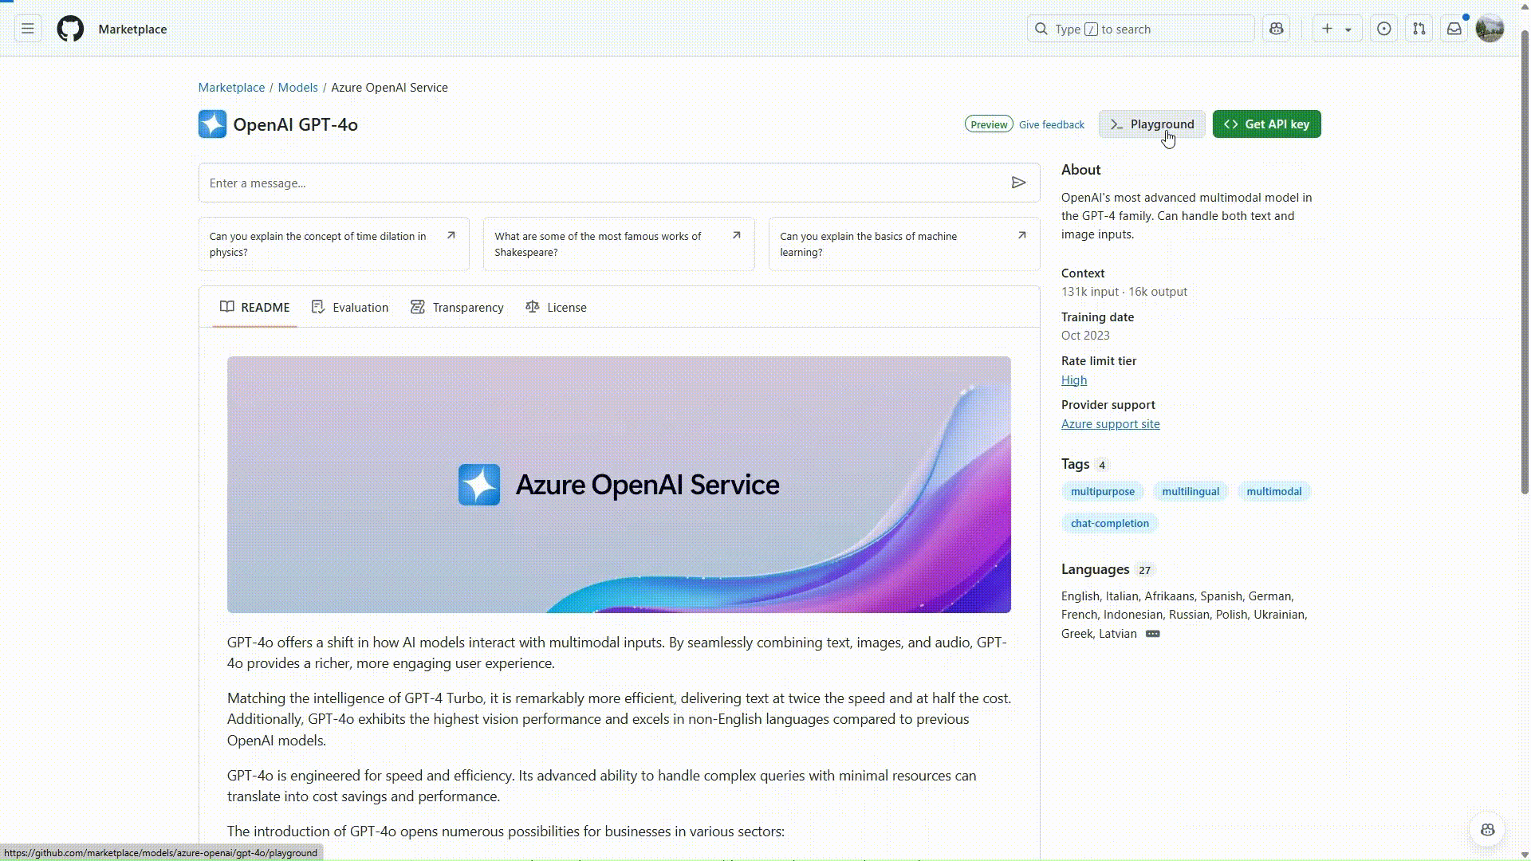
Powering RAG in GitHub Models
aka.ms/rag-in-github-signup
Easy access glide path from playground to IDE
Free AI Search service created automatically, without having to switch screens
Full-featured retrieval: use hybrid search, reranking, query rewriting
From code, test out and modify various features

Slide 12
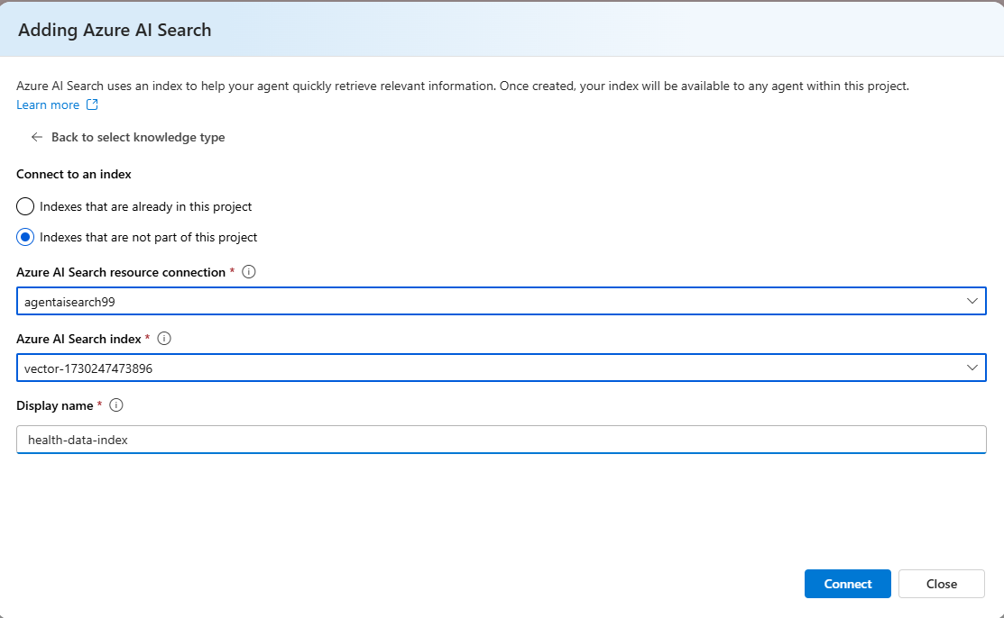
Knowledge Tool in Azure AI Agent Service
Introducing Azure AI Search as a Knowledge Tool
Build agents with deeper knowledge
Bring your own Azure AI Search index
Ground agents with your own data

Slide 13

Powering RAG in GitHub Models Ground Models with Your Proprietary Data
Easy access glide path from playground to IDE
Free AI Search service created automatically, without having to switch screens
Free. Frictionless. Just add data
Notes:
When it comes to furthering your AI journey and building your own intelligent applications, Microsoft has multiple studios that streamline the process and elevate the developer experience.
Starting with Azure AI Foundry, Microsoft’s solution for developers seeking to build generative AI applications on an enterprise-grade platform. Azure AI Foundry is a trusted and inclusive platform that empowers developers of all abilities to innovate with AI and allows them to seamlessly explore, build, test, and deploy cutting-edge AI tools, from ML models to LLM-powered GenAI solutions. Working within Azure AI Foundry, you can collaborate as a team, using ready-to-use toolkits to build copilots and evaluating LLM responses to help you choose the right model for your project, further enabling you to scale your PoCs and progress on your AI journey.
Another solution to consider is Microsoft Copilot Studio, a low-code tool to customize Copilot for Microsoft 365 which lets you create powerful AI-powered copilots for a range of requests. For those who may not be data pros, Copilot Studio brings together a set of powerful conversational capabilities – from custom GPTs, generative AI plugins, and manual topics - and allows you to engage with customers and employees in multiple languages across websites and applications - without the need for data scientists or developers.
A third solution to consider as you choose how to build your copilot(s) is Windows AI Studio which, as a new experience for developers, strives to simplify generative AI app development. With so many tools and frameworks, generative AI app development can be a difficult process to navigate, and Windows AI Studio extends the tooling of Azure AI Foundry to jumpstart AI development locally on Windows. By bringing together cutting-edge tools and models from Azure AI Foundry and other catalogs, developers are able to fine-tune, customize and deploy state-of-the art SLMs for local use in their Windows apps. They can also achieve a hybrid AI scenarios across Azure and client devices, gaining greater choice regarding whether to run their models on the cloud on Azure on genial the edge locally on Windows (or across the two) to meet their needs.
Regardless of your AI initiative, Microsoft has the studio solution for your needs, empowering you to move forward confidently knowing you have all the tools and support you need.

Slide 14
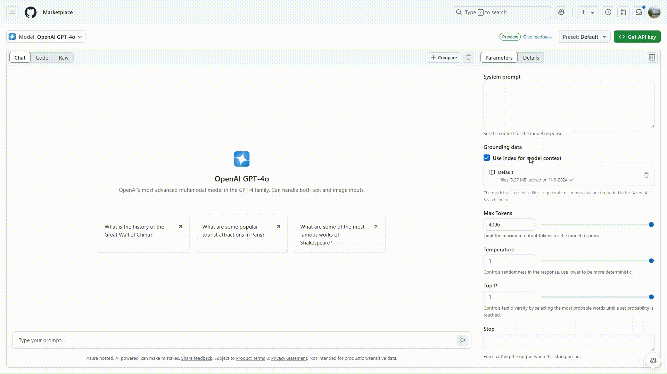
Code Experience in GitHub Models RAG Access full-featured AI Search with only GitHub PAT
Auth using GitHub personal access token (PAT) only
Full-featured Azure AI Search service with hybrid search, reranking, etc.
Copy code samples and test in Codespaces or your IDE
Notes:
When it comes to furthering your AI journey and building your own intelligent applications, Microsoft has multiple studios that streamline the process and elevate the developer experience.
Starting with Azure AI Foundry, Microsoft’s solution for developers seeking to build generative AI applications on an enterprise-grade platform. Azure AI Foundry is a trusted and inclusive platform that empowers developers of all abilities to innovate with AI and allows them to seamlessly explore, build, test, and deploy cutting-edge AI tools, from ML models to LLM-powered GenAI solutions. Working within Azure AI Foundry, you can collaborate as a team, using ready-to-use toolkits to build copilots and evaluating LLM responses to help you choose the right model for your project, further enabling you to scale your PoCs and progress on your AI journey.
Another solution to consider is Microsoft Copilot Studio, a low-code tool to customize Copilot for Microsoft 365 which lets you create powerful AI-powered copilots for a range of requests. For those who may not be data pros, Copilot Studio brings together a set of powerful conversational capabilities – from custom GPTs, generative AI plugins, and manual topics - and allows you to engage with customers and employees in multiple languages across websites and applications - without the need for data scientists or developers.
A third solution to consider as you choose how to build your copilot(s) is Windows AI Studio which, as a new experience for developers, strives to simplify generative AI app development. With so many tools and frameworks, generative AI app development can be a difficult process to navigate, and Windows AI Studio extends the tooling of Azure AI Foundry to jumpstart AI development locally on Windows. By bringing together cutting-edge tools and models from Azure AI Foundry and other catalogs, developers are able to fine-tune, customize and deploy state-of-the art SLMs for local use in their Windows apps. They can also achieve a hybrid AI scenarios across Azure and client devices, gaining greater choice regarding whether to run their models on the cloud on Azure on genial the edge locally on Windows (or across the two) to meet their needs.
Regardless of your AI initiative, Microsoft has the studio solution for your needs, empowering you to move forward confidently knowing you have all the tools and support you need.

Slide 15
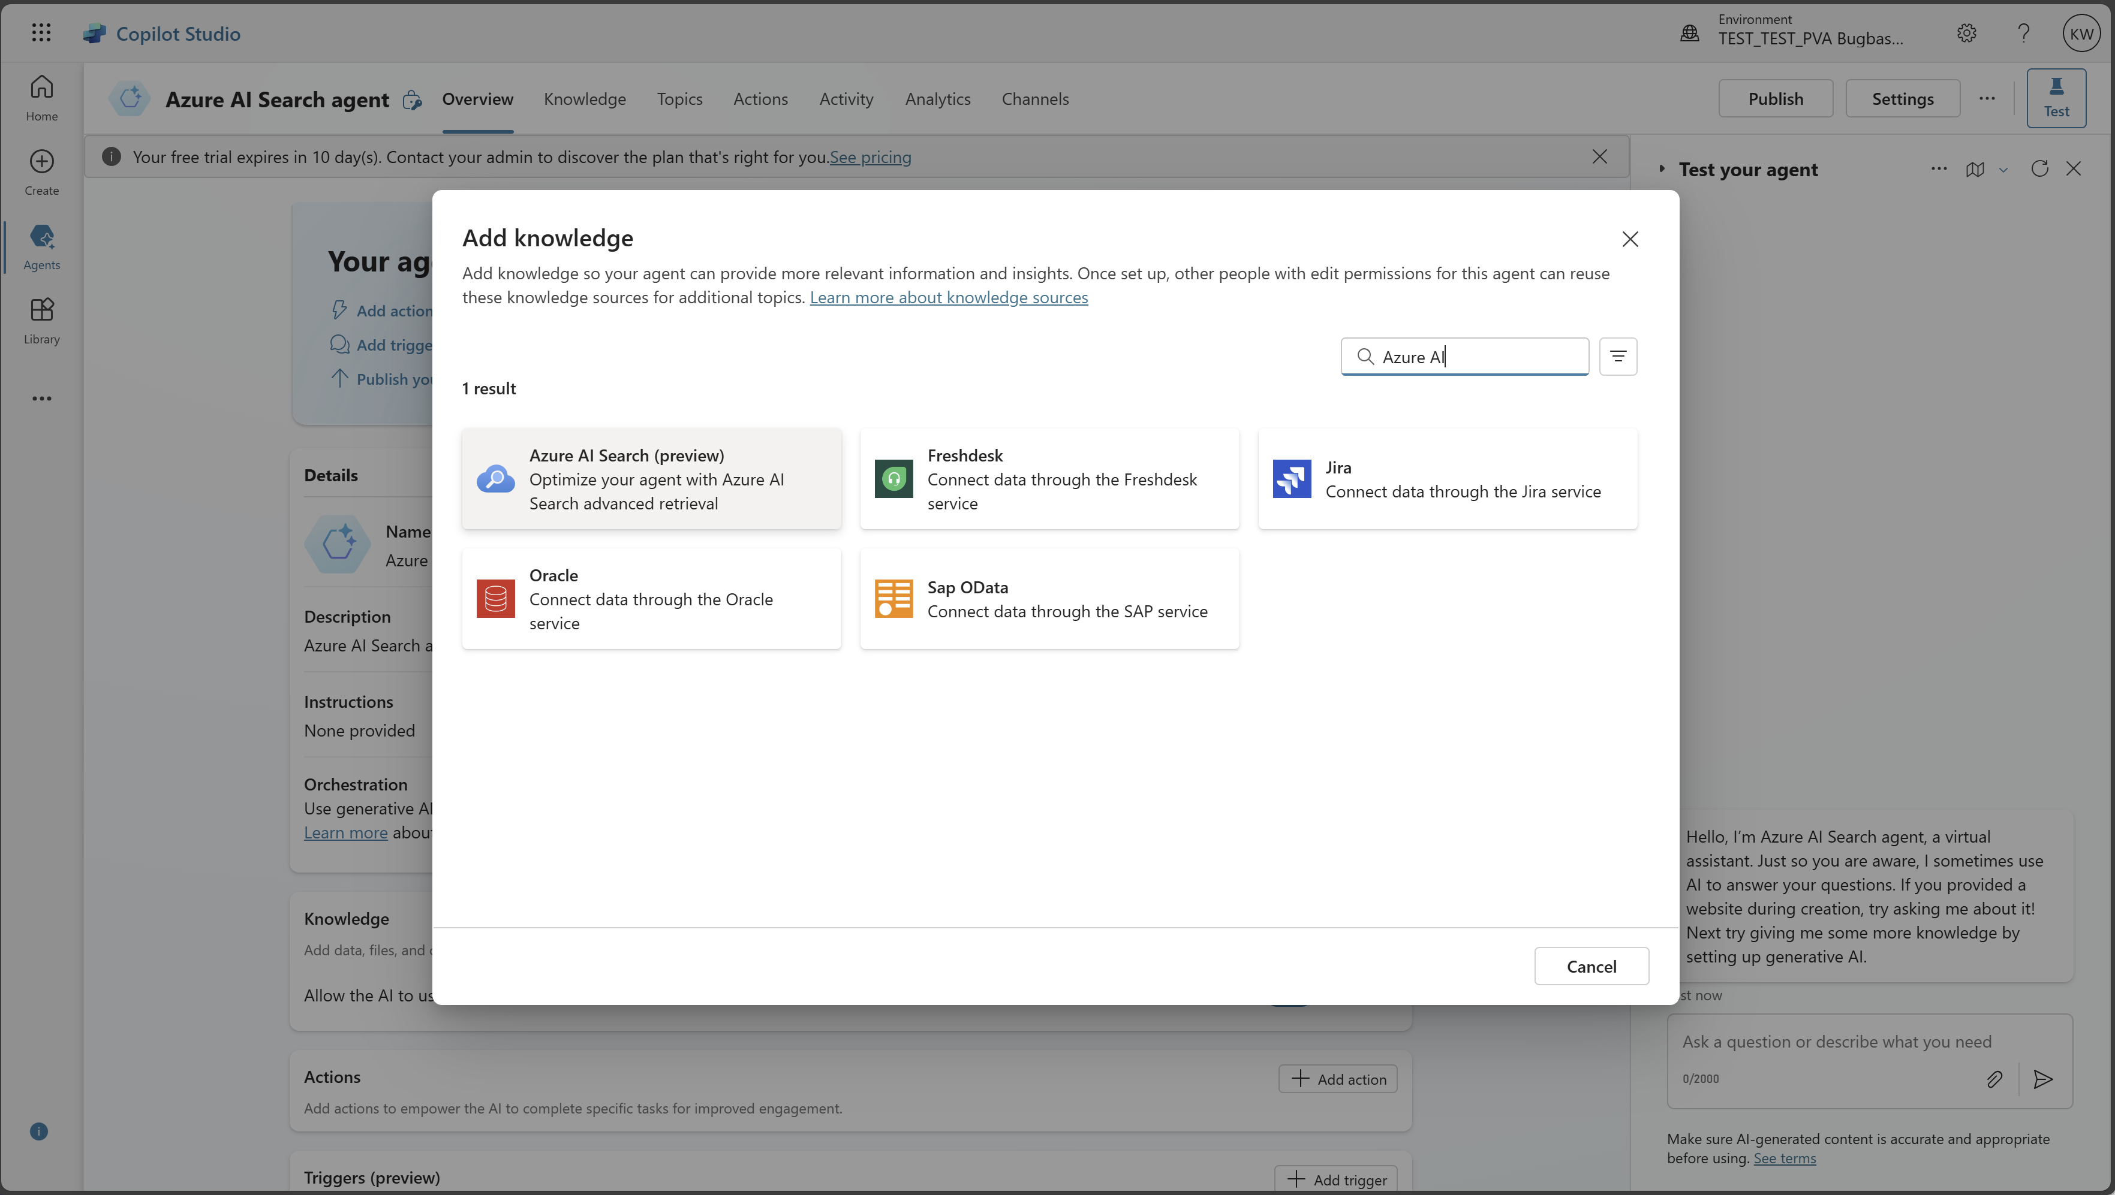
AI Search as a Knowledge Source in Copilot Studio Optimize Agents with AI Search’s Revolutionary Retrieval System
Maker selects Azure AI Search for the list of available knowledge sources
Maker enters AI Search endpoint URL and API keys
Maker selects a vector index to be used for knowledge source
Notes:
When it comes to furthering your AI journey and building your own intelligent applications, Microsoft has multiple studios that streamline the process and elevate the developer experience.
Starting with Azure AI Foundry, Microsoft’s solution for developers seeking to build generative AI applications on an enterprise-grade platform. Azure AI Foundry is a trusted and inclusive platform that empowers developers of all abilities to innovate with AI and allows them to seamlessly explore, build, test, and deploy cutting-edge AI tools, from ML models to LLM-powered GenAI solutions. Working within Azure AI Foundry, you can collaborate as a team, using ready-to-use toolkits to build copilots and evaluating LLM responses to help you choose the right model for your project, further enabling you to scale your PoCs and progress on your AI journey.
Another solution to consider is Microsoft Copilot Studio, a low-code tool to customize Copilot for Microsoft 365 which lets you create powerful AI-powered copilots for a range of requests. For those who may not be data pros, Copilot Studio brings together a set of powerful conversational capabilities – from custom GPTs, generative AI plugins, and manual topics - and allows you to engage with customers and employees in multiple languages across websites and applications - without the need for data scientists or developers.
A third solution to consider as you choose how to build your copilot(s) is Windows AI Studio which, as a new experience for developers, strives to simplify generative AI app development. With so many tools and frameworks, generative AI app development can be a difficult process to navigate, and Windows AI Studio extends the tooling of Azure AI Foundry to jumpstart AI development locally on Windows. By bringing together cutting-edge tools and models from Azure AI Foundry and other catalogs, developers are able to fine-tune, customize and deploy state-of-the art SLMs for local use in their Windows apps. They can also achieve a hybrid AI scenarios across Azure and client devices, gaining greater choice regarding whether to run their models on the cloud on Azure on genial the edge locally on Windows (or across the two) to meet their needs.
Regardless of your AI initiative, Microsoft has the studio solution for your needs, empowering you to move forward confidently knowing you have all the tools and support you need.

Slide 16
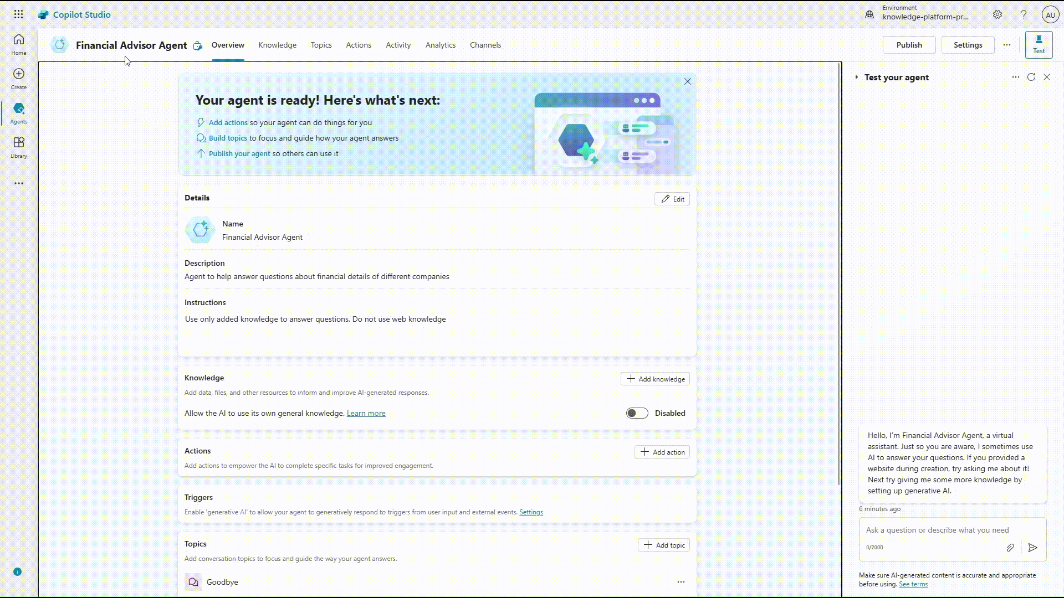
AI Search as a Knowledge Source in Copilot Studio Optimize Agents/Copilots with AI Search’s Revolutionary Retrieval System
Maker selects Azure AI Search for the list of available knowledge sources
Maker enters AI Search endpoint URL and API keys
Maker selects a vector index to be used for knowledge source
Notes:
When it comes to furthering your AI journey and building your own intelligent applications, Microsoft has multiple studios that streamline the process and elevate the developer experience.
Starting with Azure AI Foundry, Microsoft’s solution for developers seeking to build generative AI applications on an enterprise-grade platform. Azure AI Foundry is a trusted and inclusive platform that empowers developers of all abilities to innovate with AI and allows them to seamlessly explore, build, test, and deploy cutting-edge AI tools, from ML models to LLM-powered GenAI solutions. Working within Azure AI Foundry, you can collaborate as a team, using ready-to-use toolkits to build copilots and evaluating LLM responses to help you choose the right model for your project, further enabling you to scale your PoCs and progress on your AI journey.
Another solution to consider is Microsoft Copilot Studio, a low-code tool to customize Copilot for Microsoft 365 which lets you create powerful AI-powered copilots for a range of requests. For those who may not be data pros, Copilot Studio brings together a set of powerful conversational capabilities – from custom GPTs, generative AI plugins, and manual topics - and allows you to engage with customers and employees in multiple languages across websites and applications - without the need for data scientists or developers.
A third solution to consider as you choose how to build your copilot(s) is Windows AI Studio which, as a new experience for developers, strives to simplify generative AI app development. With so many tools and frameworks, generative AI app development can be a difficult process to navigate, and Windows AI Studio extends the tooling of Azure AI Foundry to jumpstart AI development locally on Windows. By bringing together cutting-edge tools and models from Azure AI Foundry and other catalogs, developers are able to fine-tune, customize and deploy state-of-the art SLMs for local use in their Windows apps. They can also achieve a hybrid AI scenarios across Azure and client devices, gaining greater choice regarding whether to run their models on the cloud on Azure on genial the edge locally on Windows (or across the two) to meet their needs.
Regardless of your AI initiative, Microsoft has the studio solution for your needs, empowering you to move forward confidently knowing you have all the tools and support you need.

Slide 17
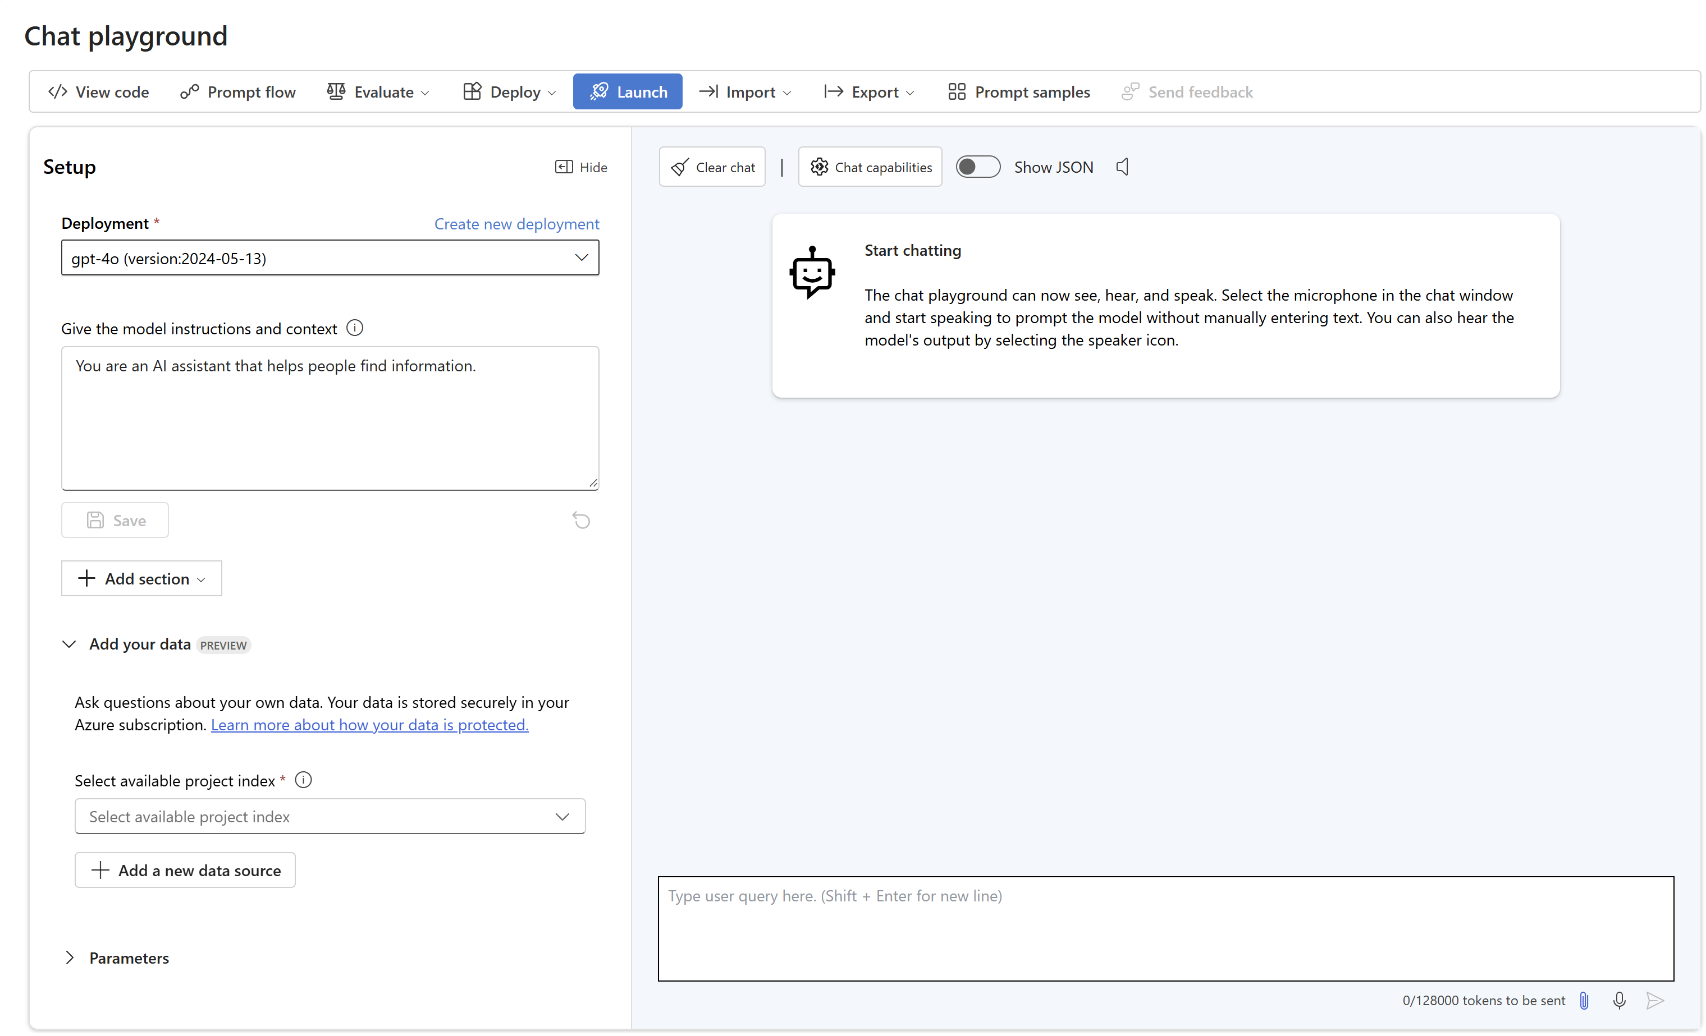
Azure AI Foundry Build and consume AI Search indexes
Explore cutting-edge APIs and models
Build and test solutions with collaborative and responsible AI tools, safeguard, and best practices
Build and consume AI Search indexes in Azure AI Foundry
Notes:
When it comes to furthering your AI journey and building your own intelligent applications, Microsoft has multiple studios that streamline the process and elevate the developer experience.
Starting with Azure AI Foundry, Microsoft’s solution for developers seeking to build generative AI applications on an enterprise-grade platform. Azure AI Foundry is a trusted and inclusive platform that empowers developers of all abilities to innovate with AI and allows them to seamlessly explore, build, test, and deploy cutting-edge AI tools, from ML models to LLM-powered GenAI solutions. Working within Azure AI Foundry, you can collaborate as a team, using ready-to-use toolkits to build copilots and evaluating LLM responses to help you choose the right model for your project, further enabling you to scale your PoCs and progress on your AI journey.
Another solution to consider is Microsoft Copilot Studio, a low-code tool to customize Copilot for Microsoft 365 which lets you create powerful AI-powered copilots for a range of requests. For those who may not be data pros, Copilot Studio brings together a set of powerful conversational capabilities – from custom GPTs, generative AI plugins, and manual topics - and allows you to engage with customers and employees in multiple languages across websites and applications - without the need for data scientists or developers.
A third solution to consider as you choose how to build your copilot(s) is Windows AI Studio which, as a new experience for developers, strives to simplify generative AI app development. With so many tools and frameworks, generative AI app development can be a difficult process to navigate, and Windows AI Studio extends the tooling of Azure AI Foundry to jumpstart AI development locally on Windows. By bringing together cutting-edge tools and models from Azure AI Foundry and other catalogs, developers are able to fine-tune, customize and deploy state-of-the art SLMs for local use in their Windows apps. They can also achieve a hybrid AI scenarios across Azure and client devices, gaining greater choice regarding whether to run their models on the cloud on Azure on genial the edge locally on Windows (or across the two) to meet their needs.
Regardless of your AI initiative, Microsoft has the studio solution for your needs, empowering you to move forward confidently knowing you have all the tools and support you need.

Slide 18
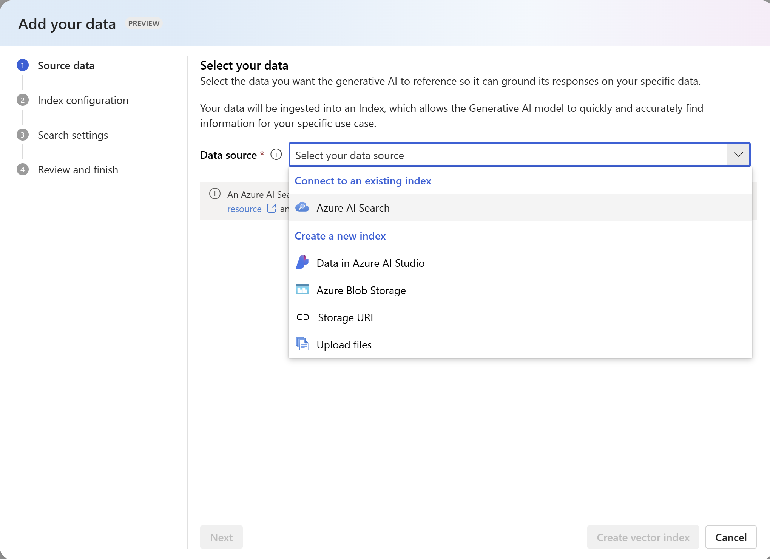
Azure AI Foundry Build and consume AI Search indexes
Explore cutting-edge APIs and models
Build and test solutions with collaborative and responsible AI tools, safeguard, and best practices
Build and consume AI Search indexes in Azure AI Foundry
Notes:
When it comes to furthering your AI journey and building your own intelligent applications, Microsoft has multiple studios that streamline the process and elevate the developer experience.
Starting with Azure AI Foundry, Microsoft’s solution for developers seeking to build generative AI applications on an enterprise-grade platform. Azure AI Foundry is a trusted and inclusive platform that empowers developers of all abilities to innovate with AI and allows them to seamlessly explore, build, test, and deploy cutting-edge AI tools, from ML models to LLM-powered GenAI solutions. Working within Azure AI Foundry, you can collaborate as a team, using ready-to-use toolkits to build copilots and evaluating LLM responses to help you choose the right model for your project, further enabling you to scale your PoCs and progress on your AI journey.
Another solution to consider is Microsoft Copilot Studio, a low-code tool to customize Copilot for Microsoft 365 which lets you create powerful AI-powered copilots for a range of requests. For those who may not be data pros, Copilot Studio brings together a set of powerful conversational capabilities – from custom GPTs, generative AI plugins, and manual topics - and allows you to engage with customers and employees in multiple languages across websites and applications - without the need for data scientists or developers.
A third solution to consider as you choose how to build your copilot(s) is Windows AI Studio which, as a new experience for developers, strives to simplify generative AI app development. With so many tools and frameworks, generative AI app development can be a difficult process to navigate, and Windows AI Studio extends the tooling of Azure AI Foundry to jumpstart AI development locally on Windows. By bringing together cutting-edge tools and models from Azure AI Foundry and other catalogs, developers are able to fine-tune, customize and deploy state-of-the art SLMs for local use in their Windows apps. They can also achieve a hybrid AI scenarios across Azure and client devices, gaining greater choice regarding whether to run their models on the cloud on Azure on the edge locally on Windows (or across the two) to meet their needs.
Regardless of your AI initiative, Microsoft has the studio solution for your needs, empowering you to move forward confidently knowing you have all the tools and support you need.

Slide 19
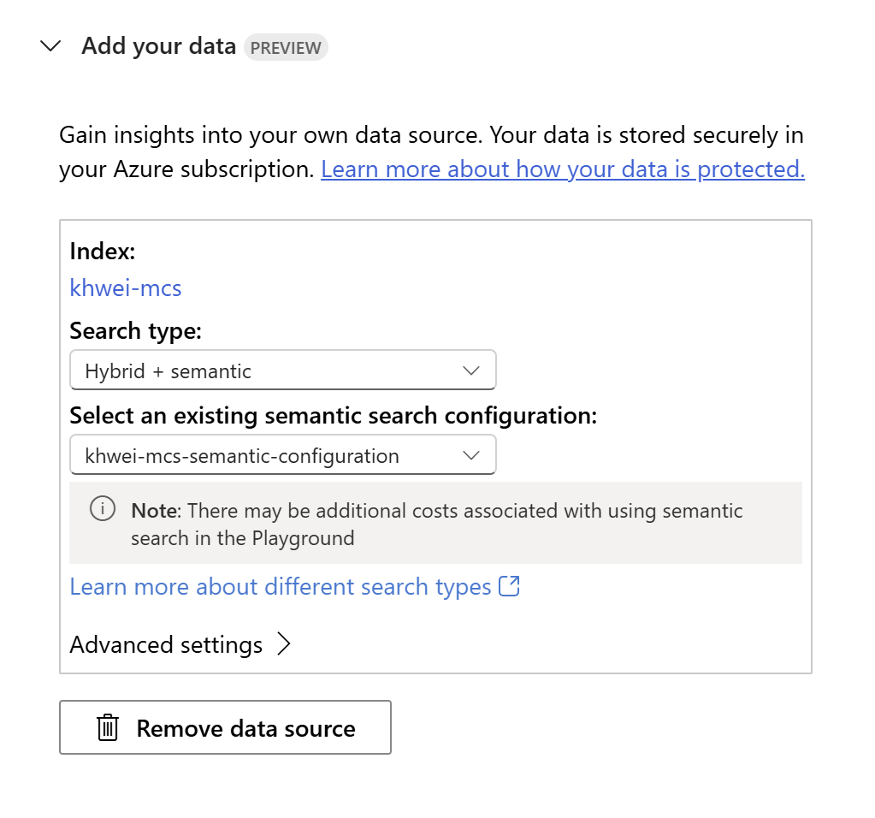
Azure AI Foundry Build and consume AI Search indexes
Explore cutting-edge APIs and models
Build and test solutions with collaborative and responsible AI tools, safeguard, and best practices
Build and consume AI Search indexes in Azure AI Foundry
Notes:
When it comes to furthering your AI journey and building your own intelligent applications, Microsoft has multiple studios that streamline the process and elevate the developer experience.
Starting with Azure AI Foundry, Microsoft’s solution for developers seeking to build generative AI applications on an enterprise-grade platform. Azure AI Foundry is a trusted and inclusive platform that empowers developers of all abilities to innovate with AI and allows them to seamlessly explore, build, test, and deploy cutting-edge AI tools, from ML models to LLM-powered GenAI solutions. Working within Azure AI Foundry, you can collaborate as a team, using ready-to-use toolkits to build copilots and evaluating LLM responses to help you choose the right model for your project, further enabling you to scale your PoCs and progress on your AI journey.
Another solution to consider is Microsoft Copilot Studio, a low-code tool to customize Copilot for Microsoft 365 which lets you create powerful AI-powered copilots for a range of requests. For those who may not be data pros, Copilot Studio brings together a set of powerful conversational capabilities – from custom GPTs, generative AI plugins, and manual topics - and allows you to engage with customers and employees in multiple languages across websites and applications - without the need for data scientists or developers.
A third solution to consider as you choose how to build your copilot(s) is Windows AI Studio which, as a new experience for developers, strives to simplify generative AI app development. With so many tools and frameworks, generative AI app development can be a difficult process to navigate, and Windows AI Studio extends the tooling of Azure AI Foundry to jumpstart AI development locally on Windows. By bringing together cutting-edge tools and models from Azure AI Foundry and other catalogs, developers are able to fine-tune, customize and deploy state-of-the art SLMs for local use in their Windows apps. They can also achieve a hybrid AI scenarios across Azure and client devices, gaining greater choice regarding whether to run their models on the cloud on Azure on genial the edge locally on Windows (or across the two) to meet their needs.
Regardless of your AI initiative, Microsoft has the studio solution for your needs, empowering you to move forward confidently knowing you have all the tools and support you need.

Slide 20
Orchestration: Prompting and communication
Orchestration in RAG
Coordination between the LLM (i.e., GPT-4), the retriever (i.e., AI Search) and the user interface app
Prompting
🔗 Prompt engineering: Crafting effective and efficient prompts
Example of a prompt:
“"You are an intelligent assistant helping Contoso Inc employees with their healthcare plan questions and employee handbook questions. "
+ "Use 'you' to refer to the individual asking the questions even if they ask with 'I'. "
+ "Answer the following question using only the data provided in the sources below. "
+ "For tabular information return it as an html table. Do not return markdown format. "
+ "Each source has a name followed by colon and the actual information, always include the source name for each fact you use in the response. "
+ "If you cannot answer using the sources below, say you don't know. Use below example to answer"
Orchestrator communication with LLM, retriever and user interface app
Orchestrator based on prompt communicates with the LLM and the retriever to request for indexed data
The retriever (AI Search) fetches relevant documents and results are returned to the orchestrator
Based on the prompt, the LLM prepares the response with the results fetched by the retriever
The orchestrator returns the LLM crafted response to the User Interface app
🔗 Prompting code sample
Notes:
Now, we're going to explore the concept of Orchestration in RAG, focusing particularly on the coordination between the Language Model, GPT-4, the Retriever, AI Search, and the User Interface app.
Firstly, let's delve into the art of Prompting. 'Prompt Engineering' refers to the process of crafting effective and efficient prompts to guide the AI's responses. For instance, consider this example of a prompt:
"You are an intelligent assistant helping Contoso Inc employees with their healthcare plan questions and employee handbook questions. When responding, refer to the questioner as 'you' even if they use 'I'. Please answer the following question using only the data provided in the sources below. If the information is tabular, return it as an HTML table, and avoid markdown format. Each source has a name followed by colon and the actual information, always include the source name for each fact you use in the response. If you cannot answer using the sources below, simply say you don't know."
In the process of Orchestration, the Orchestrator communicates with both the LLM and the Retriever based on the prompt, requesting for indexed data. The Retriever, or AI Search, is responsible for fetching relevant documents, with the results returned to the Orchestrator. The LLM then prepares a response based on the prompt and the results fetched by the Retriever. The Orchestrator returns this LLM crafted response to the User Interface app for display.
Finally, we have an example of Prompting code, which demonstrates how these concepts are practically applied.

Slide 21
Vector search section

Slide 22

Vectors
Learned vector representations
Models that encode item -> vector
Similar items map to close vectors
Sentences, images, graphs, etc.
Vector search
Find K closest vectors given a “query” vector
Search exhaustively or through approximations

Slide 23

Vector search
Full-featured
Create embeddings using any model
Explicit and transparent vector data processing
Exhaustive KNN search​ & ANN search
Multi-vector
Notes:
Vector databases are extremely popular in the GenAI market, and so for customers who want to understand whether we are a vector database – we tick all of those boxes and more. Vector search is only one strategy that can be implemented, you often need a variety of search practices for your use cases.
OSS, libraries
FAISS, nmslib, etc.
OSS, pure vector databases
Qdrant, Milvus, Weaviate, ChromaDB, etc.
OSS, search engines
Elasticsearch, OpenSearch, Vespa
Cloud services, pure vectors
Pinecone, Vertex AI Search Engine
Cloud services, search engines
AWS OpenSearch, Azure AI Search

Slide 24
Vector search basics
Exhaustive KNN search and ANN search strategies
Multi-modal, multi-lingual similarity search that supports any embedding model
Filters to include or exclude certain information
End-to-end data ingestion, Chunking, Vectorization, and Advanced Retrieval
Integrated with Semantic kernel, LangChain, Azure OpenAI, and AML Promptflow

Slide 25



Vector search at a high level
Scenario
The challenge
The solution
A diverse collection of books, each containing unique insights and knowledge
Finding a book on a specific topic or theme can be time-consuming and overwhelming, especially when the content is scattered
A skilled librarian can quickly connect you to books with similar topics or themes
Notes:
I was trying to explain vector search to my 5th grade nephew the other day and here is an analogy that finally clicked with him.
Imagine you're in a library with a diverse collection of books, each containing unique insights and knowledge.
Finding a book on a specific topic or theme can be time-consuming and overwhelming, especially when the content is scattered.
Vector search is like a skilled librarian that helps computers quickly find and connect you to the information you need by organizing similar items closer together.

Slide 26


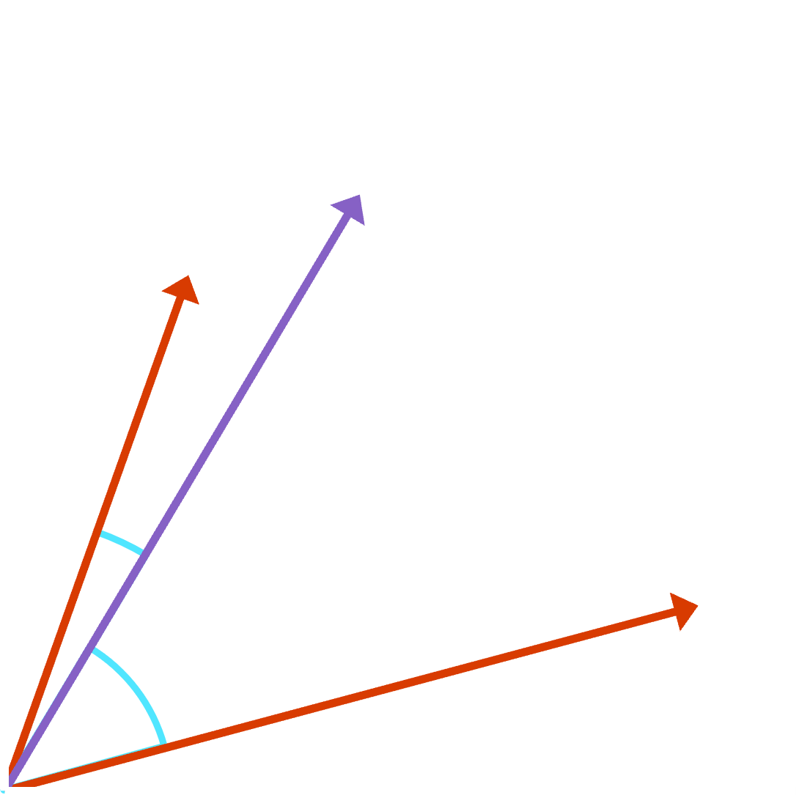
Vector search: deeper dive
Scenario
The challenge
The solution
Organizations need efficient methods to retrieve semantically similar items from large-scale data sources
Sifting through large-scale databases to find related items can be resource-intensive and time-consuming
By calculating similarity metrics like cosine similarity, vector search organizes data and retrieves semantically similar items within the high-dimensional space
Notes:
Here’s a more technical example:
Advanced users require efficient methods to retrieve semantically similar items from large-scale databases. Embedding algorithms map data items into continuous vector representations, capturing inherent relationships and semantic structures. Vector search enhances scalability and search performance by calculating similarity metrics and using approximate nearest neighbor algorithms to rank and retrieve the most relevant items.

Slide 27
Embeddings: convert data into vector representation Simplifying complex data structures for efficient analysis and processing in various applications
Definition
Purpose
Benefits
Abstract, dense, compact, learned numerical representations of data
Map complex structures into simpler, fixed-size vectors
Applicable to diverse data types (text, images, audio, etc.)
Facilitate analysis and processing of diverse data types
Enable similarity measurement, clustering, and classification
Power applications like Vector search and recommendation systems
Efficient search and organization of vast datasets
Improved accuracy and relevance of search results
Scalable and adaptable to various industries and use cases
Notes:
Why do we use embeddings. I think the core reason is that vectors are a universal representation of data. Whether you have massive text docs, images, audio or video clip, any of those things can be represented by a vector. And you can construct those vectors in such a way in that they are directly comparable with each other regardless of format.

Slide 28
Why do I need embeddings? Vectors are a universal representation of data
3.4MB
0.1912
0.4123
. . .
0.9128
4.1MB
1.1GB
Notes:
Why do we use embeddings. I think the core reason is that vectors are a universal representation of data. Whether you have massive text docs, images, audio or video clip, any of those things can be represented by a vector. And you can construct those vectors in such a way in that they are directly comparable with each other regardless of format.

Slide 29

Find relevant objects with embeddings Convert data vectors (embeddings) and find the most similar objects according to metric
Data Sources
Vector Representation
Vector index
Vector Representation
App/UX
Images
-2, -1 , 0, 1
Audio
Azure AI
Search
Transform using embedding model
2, 3, 4, 5
2, 3, 4, 5
Transform using embedding model
6, 7, 8, 9
Video
Text
Results
...and more!
Notes:
Often applications need to assess similarity between items. These items could be documents, sentences, images, audio, etc. While in some cases direct comparisons are appropriate (e.g. find exact words in a sentence), typically it's desired for these comparisons to be based on whether items are semantically similar, regardless of or their representation in text, pixels, etc.
Embeddings are vector representations of items of one or more media type that are trained such that vectors that are close together have similar meaning. Some of these embeddings are trained on a single type of data (e.g. sentence embeddings), while others map multiple types of data into the same vector space (e.g. sentences and images).
Once you have a vector encoding for your data, how do you put it to use? A common scenario is to vectorize all of your data into a vector database, and then when the application needs to find an item, you use a query vector (vectorizing the user query) to retrieve similar items. This is the role of vector search.

Slide 30
Choosing an embedding model Key factors for selecting the optimal model for your use case
Model characteristics
Implementation considerations
Task specificity
Performance
Context awareness
Model size and inference speed
Language support
Customizability (ability to fine-tune)
Training time and complexity
Pre-trained models
Integration
Community support and updates
Cost
We recommend Azure OpenAI “text-embedding-ada-002” for text embeddings
We recommend Azure AI Vision Image Retrieval API for image embeddings
Notes:
When choosing an embedding model, it's crucial to consider both the model's characteristics and implementation factors.
In terms of model characteristics, ensure that the model aligns with your data type and specific application. Assess the model's performance, including accuracy, recall, precision, and F1-score, on benchmark datasets relevant to your use case. Determine whether context-aware embeddings are necessary for your text data, and ensure the model balances complexity with performance requirements in terms of size and inference speed. Additionally, verify that the model supports the target languages and can be customized for your specific domain. For implementation considerations, be mindful of the training time and computational resources required for the chosen model. Whenever possible, leverage pre-trained models to save time and resources, ensuring they are relevant to your domain. Evaluate how easily the model can be integrated into your existing infrastructure, and gauge the level of community support and ongoing development, as this can impact the availability of resources for implementation and troubleshooting. By carefully evaluating these factors, you can confidently select the optimal embedding model for your use case, leading to more effective and efficient results.

Slide 31
Vector search strategies
ANN search
Exhaustive KNN search
Fast vector search at scale
Uses HNSW, a graph method with excellent performance-recall profile
Fine control over index parameters
Per-query or built into schema
Useful to create recall baselines
Scenarios with highly selective filters
e.g., dense multi-tenant apps
r = search_client.search(
None,
top=5,
vector_queries=[RawVectorQuery(
vector=search_vector,
k=5,
fields="embedding")])
r = search_client.search(
None,
top=5,
vector_queries=[RawVectorQuery(
vector=search_vector,
k=5,
fields="embedding",
exhaustive=True)])

Slide 32
Approximate nearest neighbor search Efficient and scalable similarity search with AI
Definition
Purpose
Benefits
A fast search method for finding approximate nearest neighbors in high-dimensional spaces
Applicable in image search, NLP, recommendation systems
Provide faster search results in high-dimensional data by trading off a small degree of recall for significant performance gains compared to exhaustive vector search
Vector indexes are data structures that let us perform approximate nearest neighbor search
Notes:
Approximate Nearest Neighbor (ANN) search is an AI-driven approach that aims to find the most similar items to a query item within a specified search radius. This is achieved by using approximations instead of exact matches, and by leveraging AI techniques such as locality-sensitive hashing, tree-based methods, and neural networks to enhance efficiency. The primary purpose of ANN search is to provide both speed and scalability, especially in high-dimensional data sets. It has found applications in various domains, including image and video search, natural language processing, and recommendation systems. The benefits of ANN search include delivering more relevant results compared to traditional search methods and improving user experience by offering faster search results. These factors contribute to enhancing the overall effectiveness of search systems.

Slide 33
Exhaustive nearest neighbor search (KNN) Efficient and scalable similarity search with AI
Definition
Purpose
Benefits
A computationally intensive search method for finding the global set of nearest neighbors in high-dimensional spaces
Applicable in image search, NLP, recommendation systems etc., when recall is of utmost importance.
Provide exhaustive search results in high-dimensional data by trading off performance for recall gains compared to ANN vector search; an example use case is to use KNN to build an evaluation set for measuring ANN performance.
Vector indexes are data structures that let us perform approximate nearest neighbor search
Notes:
Exhaustive Nearest Neighbor (KNN) search is an AI-driven approach that aims to find the search vector global set of nearest neighbors for a given query. This is achieved by using a brute-force approach that calculates the distance between ALL pairs of data points and finds the exact K nearest neighbors for a query point. The primary purpose of KNN search is intended for scenarios where high recall is of utmost importance, and users are willing to accept the trade-offs in search performance. Because it's computationally intensive, use exhaustive KNN for small to medium datasets, or when precision requirements outweigh query performance considerations.
The benefits of KNN are found in the complete recall. An example use case is to build a dataset to evaluate approximate nearest neighbor algorithm recall. Exhaustive KNN can be used to build the ground truth set of nearest neighbors.

Slide 34
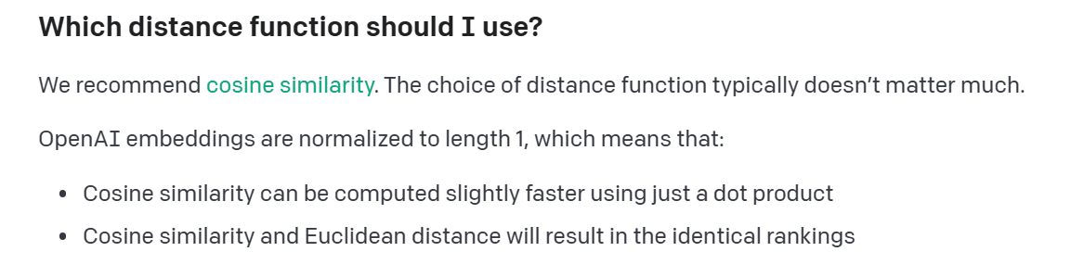
Similarity metrics
Cosine similarity
Dot product
Euclidean distance
Angular
Jaccard
Many more!
https://platform.openai.com/docs/guides/embeddings/which-distance-function-should-i-use

Slide 35
Common approximate nearest neighbor algorithms Exploring AI techniques for efficient similarity search
HNSW (Hierarchical Navigable Small World)
FLAT (Brute Force)
LSH (Locality-Sensitive Hashing)
IVF (Inverted File Index)
Hierarchical graph structure
Fast search performance
Exhaustive search in high-dimensional data
Slower but highly accurate
Hash-based similarity search
Trade-off between speed and accuracy
Reduces search space using quantization
Scalable and memory-efficient
When productionizing, it doesn’t matter what algorithm you chose, but rather the information retrieval system it’s part of
https://github.com/erikbern/ann-benchmarks
Notes:
In this slide, we explore four common Approximate Nearest Neighbor (ANN) algorithms that use AI techniques for efficient similarity search. Let’s start with Inverted File Index (IVF) algorithm reduces the search space using quantization, making it scalable and memory-efficient.
Locality-Sensitive Hashing (LSH) is a hash-based similarity search method that balances speed and accuracy by making trade-offs between them. Third, the Brute Force (FLAT) algorithm conducts an exhaustive search in high-dimensional data. Although slower compared to other methods, it offers high accuracy. Lastly, the Hierarchical Navigable Small World (HNSW) algorithm employs a hierarchical graph structure, resulting in fast and accurate search performance. These algorithms offer diverse approaches to ANN search, catering to different requirements in terms of speed, accuracy, and efficiency.

Slide 36
Limitations of common OSS ANN indexes
ANN indexes on their own, are simply just a data structure
Limited scalability: struggle with vertical and horizontal scaling in large-scale data sets
Memory constraints: high memory consumption affecting search performance and resource efficiency
Persistence and durability: lack of built-in mechanisms for data storage, recovery, and metadata management
Simplistic query support: limited capabilities for combining sparse and dense retrieval methods
Hosting challenges: complex setup and hosting requirements
No built-in security features: open-source solutions often lack advanced security features
Embedding management: limited support for managing the embedding functions themselves
Notes:
In this slide, we discuss the limitations of in-memory Approximate Nearest Neighbor (ANN) indexes, compared to full-fledged vector databases like Azure Cognitive Search. First, in-memory solutions have limited scalability, struggling with vertical and horizontal scaling in large-scale data sets. Second, memory constraints can be an issue as high memory consumption affects search performance and resource efficiency. Third, these solutions lack built-in mechanisms for data storage, recovery, and metadata management, posing challenges in terms of data durability. Fourth, in-memory solutions offer limited capabilities for combining sparse and dense retrieval methods, restricting query support. Fifth, they often have complex setup and hosting requirements compared to full-fledged vector databases, creating hosting challenges. Sixth, open-source solutions often lack advanced security features, which may be a concern for organizations handling sensitive data. Lastly, there is limited support for managing the embedding functions themselves in in-memory ANN indexes. These limitations make in-memory ANN indexes less suitable for certain use cases, especially when compared to the more robust features offered by full-fledged vector databases like Azure Cognitive Search.

Slide 37
The dream scenario for vector search Effortless data management and relevant search results
Dump a bunch of data
Get the most relevant data back
Run a query
Scalability
Preprocessing
Splitting/Chunking
Embedding management
Ranking accuracy
Result diversity
Search algorithm
Common challenges
Query understanding
Query flexibility
Notes:
In this slide, we visualize the dream scenario for vector search, where managing data and obtaining relevant search results become effortless processes. The first step involves seamlessly adding data from various sources into a centralized vector database, eliminating the need for manual data management. Next, users can easily submit queries to the vector database using natural language or specific search parameters, simplifying the search process. Finally, the system returns highly relevant search results, ranked by their similarity to the query, ensuring that users receive the most pertinent information for their needs. This dream scenario envisions a seamless and efficient vector search experience, where data management and search relevance are optimized for the user. In this slide, we delve into the challenges associated with achieving the dream scenario for vector search and discuss potential obstacles in each of the three steps. In the first step of dumping a bunch of data, challenges include data integration, data preprocessing, and scalability. These involve managing diverse data formats and sources, cleaning and transforming data for efficient storage, and handling large-scale, high-dimensional data sets. The second step, issuing a query, presents challenges such as query understanding, query flexibility, and performance. These entail interpreting natural language queries accurately, supporting various search parameters and filters, and ensuring fast query execution and response times. Finally, in the third step of getting the most relevant data back, challenges include ranking accuracy, result diversity, and continuous learning. These require identifying and ranking relevant results effectively, balancing the variety and relevance of search results, and updating the system to improve search quality over time. Addressing these challenges is essential to successfully implementing the dream scenario for vector search and creating a seamless, efficient search experience.

Slide 38
Best practices – vector search

Slide 39
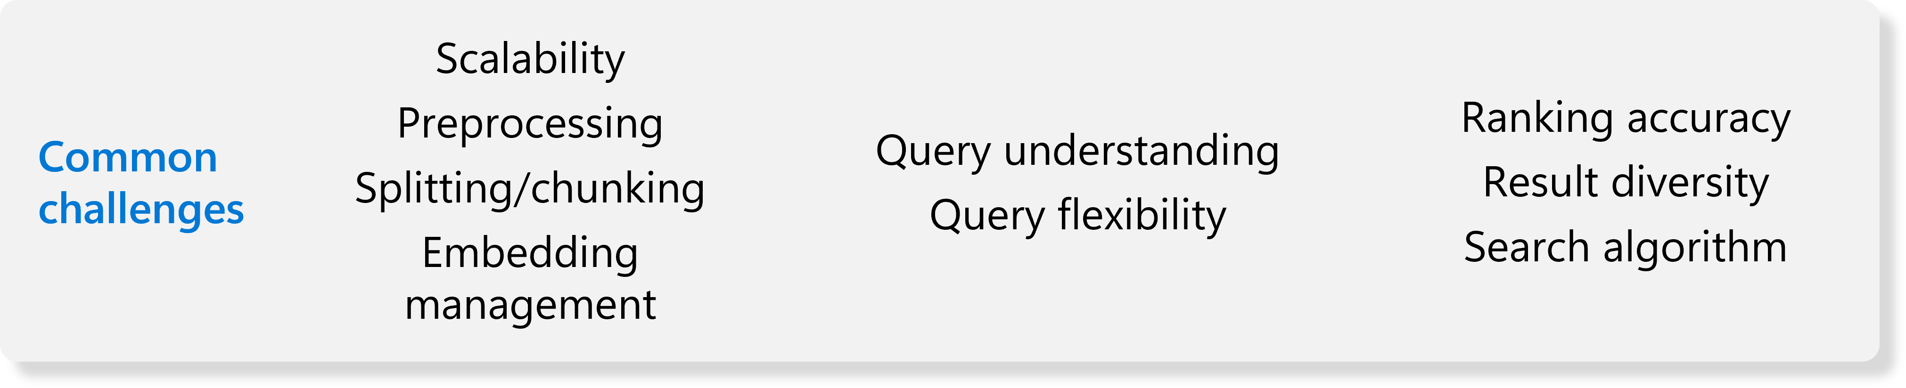
Scalability in vector search Key questions and considerations for efficient scaling
Data volume: can the system handle increasing amounts of data?
Storage capacity and management
Indexing and search performance
Query load: how well does the system respond to growing query demands?
Query execution speed and response times
Handling concurrent queries and user connections
Distributed infrastructure: does the system support distributed and parallel processing?
Horizontal scaling across multiple nodes
Load balancing and fault tolerance
Cost efficiency: how does the system optimize resource usage and cost management?
Balancing performance and cost requirements
Efficient use of hardware and cloud resources
Notes:
In this slide, we discuss the importance of scalability in vector search and elaborate on key questions and considerations to ensure efficient scaling.
First, consider data volume. Ask whether the system can handle increasing amounts of data in terms of storage capacity, management, indexing, and search performance.
Second, examine query load and how well the system responds to growing query demands. This includes query execution speed, response times, and the ability to handle concurrent queries and user connections.
Third, assess distributed infrastructure support, such as distributed and parallel processing capabilities. This involves horizontal scaling across multiple nodes, as well as load balancing and fault tolerance.
Lastly, consider cost efficiency and how the system optimizes resource usage and cost management. This involves balancing performance and cost requirements, as well as making efficient use of hardware and cloud resources.
By addressing these questions and considerations, you can ensure that your vector search solution scales effectively to meet growing demands and changing requirements.

Slide 40
Preprocessing & document Chunking Optimizing data preparation for efficient Vector Search
Text preprocessing: ensuring clean and structured data for the embedding model
Tokenization (or segmentation): breaking text into words, phrases, or symbols
Lowercasing and normalization: standardizing text representation
Stopword removal: eliminating common words with little semantic value
Stemming and lemmatization: reducing words to their root forms
Document splitting: adapting documents to fit within embedding model limits
Chunking: dividing long documents into smaller, manageable sections
Passage extraction: identifying and retaining meaningful segments
Overlap management: ensuring continuity and context preservation
Model compatibility: preparing data to align with the chosen embedding model
Input requirements: adhering to model-specific formatting and length constraints
Vocabulary coverage: maximizing the overlap between document vocabulary and model vocabulary
Evaluation and iteration: continuously improving preprocessing and splitting strategies
Performance monitoring: assessing the impact of preprocessing and splitting on search quality
Strategy refinement: adjusting techniques based on observed results and user feedback
Notes:
In this slide, we explore the importance of preprocessing and document splitting for overcoming embedding model limits and ensuring efficient vector search. First, text preprocessing is crucial for creating clean and structured data to feed into the embedding model. Techniques like tokenization (e.g. Example: "The quick brown fox" -> ["The", "quick", "brown", "fox"]) , lowercasing, normalization, stopword removal, stemming, and lemmatization (e.g. "running, runs, ran“ -> "run, run, run“) help improve the model's understanding of the text. Second, document splitting adapts documents to fit within embedding model limits. This involves dividing long documents into smaller sections using Chunking or passage extraction and managing overlaps to ensure continuity and context preservation. Third, consider the model compatibility by preparing data to align with the chosen embedding model. This includes adhering to input requirements such as formatting and length constraints, as well as maximizing vocabulary coverage to improve model performance. Lastly, continuously evaluate and iterate on your preprocessing and splitting strategies. Monitor performance to assess the impact of these techniques on search quality and refine strategies based on observed results and user feedback.

Slide 41
Challenge of embedding management Overcoming embedding management in Vector Search
Embedding quality: ensuring high-quality and accurate vector representations
Selecting appropriate embedding models (e.g., OpenAI, BERT)
Fine-tuning models for domain-specific vocabulary and context
Dimensionality: balancing embedding size and search performance
Reducing dimensions while retaining semantic information
Implementing dimensionality reduction techniques (e.g., PCA, t-SNE)
Indexing and storage: efficiently managing and storing embeddings
Using optimized data structures for quick look-up and retrieval (e.g., approximate nearest neighbors)
Embedding updates: keeping vector representations up-to-date with evolving data
Incremental updates to embeddings based on new or updated documents
Periodic model retraining for continuous improvement and/or model version updating
Evaluation and iteration: continuously assessing and refining embedding management strategies
Monitoring performance metrics (e.g., search relevance, recall, precision)
Adjusting techniques based on observed results and user feedback

Slide 42
Addressing the query language challenge Enhancing Vector Search through improved query understanding
Beyond similarity: addressing complex search scenarios beyond “most similar documents”
Understanding user intent: identifying specific search goals and requirements
Query flexibility: supporting various search parameters and filters
Boolean operators: handling AND, OR, and NOT conditions
Filtering and faceting: allowing users to filter results based on specific attributes
Query transformation: converting user queries into vector representations
Text-to-vector conversion: transforming query text into compatible embeddings
Query expansion: incorporating additional keywords or phrases to improve search relevance
Evaluation and iteration: continuously refining query language understanding
Monitoring query performance metrics (e.g., query success rate, user satisfaction)
Adjusting techniques based on observed results and user feedback
Notes:
In this slide, we focus on enhancing query flexibility and transformation to address complex search scenarios and adapt to user requirements beyond simply finding the "most similar documents". First, go beyond similarity by understanding user intent and identifying specific search goals and requirements for more complex scenarios. Second, ensure query flexibility by supporting various search parameters and filters. This includes handling Boolean operators, such as AND, OR, and NOT conditions, as well as filtering and faceting to enable users to refine results based on specific attributes. Third, implement query transformation by converting user queries into vector representations. Transform query text into compatible embeddings and improve search relevance through query expansion, incorporating additional keywords or phrases. Lastly, continuously evaluate and iterate on query language understanding. Monitor query performance metrics like query success rate and user satisfaction, and adjust techniques based on observed results and user feedback. By addressing these aspects, you can significantly enhance query flexibility and transformation, catering to a wider range of search scenarios and user needs in your Vector Search solution.

Slide 43
Enhancing search relevance in Vector Search Achieving accurate ranking, result diversity, and adaptability
Ranking accuracy: ensuring highly relevant results are ranked at the top
Hyperparameter tuning leverage hyperparameters as needed to tradeoff recall/latency
Rank fusion (hybrid, re-ranker, HyDE): combining multiple ranking signals for improved accuracy
Result diversity: balancing the variety and relevance of search results
Diversification strategies: Introducing variety while maintaining relevance
Document-level vs. Chunk-level search: considering the impact of Chunking long documents
More focused and relevant results from individual Chunks (good or bad? -> depends on task)
Top results may all belong to the same document, reducing result diversity (good or bad? -> depends on task)
Search algorithm adaptability: customizing search behavior based on the task at hand
Task-oriented search: adjusting search algorithms for specific tasks or user requirements
Evaluation and iteration: continuously refining search relevance strategies
Monitoring search performance metrics (e.g., precision, recall, user satisfaction)
Adjusting techniques based on observed results and user feedback
Notes:
In this slide, we delve into the key aspects of enhancing search relevance in Vector Search, focusing on ranking accuracy, result diversity, search algorithm adaptability, and continuous evaluation. First, we discuss ranking accuracy, which ensures that the most relevant results are ranked at the top. This involves assigning relevance scores to search results based on their similarity to the query and employing rank fusion techniques, such as hybrid approaches, to combine multiple ranking signals for improved accuracy. Next, we explore result diversity, which aims to balance the variety and relevance of search results. This can be achieved through diversification strategies and by considering the impact of Chunking long documents on search behavior. While Chunk-level search can lead to more focused and relevant results, it may also result in top results all belonging to the same document, reducing diversity. The desirability of these outcomes depends on the specific task at hand. We then examine search algorithm adaptability, which involves customizing search behavior based on the task or user requirements. Task-oriented search allows for adjustments to search algorithms to cater to specific needs. Finally, we emphasize the importance of evaluation and iteration, which involves continuously refining search relevance strategies. This includes monitoring search performance metrics such as precision, recall, and user satisfaction, and adjusting techniques based on observed results and user feedback.

Slide 44


How do I get started with Vector search?
Generate document embeddings
Create your vector configuration
Generate query embedding
Ingest data sources
Add to your index
Search using vectors
Gather your data sources
Generate embeddings for your data using you own model
Insert your vectors into your search index as a collection of floats via the Push API or the Indexer via a Custom Embedding Skill
Configure your algorithm, similarity function, and parameters
Generate an embedding for your query using the same model as your docs
Search your index using a vector representation of your data

Slide 45


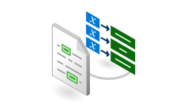

RAG Example: Q&A with Semantic Answering over Document Library
Embedded question
Questions
?
text-embedding-3-small
Application
User
Azure Open AI Service
Section 1
Embedding 1
Vector
search
Section 2
Embedding 2
Section 3
Embedding 3
N-Relevant Sections
NLP Tasks:
Summarization,
Q&A, etc.
Document Intelligence
Layout Model
text-embedding-3-small
VectorDB
text-davinci-003
Section 4
Embedding 4
Extracted Section Text
Document Library

Slide 46
Storage optimization

Slide 47
Narrow types in Azure AI Search
Description | Size | Index definition data type
Single precision floating point | 32 bits | Edm.Single
Half precision floating point | 16 bits | Edm.Half
Short int | 16 bits | Edm.Int16
Signed byte | 8 bits | Edm.Sbyte
Packed binary | 1 bit, packed in bytes | Edm.Byte, packedBinary=true
Use with client-side quantization, or with an API or model that already returns narrower numeric types
Enables optimized data storage for vector fields
Reduced memory footprint. | Enhanced cost-efficiency for large datasets.
Basic SKU now supports up to 3 partitions, up from a single partition
Limits are GB/partition
Notes:
Enables optimized data storage for vector fields.
Supported data types:
Collection(Edm.Single) - 32-bit float (default).
Collection(Edm.Half) - 16-bit float (narrow).
Collection(Edm.Int16) - 16-bit signed integer (narrow).
Collection(Edm.SByte) - 8-bit signed integer (narrow).
Collection(Edm.Byte) - 8-bit unsigned integer for binary data.
Benefits:
Reduced memory footprint.
Enhanced cost-efficiency for large datasets.

Slide 48
Storage optimization options
Quantization to compress vectors
8-bit scalar quantization and binary quantization
Rescoring with original vectors from disk to compensate for compression loss
New: native MRL
Vectors can be truncated with low information loss
Example:
BQ + rescoring w/ 2x oversampling: 99.85% of original
MRL(3x) + BQ(32x) + rescoring w/ 2x oversampling: 99.01%
Not sure where to start?
For OpenAI text-embedding-003-large:
1024 vector prefix (MRL) + binary quantization + rescoring with 2x oversampling
...
MRL
...
BQ
.

Slide 49
Scalar Quantization
Compresses vector data by reducing resolution.
Uses 8-bit integers to encode vectors.
Key advantages:
Reduces vector index size for Edm.Single fields by 75% and vector storage on disk by ~25%. vector storage reduction.
Minimal loss in retrieval quality with quantization bins.
Recommended for datasets with high vector dimensions.

Slide 50
Binary Quantization
Encodes each vector component as a single bit (0 or 1).
Drastically reduces vector memory footprint.
Key advantages:
Up to 96% reduction in index size.
Optimized for embeddings with dimensions >1024.
Faster vector performance (up to 40% query latency reductions)

Slide 51
MRL
Multi-level compression for vector embeddings.
Enables truncated dimensions with minimal semantic loss.
Best paired with:
Binary quantization for maximum storage reduction.
OpenAI models (text-embedding-3-small, text-embedding-3-large).

Slide 52
HNSW Storage Optimization
Enables automatic storage reductions for vector indexes.
Features:
50% reduction via duplication elimination.
Enhanced compression for quantized data (rescoreStorageMethod options).
Benefits:
Reduces monthly costs for large-scale deployments.
Up to 98% storage savings for 1B vector indexes.

Slide 53
HNSW Storage Optimization
Index name | Scenario | Storage size (MB) | Storage reduction (%) | Vector Size (MB) | Vector Reduction (%)
compression-test-baseline | baseline | 3813.29 | 0 | 1177.15 | 0
compression-test-baseline-s | baseline-s | 1305.12 | 65.77 | 1177.12 | 0
compression-test-scalar-full | scalar-full | 1606.84 | 57.86 | 300.603 | 74.46
compression-test-scalar-truncated-1024 | scalar-truncated-1024 | 1409.21 | 63.04 | 103.769 | 91.18
compression-test-binary-full | binary-full | 1347.59 | 64.66 | 41.8804 | 96.44
compression-test-binary-truncated-1024 | binary-truncated-1024 | 1323.33 | 65.3 | 17.4668 | 98.52
compression-test-scalar-truncated-1024-discard | scalar-truncated-1024-discard | 232.592 | 93.9 | 102.906 | 91.26
compression-test-binary-truncated-1024-discard | binary-truncated-1024-discard | 145.436 | 96.19 | 17.4491 | 98.

Slide 54
Rich vector search query capabilities
Filtered vector search
Scope to date ranges, categories, geographic distances, etc.
Rich filter expressions
Pre-/post-filtering
Pre-filter: great for selective filters, no recall disruption
Post-filter: better for low-selectivity filters, but watch for empty results
r = search_client.search(
None,
top=5,
vector_queries=[RawVectorQuery(
vector=query_vector,
k=5,
fields="embedding")],
vector_filter_mode=VectorFilterMode.PRE_FILTER,
filter=
"category eq 'perks' and created gt 2023-11-15T00:00:00Z")
Multi-vector scenarios
Multiple vector fields per document
Multi-vector queries
Can mix and match as needed
r = search_client.search(
None,
top=5,
vector_queries=[
RawVectorQuery(
vector=query1, k=5, fields="embedding"),
RawVectorQuery(
vector=query2, k=5, fields="embedding")
])

Slide 55
Relevance Control functionality
MaxTextSizeRecall for Hybrid Search
Score Threshold Filtering
Vector Weighting
Vector Boosting
results = search_client.search(
search_text=query,
vector_queries=[vector_query],
hybrid_search=HybridSearch(
max_text_recall_size=3,
count_and_facet_mode=HybridCountAndFacetMode.COUNT_RETRIEVABLE_RESULTS,
),
include_total_count=True,
)
query = "Coverage and exclusions for emergency and non-emergency medical transport under Northwind health plans"
vector_query = VectorizableTextQuery(
text=query,
k_nearest_neighbors=3,
fields="vector",
weight=2
)
query = "Coverage and exclusions for emergency and non-emergency medical transport under Northwind health plans"
vector_query = VectorizableTextQuery(
text=query,
k_nearest_neighbors=3,
fields="vector",
threshold=SearchScoreThreshold(value=0.75),
)
Notes:
Score Threshold Filtering: This feature improves search result relevance for vector and hybrid search queries by filtering out documents with low similarity scores.
Vector Weighting: Allows users to specify relative weight of vector queries to term queries in hybrid search scenarios. It gives more control over the final result set.
MaxTextSizeRecall for Hybrid Search: Users can specify the maximum number of documents recalled in hybrid search queries. It also allows adjusting the 'count' property to include all matching documents or only those retrieved within a defined window.
Document Boosting support for Vector/Hybrid Search: It allows for targeted document boosting, ensuring the most relevant results based on factors like freshness, geolocation, or specific keywords. This is enabled through scoring profiles.

Slide 56
Vector search demos
💻 Demo: Azure AI Search with vectors
💻 Demo: Compute a vector with ada-002
💻 Demo: Search vectors with query vector
💻 Demo: Searching images
💻 Demo: Compare text, vector, hybrid, reranker

Slide 57
Multimodal

Slide 58
L400
Multimodal Search
From Gia for Build update –
Remove this slide after added to the right part of the WIP L400 deck, before publishing.

Slide 59
Multimodal Search
From raw PDFs with complex diagrams and charts to conversational answers, faster:
Wizard-driven indexing, image annotation, and Gen AI prompts slash prep time.
Functionality in Azure portal:
RAG-ready index for multimodal search!
Data sources supporting blobs
Built-in indexers/ skillset
Index with multimodal text/embeddings and image references
RAG app
UX
Knowledge Store
(extracted image store)
New Azure AI Search wizard functionality, a few clicks away from delivering a multimodal-RAG index ready for Multimodal Search.
Indexer/skillset functionality:
Brand new GenAI prompt skill (with image verbalization)
Document Intelligence document layout skill updates:
Page number exposure | Image extraction | Text output
Split skill updates: text location
GitHub Sample App for Multimodal search: Search for text and get answers coming from PDFs, charts, diagrams, and workflows and their image annotations!

Slide 60
What is multimodality and why it matters for RAG, AI Agents grounding data?
Preview
Multimodality
• Ability to ingest, understand, and retrieve knowledge across *text + images* as a single corpus
• Combines textual descriptions *and* complex visual data (diagrams, screenshots, scanned forms)
• Azure AI Search pipeline
– Extracts page text and inline images together
– Verbalizes diagrams → captions LLM can reason over
– Creates embeddings for hybrid recall
– Stores cropped images in Knowledge Store and saves → UI can show exact snippet
• Result for RAG / agents
– Richer, grounded answers (text + picture)
– Example: HR-access workflow diagram → agent returns step-by-step list and the diagram slice
Notes:
https://learn.microsoft.com/en-us/azure/search/multimodal-search-overview

Slide 61
Why multimodality matters for developers?
Preview
• Old way: stitch OCR, image-annotation, vector store, custom code → weeks of “plumbing”
• New way in Azure AI Search (API 2025-05-01-preview)
– “Import and vectorize data” portal wizard (Multimodal toggle): point-and-click RAG-ready index, no JSON
– REST API/SDKs: same power via code / CI pipeline
– GitHub sample app: plug-and-play RAG demo, swap in your own data
• Dev benefits
– Less set-up time → focus on business logic
– Fast iterations: tweak verbalization vs. direct embeddings in UI
– Works with AOAI, AI Vision, or AI Foundry embedding supported models in AI Search
• Bottom line: spend time on user value, not pipelines
Notes:
https://learn.microsoft.com/en-us/azure/search/multimodal-search-overview

Slide 62
Multimodal Search
Preview
Why Multimodal search wins?
Scenario: User asks “What’s the process for requesting HR-system access?” — answer lives only in a 5-step workflow diagram inside a PDF.
• Traditional OCR
– Pulls plain text from pages, ignores arrows & shapes
– Diagram stays invisible → copilot returns “No answer”
• Image / multimodal embeddings only
– Finds visually similar diagram (good recall)
– Single vector can’t decode step order → agent can’t explain the flow
• Azure AI Search multimodal pipeline
– Extracts inline image + page text
– Verbalizes diagram: “Submit request → Manager approval → Security review …”
– Stores extracted image snippet in Knowledge Store and reference in the index
– Query returns BOTH the caption (for LLM) AND the diagram location (for citation) → user gets a grounded, step-by-step answer
Notes:
https://learn.microsoft.com/en-us/azure/search/multimodal-search-overview

Slide 63
Multimodal Search
Preview
Step | Skill / Feature | Status | What it adds | Where it lights up
1.1 | Document Intelligence layout | Updated | Images + page #, bounding boxes, parallel plain-text | Portal wizard · REST 2025-05-01-preview · GitHub repo
OR 1.2 | Document extraction skill | Existing | Images + text (no polygons/page # only for PDF) — quick RAG ingest | Portal wizard · REST 2025-05-01-preview
2 | Text split skill | Updated | Offsets, lengths, ordinal position per chunk | Portal wizard · REST 2025-05-01-preview · GitHub repo
3 | GenAI prompt skill |  | LLM verbalizes images, summarizes, classifies | Portal wizard · REST 2025-05-01-preview · GitHub repo
4 | Embedding support | Existing | Vector embeddings at ingest & query (AOAI, AI Foundry, AI Vision) | Portal wizard · AOAI / AML / Vision embedding skills / vectorizers · REST 2025-05-01-preview · GitHub repo
5 | Native image storage |  | Cropped images auto-saved to Knowledge Store for RAG citations | Portal wizard · GitHub repo
1–5 | Portal wizard |  | Few-click, low-code flow → multimodal, RAG-ready index | Azure portal (no-code)
6 | Sample GitHub app |  | High-code RAG sample → queries index, returns text + image annotations | GitHub repo
Updated
Updated
New
New
New
New
Notes:
https://learn.microsoft.com/en-us/azure/search/multimodal-search-overview
https://aka.ms/azs-multimodal-sample-app-repo

Slide 64




Multimodal Search: Data ingestion process with Azure portal wizard, multimodal toggle
Preview
Data Ingestion and Enrichment Pipeline provided by Azure AI Search built-in indexers (Connectors)
Pulls content
Indexes transformed data through Index projections mapping for created chunks
Azure Search Index
Data Source with PDF file support: Azure Blob, OneLake, ADLS Gen2, OneLake (Preview), Azure Files (Preview), SharePoint Online (Preview)
Transforms data
Transforms data
Exports images
AI Services multi-services (Azure AI Search-owned)
Azure OpenAI/AI Foundry model (Customer-owned)
Knowledge Store: Azure Blob/Table (Customer-owned)
For Document Intelligence text and image extraction and transformation via document intelligence layout skill.
Now also available:
Page number extraction
Image extraction
Text output
For multimodal vector creation via embedding skills (AI Vision, other multimodal embedding models like Cohere’s) or new AIGen prompt skill for image verbalization and Azure OpenAI text embeddings
For extracted images storage that can be used for image annotations by the RAG app when users query the chat bot
Note that this functionality is available in Azure AI Search via Azure portal wizard or via supported SDKs/REST APIs.
Notes:
https://learn.microsoft.com/en-us/azure/search/search-document-level-access-overview
https://learn.microsoft.com/en-us/azure/search/search-get-started-portal-image-search

Slide 65


Multimodal Search: E2E multimodal search process, with Azure portal wizard and sample app
https://aka.ms/azs-multimodal-sample-app-repo
Preview
Data Ingestion and Enrichment Pipeline provided by Azure AI Search built-in indexers (Connectors)
Pulls content
Indexes transformed data
Data Source with PDF file support (Azure Blob, OneLake, ADLS Gen2, OneLake (Preview))
Azure Search Index
Transforms data
Transforms data
Exports images
Gets images returned in response
5
AI Services multi-services (Azure AI Search-owned)
Azure OpenAI/AI Foundry model (Customer-owned)
Knowledge Store: Azure Blob/Table (Customer-owned)
Sends response with text and image references
4
For Document Intelligence text and image extraction and transformation.
For text/image embeddings and/or augmentation.
For extracted images storage.
Sends user query/ transformed query
3
2
Sends user query
RAG orchestrator/ agent
UX
Queries chat bot
Sends AI augmented response with text and images found and page numbers
1
6
Notes:
https://aka.ms/azs-multimodal-sample-app-repo
You can either use only the sample app E2E code or have the index created with the portal and then use it with the sample app.
https://aka.ms/azs-multimodal-sample-app-repo
https://learn.microsoft.com/en-us/azure/search/search-document-level-access-overview
https://learn.microsoft.com/en-us/azure/search/search-get-started-portal-image-search

Slide 66
RAG pipeline

Slide 67



Streamlined RAG pipeline
Integrated vectorization and Azure AI Search
Ingest
Extract
Chunk
Embed
Index
Query
OneLake
Blob Storage
ADLSv2
SQL DB
CosmosDB
Incremental change tracking
PDFs, Office docs
Image files
Nested images in PDFs, Office docs
Document layout JSON, CSVs, markdown parsing
Split text into passages (for text portions):
Fixed-size
AI Document Intelligence layout output
Propagate document metadata
Image → vector
Text → vector
Embeddings from OpenAI, AI Vision, or custom models
Document index
Chunk index
Both
Boosting
Weighting
Thresholding
Notes:
Split text into passages (for text portions):
-Fixed-size chunking (https://learn.microsoft.com/en-us/azure/search/cognitive-search-skill-textsplit)
-Document layout output chunking (https://aka.ms/DocumentIntelligenceLayout-skill)

Slide 68
Integration and RAG Workflows

Slide 69
L400
Integration/RAG Workflows Updates
From Gia for Build update –
Remove this slide after added to the right part of the WIP L400 deck, before publishing.

Slide 70
GenAI prompt skill
Preview
{
"@odata.type": "#Microsoft.Skills.Custom.ChatCompletionSkill",
"name": "Image Describer",
"context": "/document/normalized_images/*",
"inputs": [
{ "name": "image", "source": "/document/normalized_images/*/data" },
{ "name": "imageDetail", "source": "=high" },
{ "name": "systemMessage", "source": "='You are a useful AI assistant.'" },
{ "name": "userMessage", "source": "='Describe this image:'" }
],
"outputs": [ { "name": "response" } ],
"uri": "https://demo.openai.azure.com/openai/deployments/gpt-4o/chat/completions",
"authIdentity": "11111111-2222-3333-4444-555555555555",
"responseFormat": { "type": "text" }
}
🔗 Sample where GenAI prompt skill is defined
I want to verbalize my images, summarize content, classify documents with my custom prompt to an LLM during data ingestion, before I index it, to give more context at query-time.
Notes:
https://learn.microsoft.com/en-us/azure/search/cognitive-search-skill-GenAI-prompt
GenAI Prompt skill (Preview) – executes a chat-completion call to an LLM you’ve deployed in Azure OpenAI or Azure AI Foundry while the indexer runs. Use it to verbalize images, summarize text, transform content, or extract structured JSON into index fields.
Available only with 2025-05-01-preview API
Requires a chat-completion model (e.g., gpt-4o) + API key or managed identity
@odata.type #Microsoft.Skills.Custom.ChatCompletionSkill
Default limits: maxTokens = 1024, 30 s timeout, image size/model-dependent
Outputs: response (text/JSON) + usageInformation (token counts)
Tip — Chunk long docs with Text Split, co-locate model and search service in the same region, and use responseFormat.json_schema for reliable structured extraction.

Slide 71
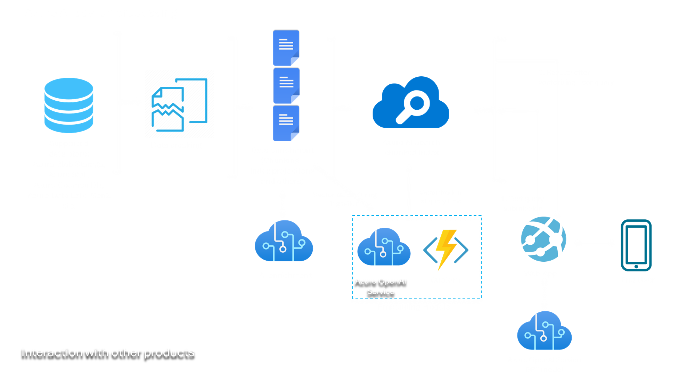
GenAI prompt skill diagram
Preview
Data Ingestion and Enrichment Pipeline provided by Azure AI Search built-in indexers (Connectors)
Azure AI Search processing
Query pipeline
Supported data store
Data cracking
Data enrichment
Azure AI Search Chunked index
Query submission/ response
Query submission/ response
New Functionality
Supported data store: Azure Blob Storage, Azure SQL, Azure Cosmos DB, Azure Data Lake Gen2, etc.
Data enrichment includes: chunking,
index projections, embeddings creation. Now includes GenAI Prompt skill
A custom prompt is sent for transformation requirement over provided input: Image verbalization, summarization, categorization, etc. to get a text augmented. Response to be used in the skillset pipeline/sent to the index.
Gen AI App/agent
UX
Query submission
AI Foundry Chat completions/ inference model (customer owned)
Notes:
https://learn.microsoft.com/en-us/azure/search/cognitive-search-skill-GenAI-prompt

Slide 72
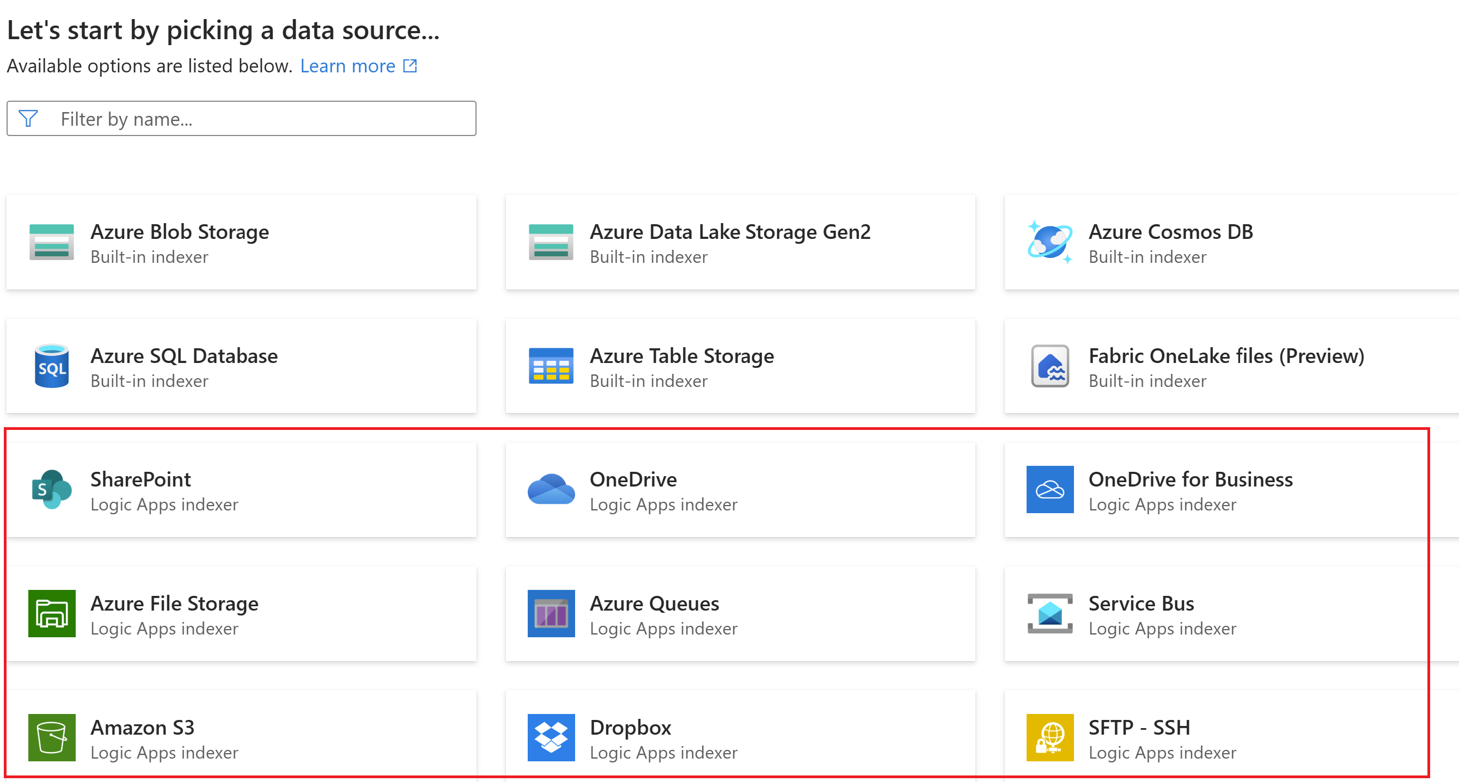
Azure Logic App-powered connectors in Azure AI Search portal RAG indexes with chunk and vectorized data
Preview
Low-code indexing with Azure Logic App-powered connectors and functionality, available from Azure AI Search portal:
Text data cracking
Text chunking
Azure OpenAI embeddings
Index text + vectors
Notes:
https://learn.microsoft.com/en-us/azure/search/search-how-to-index-logic-apps-indexers

Slide 73
Azure Logic App-powered connectors in Azure AI Search portal vs. AI Search built-in indexers
Aspect | Logic Apps ingestion templates | Built-in indexers
Typical data sources / connectors | SharePoint Online, OneDrive, Amazon S3, + other SaaS & on-prem connectors (via Logic Apps) | OneLake, Azure Blob, ADLS Gen2, Azure SQL, Cosmos DB, Azure Table, …
Execution engine (where it runs) | Serverless Logic Apps (Consumption) – external to AI Search | Inside the Azure AI Search service (same region & scale-unit)
Extraction & transformation | Logic Apps action chain – default text extraction; add Document Intelligence steps for images/layout as needed | Indexer → Skillset pipeline; built-in cracking for text (free) & images (billed), then OCR / Image Analysis / Layout / GenAI, etc.
How you monitor runs | Azure portal ▶ Logic App → Run history (step-level) + optional Azure Monitor logs | Azure portal ▶ Indexers → Runs or GET /indexers/{name}/status
Cost model | Pay-as-you-go per trigger | Ingest cost included in Search Scale Unit hours; AI skills billed (free ≤ 20 docs/day, then PAYG); image extraction per 1 K images. Other services customer owned PAYG.
Value | • No-code path for sources AI Search doesn’t crawl natively | • Zero-code crawler for core Azure stores
 |  | • Built-in deletion detection keeps index tidy
 | • Editable workflow: add pre-processing, Document Intelligence image extraction, branching | • Full AI enrichment in-line, add pre-processing steps through native skills or custom skills
Notes:
https://learn.microsoft.com/en-us/azure/search/search-how-to-index-logic-apps-indexers
Indexer overview - Azure AI Search | Microsoft Learn

Slide 74
Data ingestion

Slide 75
Data ingestion
Consider:
Data sources
Data preparation
Understanding your data
Ingestion mechanisms (Pull/Push)
Data AI enrichment
Chunking
Vectorization
Incremental indexing
Deletion policies
Scheduling
Security
Data and service limits
Scalability
Cost
Error handling and logging
Compliance
Notes:
Consider:
Data Sources: Identify your data sources and their locations. This knowledge is key for effective data ingestion. Data sources gallery - Azure AI Search | Microsoft Learn
Data Preparation: Evaluate potential data duplicates and determine the unique keys for your documents in the index for identification. This step is essential to avoid redundancy and ensure efficient data ingestion.
Understanding Your Data: Analyze the structure, format, type, and size of your data. Whether your data is structured or unstructured, understanding its nuances is crucial for effective Azure AI Search implementation.
Ingestion mechanisms:
Pull: For Azure AI Search integration with directly supported data sources (Blob, Azure SQL, ADLS Gen2, Cosmos DB, etc.) => Through indexers (Indexer overview - Azure AI Search | Microsoft Learn)
Push: For any requirements not covered by Azure AI Search built-in features and any data sources that you can access using APIs/SDKs => Through Azure AI Search Push API/SDK: Data import and data ingestion - Azure AI Search | Microsoft Learn
AI Enrichment of Data: Transform your data to fit the required shape that facilitates answering your users' queries. This may involve extracting key phrases, identifying people, pinpointing locations, and more. AI enrichment concepts - Azure AI Search | Microsoft Learn
Chunking: Involves breaking down larger pieces of data into smaller, manageable Chunks. This allows for more efficient processing and retrieval of data. When indexing data, consider how to effectively Chunk your data to optimize the search performance: Chunk documents in vector search - Azure AI Search | Microsoft Learn
Vectorization: Creating vector embeddings to provide semantic awareness to content for query results relevance improvements. There is another section in which we’re delving into this.
Vector search - Azure AI Search | Microsoft Learn
Integrated Vectorization - Azure AI Search | Microsoft Learn
Incremental Indexing: Maintain an up-to-date index by devising a regular update strategy. This ensures that your search index remains synchronized with the underlying data source. AI Search indexers have incremental indexing when configuring a schedule: Indexer overview - Azure AI Search | Microsoft Learn
Deletion Policies: By default, indexers do not have a deletion policy configured, when you delete a record from the source. Review the conditions of each data source to enable deletion policies.
Changed and deleted blobs - Azure AI Search | Microsoft Learn
Azure SQL indexer - Azure AI Search | Microsoft Learn
Azure Cosmos DB NoSQL indexer - Azure AI Search | Microsoft Learn
Security Measures: Protect your data by considering access control measures, private endpoints, firewall configurations, and other security protocols.
Security filters to trim results using Microsoft Entra ID - Azure AI Search | Microsoft Learn
Security filters for trimming results - Azure AI Search | Microsoft Learn
Connect using a managed identity - Azure AI Search | Microsoft Learn
Create a Private Endpoint for a secure connection - Azure AI Search | Microsoft Learn
Configure an IP firewall - Azure AI Search | Microsoft Learn
Data and service Limitations: Analyze your content size and review data limits as part of your service configuration. This ensures optimal usage of the Azure AI Search service and any considerations you need to take when preparing your data as well for ingestion: Service limits for tiers and skus - Azure AI Search | Microsoft Learn
Scalability: Plan for data growth by understanding how your indexing will scale. Azure AI Search provides scalability features, but it's advisable to perform stress testing to choose the best options for your solution. Also, if the customer would like to maintain indexing SLA (in terms of keep indexing/renewing indexing at next run while there is a service update/outage), service must have at least 3 replicas and higher number of partitions could help with indexing speed as well (when only raw text is being indexed). We recommend testing with a sample of a couple of hundreds of documents/records to understand sizing and performance and stress testing to understand scalability.
Cost Considerations: Analyze the costs associated with the AI enrichment options and search configurations you choose. While indexing with built-in indexers is part of the service fee, enrichments are not. Proper cost analysis can ensure efficient workload allocation and indexing SLA compliance.
Error Handling and Logging: Establish robust error handling and logging mechanisms. These will help troubleshoot any issues that may arise during indexing.
Compliance: Ensure your data practices comply with regulatory standards and guidelines. Adherence to compliance will safeguard your organization against legal repercussions.

Slide 76
Tools for ingesting data into AI Search for RAG
 | Azure AI Foundry | Azure OpenAI On your data | Azure AI Search built-in indexer
Incremental indexing | Using versioning only | Yes | Yes
Multiple data source support | Yes | Yes | Yes
Different data sources going to the same index | No | No | Yes one indexer per data source, multiple indexers pointing to the same index
Configurable deletion policy | No | No | Yes
Chunking | Yes | Yes | Yes through split skill/ markdown parsing / doc layout skill/ custom skill
Vectorization | Yes | Yes | Yes through embedding skill/ custom skill
Using an existing AI Search Chunked index | No | Yes | Yes
AI enrichment | Some transformation options available to add | Some transformations available via plugins | Yes
Notes:
For data ingestion in RAG applications, Microsoft offers three distinct options. These are: Azure AI Foundry, Azure OpenAI "On Your Data", and Azure AI Search Built-In Indexer.
Each option has unique functionalities, and understanding these will assist you in making the optimal choice. Here is a comparison:
AI Studio: This option supports incremental indexing through versioning only, works with multiple data sources, offers Chunking, Vectorization, and data transformation options. However, it doesn't support different data sources going to the same index, configurable deletion policy or using an existing AI Search Chunked index.
How to add and manage data in your Azure AI project - Azure AI Studio | Microsoft Learn
Retrieval Augmented Generation in Azure AI Studio - Azure AI Studio | Microsoft Learn
Azure OpenAI "On your data": Similar to Azure AI Foundry, it supports incremental indexing, multiple data sources, Chunking, and Vectorization. It can also use an existing AI Search Chunked index and perform some data transformations using plugins. However, it doesn't allow different data sources to go to the same index or configurable deletion policy.
Azure AI Search built-in indexer: This option supports incremental indexing, multiple data sources, Chunking (through split skill / custom skill), and Vectorization (through embedding skill / custom skill). It also allows different data sources to go to the same index (one indexer per data source, multiple indexers pointing to the same index) and has a configurable deletion policy. It can use an existing AI Search Chunked index and offers AI enrichment.
Indexer overview - Azure AI Search | Microsoft Learn
Ingestion Options by AI Search:
Direct Data Source Support: AI Search directly supports data sources through built-in indexers.
🔗 Data sources gallery - Azure AI Search | Microsoft Learn
🔗 Integrated Vectorization
Data Source Support by MS Partners: Detailed information is available at https://learn.microsoft.com/EN-US/AZURE/search/search-data-sources-gallery#data-sources-from-our-partners
Push API/SDK: For any data source not supported with the pull method, you can use Push API/SDK. More details are available at Data import and data ingestion - Azure AI Search | Microsoft Learn and Push SDK in RAG (https://learn.microsoft.com/en-us/azure/search/search-what-is-data-import)

Slide 77
Data ingestion & connectors
Built-in pull indexer support for Azure data sources including OneLake, Blob Storage, Azure SQL, Cosmos DB
Data sources supported by Microsoft Partners: BA Insights has 92 connectors to pull data from including SharePoint Online, Confluence, OpenText
Push API/SDK for any data source not supported with pull method:
🔗 Supported data sources
🔗 Integrated Vectorization
🔗 Data import and ingestion
🔗 Push SDK in RAG
Notes:
🔗 Data sources gallery— Azure AI Search | Microsoft Learn
🔗 Integrated Vectorization
Data source supported by Microsoft Partners:
🔗 Data sources gallery— Azure AI Search | Microsoft Learn
🔗 Data import and data ingestion— Azure AI Search | Microsoft Learn
🔗 Push SDK in RAG

Slide 78
Use data from all over Azure
Supported data sources include
Azure Storage
Blob
Data Lake Storage Gen2
Table
Files
OneLake
Azure Cosmos DB
NoSQL
Gremlin
MongoDB
Azure SQL
Azure Database for MySQL
A variety of partner-supported data sources

Slide 79

Data sources (1/3)
Azure storage
Automatically map supported files in Azure Blob Storage, OneLake datalake, Data Lake Storage Gen2, Azure Files to Azure AI Search
Extract text from document formats such as EPUB and PDF
Track changes and deletions to your files
Extract Text from Files
Azure Storage
Update Azure AI Search
Identify Deleted Files

Slide 80



Data sources (2/3)
Other built-in data sources include
Azure Table Storage
Azure Cosmos DB for NoSQL, MongoDB, and Apache Gremlin
Azure SQL Database, Azure SQL Managed Instance, or SQL Server on Azure Virtual Machines
Supports change and deletion tracking
Azure Table Storage
Find changed rows
Update Azure AI Search
Name | Age
Sally | 30
Azure Cosmos DB
Azure SQL

Slide 81
Data sources (3/3)
Partner data sources
Find over 100 data source connectors provided by third-party Microsoft partners

Slide 82
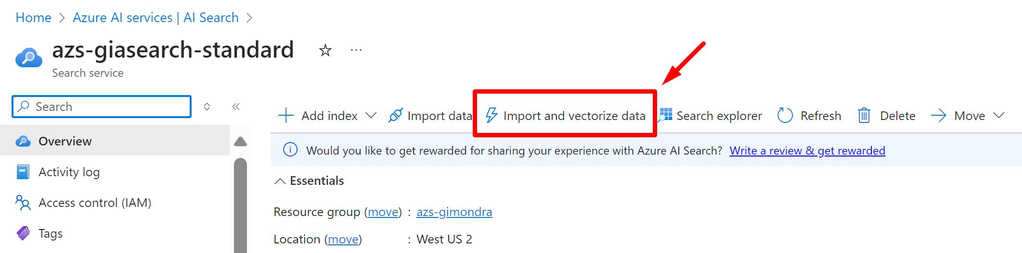
Indexing (Pull indexers)
Indexer (pull model)
Crawler that extracts data from cloud data sources and populates a search index
Drive skillset execution (AI enrichment)
Can be run on demand or on a recurring data refresh schedule (incremental indexing)
Best practices
Understand indexing limits
Run on a schedule and continuously to correct errors
Identify data source needs (multiple data sources going to a single index, data source support, limits and configuration
Configure data source document deletion policy if needed
Recognize data types for proper parsing (JSON, JSON lines, CSV, markdown, etc.)
If handling PDFs or images with embedded text, consider AI enrichment with OCR or Azure AI Document Intelligence layout
Configure batch size based on workload
Consider integrated Vectorization if using vector search
Identify AI enrichment needs, such as language translation or recognition, key phrase extraction, etc.
Test with various data types/sizes to understand indexing time and optimize the process
Identify type of authentication being used (Managed identity is recommended)
Recognize if private endpoints will be used for secure connections and configure shared private links appropriately
🔗 Indexing example with Integrated Vectorization
Notes:
We mentioned earlier that Azure AI Search provides multiple ways to index data, so besides the AI Studio and Azure OpenAI “on your data”, we have the native AI search built-in indexers.
Indexer overview - Azure AI Search | Microsoft Learn
Indexer (pull model): Refers to a data crawler that selectively extracts information from cloud-based data repositories, consequently populating an AI search index. It also drives the execution of skillsets (AI enrichment). The indexer can either be operated on-demand or set to a recurring data refresh schedule.
Best Practices:
Comprehend Indexing Constraints: Understand the limitations associated with indexing in the specific indexers and in the search limit documentation (Service limits for tiers and skus - Azure AI Search | Microsoft Learn)
Establish Regular Schedule: Consistently run the indexer on a specific schedule to rectify transient errors and ensure data accuracy. Schedule indexer execution - Azure AI Search | Microsoft Learn
Identify Data Source Requirements: Determine the needs of multiple data sources that feed into a single index, including source support, limitations, and configurations. Schedule indexer execution - Azure AI Search | Microsoft Learn
Recognize Data Formats: Properly parse different data types such as JSON, JSON lines, CSV, and more:
Index blobs containing multiple documents - Azure AI Search | Microsoft Learn
Search over plain text blobs - Azure AI Search | Microsoft Learn
Search over CSV blobs - Azure AI Search | Microsoft Learn
Search over JSON blobs - Azure AI Search | Microsoft Learn
Consider AI Enrichment for Complex Data: If dealing with PDFs or images containing embedded text, AI enrichment through Optical Character Recognition (OCR) or Azure AI Document Intelligence should be considered. AI enrichment concepts - Azure AI Search | Microsoft Learn
Configure Batch Size: Adjust the batch size according to the workload to optimize performance. Index large data sets for full text search - Azure AI Search | Microsoft Learn
Consider Vectorization: If vector search is being used, integrated Vectorization should be considered to enhance search results. Integrated Vectorization - Azure AI Search | Microsoft Learn
Identify AI Enrichment Requirements: Determine needs like language translation, key phrase extraction, recognition, etc. AI enrichment concepts - Azure AI Search | Microsoft Learn
Conduct Tests: Experiment with different data types and sizes to understand indexing time and further optimize the process.
Identify type of authentication being used (Managed identity is recommended). Connect using a managed identity - Azure AI Search | Microsoft Learn
Recognize if private endpoints will be used for secure connections and configure shared private links appropriately. Connect through a shared private link - Azure AI Search | Microsoft Learn
To get started with the indexers from the Azure portal, you can use the wizards. For RAG and specifically Chunk and vectorize data, you can use the Import and vectorize data wizard. You can change configuration of the indexer, of the data source and skillsets after running the first time. You just need to reset it to get any changes in configuration. Quickstart integrated Vectorization - Azure AI Search | Microsoft Learn

Slide 83
Indexing (Push method)
Push method uses APIs to upload documents into a search index
No restrictions on data source type or frequency of execution
Connectivity and the secure retrieval of documents under your control
Key benefits
Versatility: JSON documents from any source can be uploaded. You can use AI Document Intelligence layout model, an LLM like GPT-4o for data parsing or your preferred parsing library
Flexibility: No restrictions on frequency of data push (no specific schedule, just API restrictions apply)
Control: Retrieval of documents under your own control
Pushing data to Azure AI Search index
APIs for single or multiple documents upload
Follow best practices for indexing large documents
Indexing actions
Upload: Insert new documents or update existing ones
Merge: Updates existing document, replacing values
Merge or upload: Behaves like merge for existing documents and like upload for new ones
Delete: Removes entire document from index
🔗 Push method sample for RAG
Notes:
Now let’s discuss the Push method (Data import and data ingestion - Azure AI Search | Microsoft Learn), which utilizes APIs to upload/update and delete documents into/from a search index. This method gives you the liberty to source data from anywhere you prefer, with no restrictions on the type of data or the frequency of execution.
Your connectivity and the retrieval of documents are completely under your control. This method offers key benefits which include versatility, flexibility, and control. Versatility in that JSON documents from any source can be uploaded. You also have the option of using AI Document Intelligence for data parsing or your preferred parsing library. Flexibility since there are no restrictions on the frequency of data push (such as the pull indexer that has a minimum of 5-minute interval, for example).
When it comes to pushing data to Azure AI Search Index, APIs can be used for single or multiple document uploads.
Indexing Actions are categorized into four: Upload, Merge, MergeOrUpload, and Delete. Upload allows you to insert new documents or update existing ones. Merge updates an existing document, replacing its values. MergeOrUpload works like a merge for existing documents and like an upload for new ones. Delete, as the name suggests, removes the entire document from the index.
Here is a sample of the Push method for RAG. We believe that understanding this method will add significant value to your data management strategy.
Take into consideration the best practices for indexing large documents with the Push API: Index large data sets for full text search - Azure AI Search | Microsoft Learn

Slide 84
Chunking

Slide 85


Chunking
Chunking
Split long-form text into short passages
LLM context length limits
Focused subset of the content
Multiple independent passages
Basics
~200–500 tokens/passage
Maintain lexical boundaries
Introduce overlap
Layout
Layout information is valuable, e.g., tables, content-structure preservation
Vectorization
Indexing-time: convert passages to vectors
🔗 Example: Data preparation process (including Chunking)
Notes:
In this slide, we're discussing the concept of Chunking, a method used in language processing. Here's how we can break it down:
Split long-form text into short passages: This is the essence of Chunking. Instead of analyzing a whole document at once, we split it into smaller, manageable parts, or "Chunks". This makes it easier to process large amounts of text, such as when embedding text for language models.
LLM context length limits: Language models have a maximum limit on the number of tokens they can process at once. By Chunking the text into smaller passages, we can ensure that the text fits within these limits.
Focused subset of the content: Chunking allows us to focus on a specific subset of the content. Each Chunk can be processed separately, allowing for more focused analysis or processing of each part.
Multiple independent passages: Each Chunk or passage can be treated as an independent piece of text. This helps providing the specific details to the LLM with grounded answers.
Basics: Typically, Chunks are best if they are from 200-500 tokens long. It's important to maintain lexical boundaries, meaning Chunks should ideally not split sentences or phrases in the middle. To ensure no information is lost between Chunks, introduce some overlap where Chunks share some content.
Layout: Layout information, such as tables can be valuable in understanding the content. When Chunking, try to preserve this information if possible.
Vectorization: At indexing time, each Chunk or passage is converted into a vector representation. This is a mathematical representation that allows language models to understand and process the text.

Slide 86
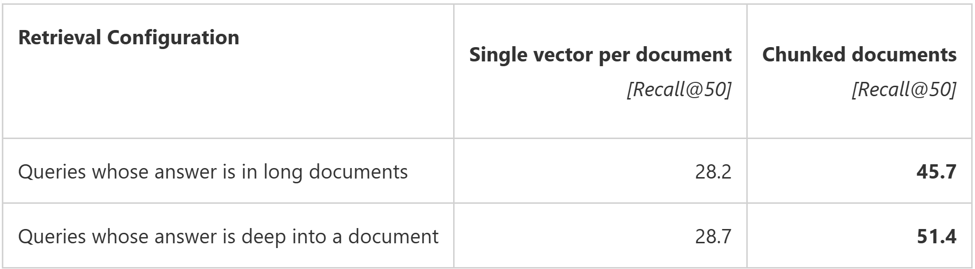
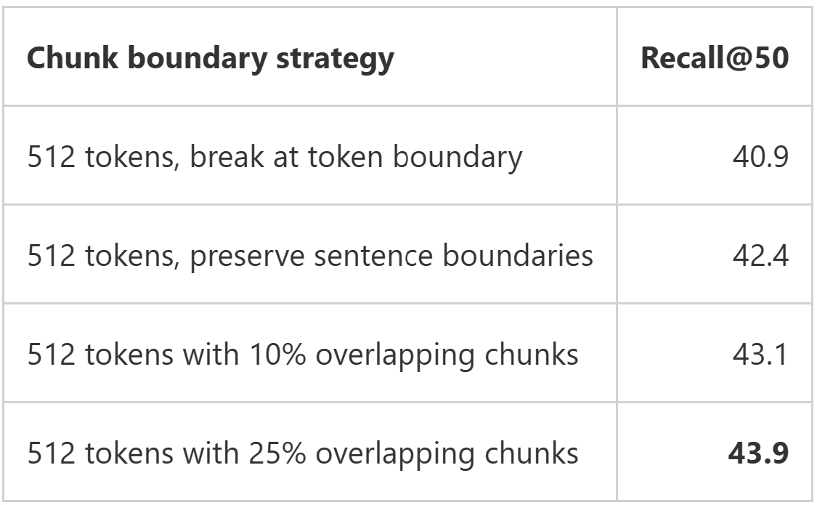
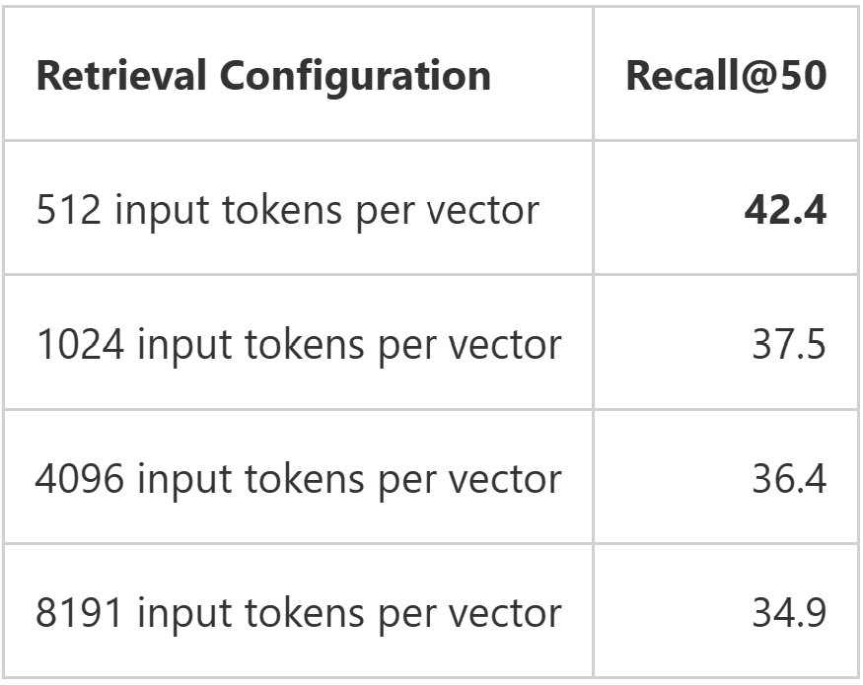
Your document Chunking strategy matters
Chunking solves 3 problems for generative AI applications:
Allows multiple retrieved documents to be passed to the LLM within its context window limit
Provides a mechanism for the most relevant passages of a given document to be ranked first
Vector search has a per-model limit to how much content can be embedded into each vector

Slide 87
Chunking strategies
Fixed-size Chunking
Simple and common, maintaining a balance between overlap and semantic context
AI Search Built-in Split Skill
Specialized Chunking
For structured content like Markdown and LaTeX
AI Search Built-in Markdown Parsing
“Structure-aware” Chunking
Content splitting using NLP libraries such as AI Document Intelligence Layout API
AI Search Built-in Doc Layout Skill
Recursive Chunking
Divides text into smaller Chunks in a hierarchical manner
AI Search Custom Skill
Preprocessing data for quality
Selecting a range of potential Chunk sizes considering content nature and embedding model capabilities
Evaluating performance of each Chunk size
Notes:
n this section, we dive deeper into the various techniques we use for Chunking text in Language Model applications.
Firstly, we have "Fixed-size Chunking". This is a straightforward and widely used method where we maintain a balance between overlap and semantic context. It involves breaking down text into fixed sizes, ensuring that no crucial contextual information is lost.
Secondly, we have "Specialized Chunking". This method comes into play when we're dealing with structured content like Markdown and LaTeX. In such cases, we can use specialized Chunking methods to preserve the original structure of the content during the Chunking process.
The third method is “Structure-aware Chunking". This involves the use of Natural Language Processing libraries to split text into sentences. This can be beneficial in situations where sentence-level semantic understanding is crucial.
Fourthly, we have "Recursive Chunking". This method divides text into smaller Chunks in a hierarchical and iterative manner. This ensures that while the Chunks aren’t going to be exactly the same size, they’ll still “aspire” to be of a similar size.
--
Fixed-size Chunking with overlap is available through split skill in AI search: Text split skill - Azure AI Search | Microsoft Learn
Other types of Chunking can be implemented through custom skill. A gallery of sample skills are here: Azure-Samples/azure-search-power-skills: A collection of useful functions to be deployed as custom skills for Azure Cognitive Search (github.com)
Now, once we've understood the methods, we move onto the process of determining the best Chunk size for your application.
This involves three steps:
"Preprocessing data for quality": Before we start Chunking, we need to pre-process the data to ensure its quality. This could involve removing noise such as irrelevant tags or elements.
"Selecting a range of potential Chunk sizes": This step involves choosing a range of possible Chunk sizes to test. This choice should take into account the nature of the content and the capabilities of the embedding model being used.
"Evaluating performance of each Chunk size": The final step is to evaluate the performance of each Chunk size. This is an iterative process where we test different Chunk sizes against different queries until we can determine the best-performing Chunk size for your content and expected queries.

Slide 88
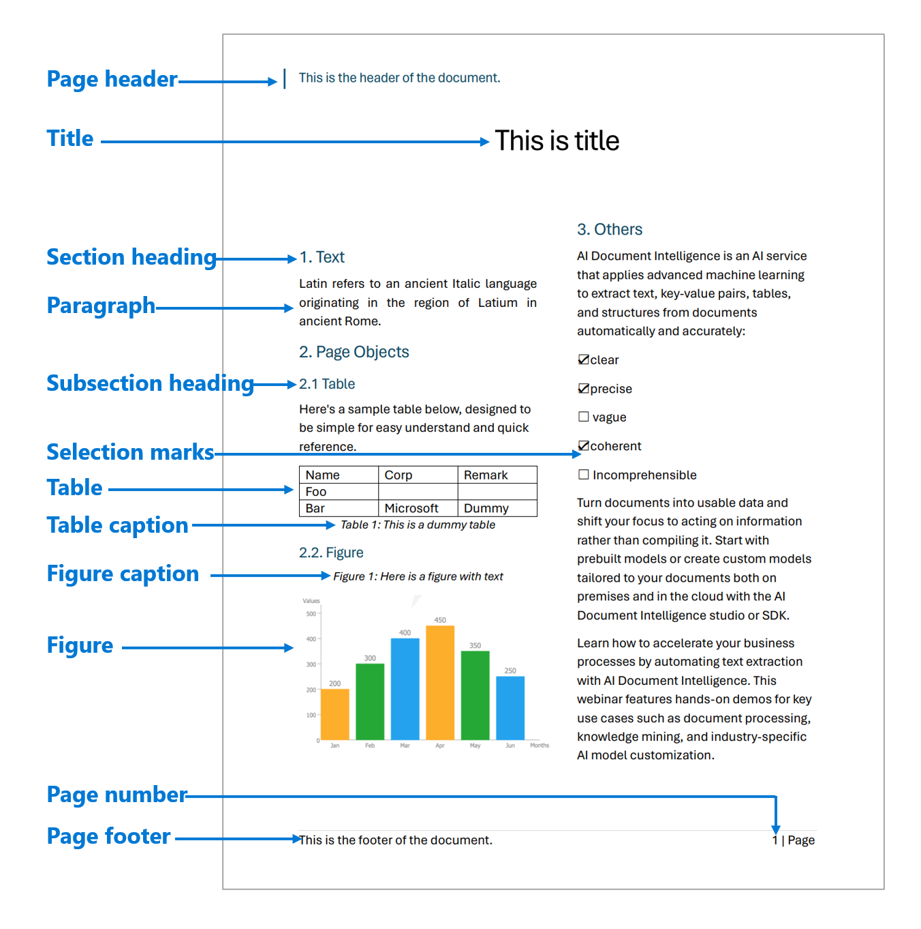
Indexing-side Improvements: Structure-Aware Chunking
→ Azure AI Search now supports both fixed and content aware chunking
Powered by Azure AI Document Intelligence
Headings help understand content hierarchy
Handles tables, lists, figures, etc.
→ New markdown parsing mode for fast and simple heading handling

Slide 89
Integrated vectorization

Slide 90
Integrated Vectorization End-to-end data ingestion, chunking, vectorization, and advanced retrieval
Chunking
Vectorization
Built-in Chunking skill for fixed-size chunking (split skill)
Configure Chunking parameters (e.g., pages, tokens, overlap window, etc.)
Layout chunking (document layout skill)
Markdown chunking (markdown parsing)
Automated via Indexer orchestration
Bring-your-own Azure OpenAI endpoint
Bring-your-own Azure AI Foundry model catalog embedding model (Preview)
Use AI Vision multimodal embeddings model deployed in AI multi-service account (Preview)
Support for other embedding model REST endpoints
Query Vectorization capability

Slide 91


Integrated Vectorization visualization End-to-end Data Ingestion, Native Parsing, Fixed-Size Chunking, Vectorization, and Advanced Retrieval with AI Search indexers
Azure AI Search processing
Supported data store:
OneLake,
Azure Blob Storage, Azure SQL, Azure Cosmos DB, Azure Data Lake Gen2, etc.
Data ingestion and parsing
Data enrichment (Chunking, index projections, and others)
Azure AI Search Chunked index
1. Text query submission
2. Results after vectorizing user query
Vectorization during ingestion
AI enrichment
Azure OpenAI
Custom
Web App
End-user
Interaction with other products
Azure AI Vision
Azure AI Foundry model catalog
Azure OpenAI GPT model
Embedding models
Notes:
Here’s an end-to-end diagram of how integrated Vectorization works.
Integrated Vectorization - Azure AI Search | Microsoft Learn
Integrated Vectorization in Azure AI Search simplifies the process of data Chunking and text-to-vector embedding by building these functionalities into the indexing process. This feature requires an indexer, a skillset with specific skills for Chunking and Vectorization, and one or more indexes to receive the processed content.
Integrated Vectorization can be used in several scenarios, including subdividing large documents into manageable Chunks, building a vector store, and combining vector and text fields for hybrid search.
You can use this feature via the built-in Vectorization support of Azure AI Foundry or by creating indexers and skillsets that invoke integrated Vectorization using Azure AI Search's programmatic interfaces.
One of the major benefits of Integrated Vectorization is that it simplifies the code by eliminating the need for a separate data Chunking and Vectorization pipeline. It also automates the end-to-end indexing process, from data retrieval to indexing, and enables projecting Chunked content to secondary indexes for advanced scenarios.

Slide 92
Integrated Vectorization visualization End-to-end data ingestion, Parsing and Chunking with Document Layout skill, Vectorization, and Advanced Retrieval
Azure AI Search processing
Supported data store:
OneLake,
Azure Blob Storage, Azure SQL, Azure Cosmos DB, Azure Data Lake Gen2, etc.
Data enrichment (split skill, index projections, and others)
Azure AI Search Chunked index
1. Text query submission
2. Results after vectorizing user query
Vectorization during ingestion
AI enrichment
(Layout parsing and chunking, other AI Services transformations via AI skills)
Azure OpenAI
Custom
Web App
End-user
Interaction with other products
Azure AI Vision
Azure AI Foundry model catalog
Azure OpenAI GPT model
Embedding models
Notes:
Here’s an end-to-end diagram of how integrated Vectorization works.
Integrated Vectorization - Azure AI Search | Microsoft Learn
Integrated Vectorization in Azure AI Search simplifies the process of data Chunking and text-to-vector embedding by building these functionalities into the indexing process. This feature requires an indexer, a skillset with specific skills for Chunking and Vectorization, and one or more indexes to receive the processed content.
Integrated Vectorization can be used in several scenarios, including subdividing large documents into manageable Chunks, building a vector store, and combining vector and text fields for hybrid search.
You can use this feature via the built-in Vectorization support of Azure AI Foundry or by creating indexers and skillsets that invoke integrated Vectorization using Azure AI Search's programmatic interfaces.
One of the major benefits of Integrated Vectorization is that it simplifies the code by eliminating the need for a separate data Chunking and Vectorization pipeline. It also automates the end-to-end indexing process, from data retrieval to indexing, and enables projecting Chunked content to secondary indexes for advanced scenarios.

Slide 93
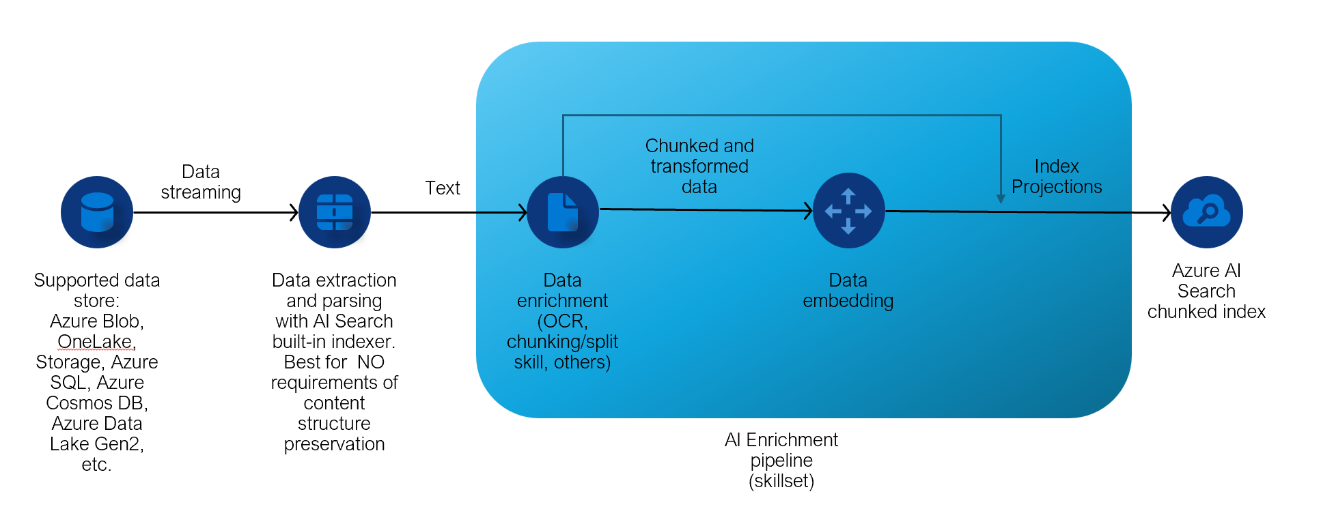
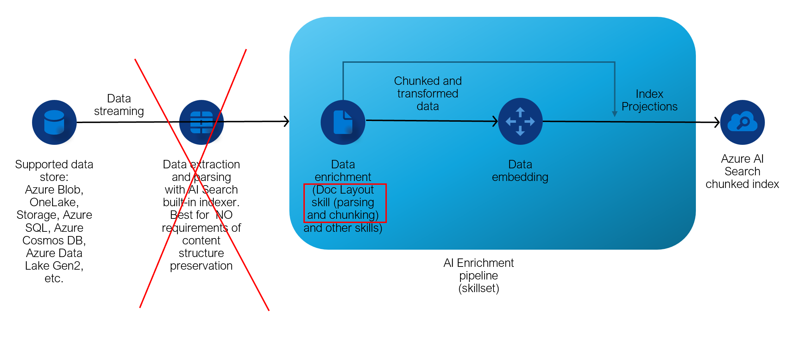
Integrated Vectorization visualization High Level Comparison between native parsing vs. document layout parsing and chunking
AI Search Native Indexers
Parsing
AI Document Intelligence
Layout Skill Parsing
and Markdown Chunking
Notes:
Here’s an end-to-end diagram of how integrated Vectorization works.
Integrated Vectorization - Azure AI Search | Microsoft Learn
Integrated Vectorization in Azure AI Search simplifies the process of data Chunking and text-to-vector embedding by building these functionalities into the indexing process. This feature requires an indexer, a skillset with specific skills for Chunking and Vectorization, and one or more indexes to receive the processed content.
Integrated Vectorization can be used in several scenarios, including subdividing large documents into manageable Chunks, building a vector store, and combining vector and text fields for hybrid search.
You can use this feature via the built-in Vectorization support of Azure AI Foundry or by creating indexers and skillsets that invoke integrated Vectorization using Azure AI Search's programmatic interfaces.
One of the major benefits of Integrated Vectorization is that it simplifies the code by eliminating the need for a separate data Chunking and Vectorization pipeline. It also automates the end-to-end indexing process, from data retrieval to indexing, and enables projecting Chunked content to secondary indexes for advanced scenarios.

Slide 94

Processing text with Azure AI Search
AI Enrichment
Extraction and parsing
Enrichment and chunking
Ingest data
Embedding
Index
Data streaming
Text
Chunked and transformed data
Enriched data defined in tables, objects and files
Indexer
Text split skill
Splits text into smaller chunks
Embedding skill
Uses embedding model integration to vectorize chunked text
Projections
Define enriched data into defined tables, objects and files for knowledge store
Data sources: Azure Blob,
OneLake, Storage, Azure SQL, Azure Cosmos DB, Azure Data Lake Gen2
Best for NO requirements of content structure preservation

Slide 95
Custom skill with Azure AI Search
Data streaming
Markdown file parsed in chunks
Chunked data
Index Projections
Supported data store
Azure Blob,OneLake, Storage,Azure SQL, Azure Cosmos DB, Azure Data Lake Gen2, etc.
Document
Layout skill
(parses markdown output file)
Split skill
(If needed only, splits big markdown chunks with fixed-size)
Data embedding
Azure AI Search chunked index
AI Enrichment pipeline (skillset)
Azure AI Document Intelligence layout model

Slide 96

Custom skill with Azure AI Search
Skillset
Extraction and parsing
Enrichment
Chunking
Embedding
Ingest data
Index
Projections
Indexer
Azure Blob Storage
Custom skill
Azure AI Foundry model
Text split skill
Embedding skill
Azure OpenAI

Slide 97
Custom skill with Azure AI Search
Skillset
Indexer with
Azure Blob Storage
Custom skill with Azure AI Foundry
Text split skill
Embedding skill with Azure OpenAI
Index
Projections
Ingest data
Extraction & parsing
Enrichment
Chunking
Embedding skill
Azure OpenAI

Slide 98
Processing text with Azure AI Search
AI Enrichment
Extraction and parsing
Enrichment and chunking
Ingest data
Embedding
Index
Data streaming
Text
Chunked and transformed data
Enriched data defined in tables, objects and files
Indexer
Text split skill
Splits text into smaller chunks
Embedding skill
Uses embedding model integration to vectorize chunked text
Projections
Define enriched data into defined tables, objects and files for knowledge store
Data sources: Azure Blob,
OneLake, Storage, Azure SQL, Azure Cosmos DB, Azure Data Lake Gen2
Best for NO requirements of content structure preservation

Slide 99
Process document structure in Azure AI Search
Data streaming
Markdown file parsed in chunks
Chunked data
Index Projections
Supported data store
Azure Blob,OneLake, Storage,Azure SQL, Azure Cosmos DB, Azure Data Lake Gen2, etc.
Document
Layout skill
(parses markdown output file)
Split skill
(If needed only, splits big markdown chunks with fixed-size)
Data embedding
Azure AI Search chunked index
AI Enrichment pipeline (skillset)
Azure AI Document Intelligence layout model

Slide 100

Built-in text processing End-to-end Data Ingestion, Native Parsing, Fixed-Size Chunking, Embedding, and Advanced Retrieval with AI Search indexers
Data store
Data ingestion and parsing
Data enrichment
Azure AI Search
1. Text query submission
3. Retrieved knowledge and embedded query
2. Embed query
AI Services
Chunking
Embedding models
Web App
End-user
Azure OpenAI
Custom
Azure AI Vision
Azure AI Foundry model catalog
Language model
Notes:
Here’s an end-to-end diagram of how integrated Vectorization works.
Integrated Vectorization - Azure AI Search | Microsoft Learn
Integrated Vectorization in Azure AI Search simplifies the process of data Chunking and text-to-vector embedding by building these functionalities into the indexing process. This feature requires an indexer, a skillset with specific skills for Chunking and Vectorization, and one or more indexes to receive the processed content.
Integrated Vectorization can be used in several scenarios, including subdividing large documents into manageable Chunks, building a vector store, and combining vector and text fields for hybrid search.
You can use this feature via the built-in Vectorization support of Azure AI Foundry or by creating indexers and skillsets that invoke integrated Vectorization using Azure AI Search's programmatic interfaces.
One of the major benefits of Integrated Vectorization is that it simplifies the code by eliminating the need for a separate data Chunking and Vectorization pipeline. It also automates the end-to-end indexing process, from data retrieval to indexing, and enables projecting Chunked content to secondary indexes for advanced scenarios.

Slide 101
Document processing with Doc Intelligence End-to-end data ingestion, Parsing and Chunking with Document Layout skill, Vectorization, and Advanced Retrieval
Data store
Data ingestion and parsing
Data enrichment
Azure AI Search
1. Text query submission
3. Retrieved knowledge and embedded query
2. Embed query
Chunking
AI Services
Layout parsing and chunking,
other AI Services transformations
Embedding models
Web App
End-user
Azure OpenAI
Custom
Azure AI Vision
Azure AI Foundry model catalog
Language model
Notes:
Here’s an end-to-end diagram of how integrated Vectorization works.
Integrated Vectorization - Azure AI Search | Microsoft Learn
Integrated Vectorization in Azure AI Search simplifies the process of data Chunking and text-to-vector embedding by building these functionalities into the indexing process. This feature requires an indexer, a skillset with specific skills for Chunking and Vectorization, and one or more indexes to receive the processed content.
Integrated Vectorization can be used in several scenarios, including subdividing large documents into manageable Chunks, building a vector store, and combining vector and text fields for hybrid search.
You can use this feature via the built-in Vectorization support of Azure AI Foundry or by creating indexers and skillsets that invoke integrated Vectorization using Azure AI Search's programmatic interfaces.
One of the major benefits of Integrated Vectorization is that it simplifies the code by eliminating the need for a separate data Chunking and Vectorization pipeline. It also automates the end-to-end indexing process, from data retrieval to indexing, and enables projecting Chunked content to secondary indexes for advanced scenarios.

Slide 102
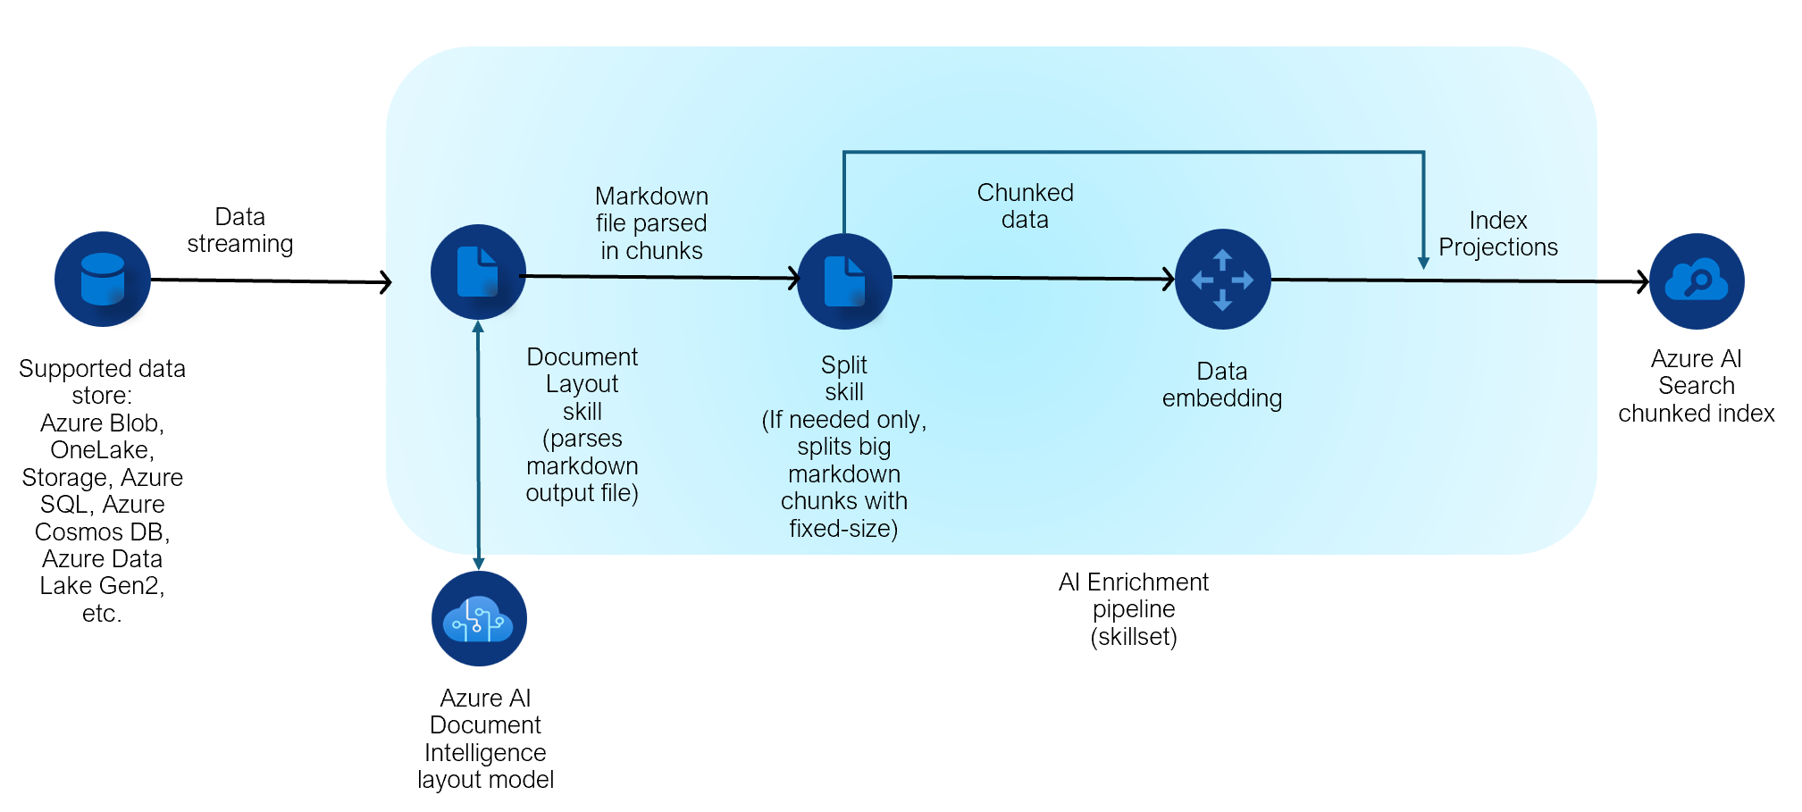
Preview
Document layout skill
Crack, parse and chunk your data with AI Document Intelligence layout model and AI Search
Leverages the AI Document Intelligence layout model for parsing, surpassing the capabilities of AI Search indexers standard parsing mode, for more complex documents. It is optimized for handling complex, layout-dependent scenarios, whereas simpler cases can utilize fixed-size chunking with a split skill.
It takes the markdown file returned by AI Document Intelligence layout model, then the content is split into chunks based on the parsed markdown structure, as long as it fits the optimal chunk size for an LLM for most scenarios.
Enables structure-aware chunking specifically designed for RAG over more complex documents’ use cases, facilitating efficient and more accurate context handling.

Slide 103
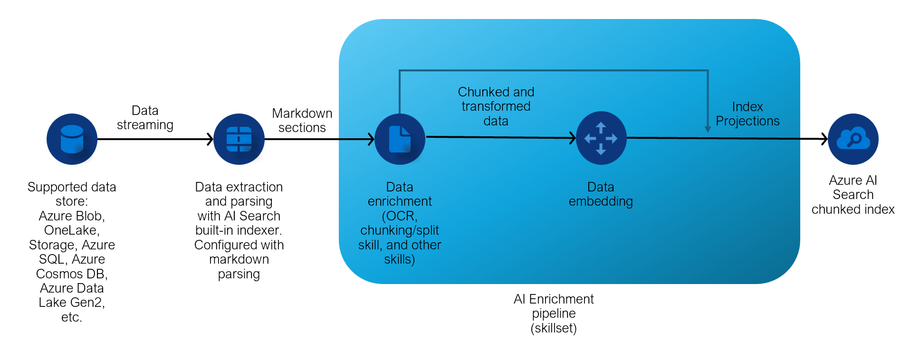
Markdown parsing
Preview
Parse your markdown documents with this mode and chunk your content preserving its structure
It takes a markdown file and splits a full document into ‘N’ chunks with oneToMany configuration, so each chunk becomes its own entry in the AI Search index.
Enables structure-aware chunking specifically designed for RAG over markdown documents, facilitating efficient and more accurate context handling.
If the markdown chunk is larger than the optimal size for most LLMs inputs for RAG, the split skill must be used for fixed-size chunking as needed.

Slide 104
Preview
More security for AI enrichment pipeline
Enable Private Endpoints for your AI Service multi-service resource and go keyless for this integration
You can enable a private endpoint on your AI Service multi-service resource used for AI enrichment of your data via a shared private link.
You can enable managed identity for your integration with AI Service multi-service resource and have your billing and authorization happening through managed identity vs. keys.

Slide 105
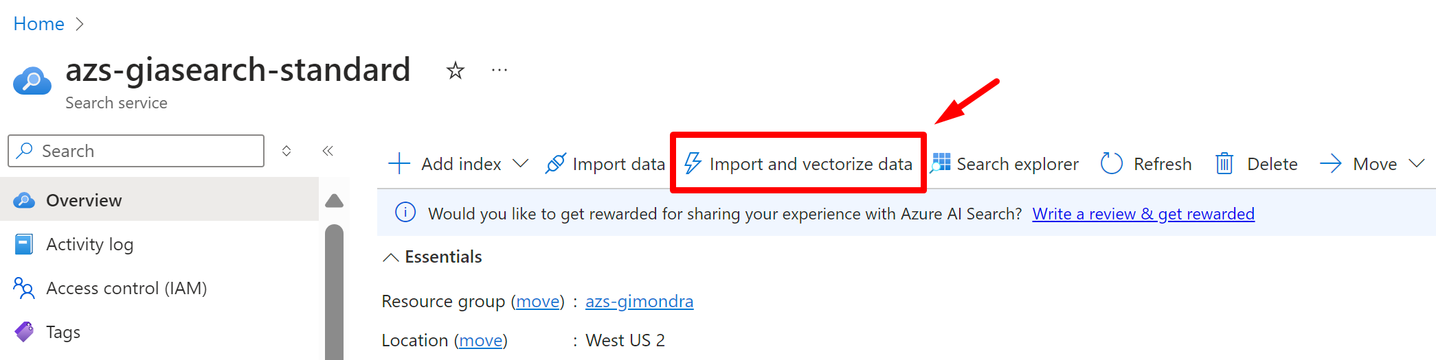
Integrated Vectorization—getting started End-to-end data ingestion, Chunking, Vectorization, and Advanced Retrieval
Configuring Integrated Vectorization from Azure portal
Notes:
Here’s an end-to-end diagram of how integrated Vectorization works.
Integrated Vectorization - Azure AI Search | Microsoft Learn
Integrated Vectorization in Azure AI Search simplifies the process of data Chunking and text-to-vector embedding by building these functionalities into the indexing process. This feature requires an indexer, a skillset with specific skills for Chunking and Vectorization, and one or more indexes to receive the processed content.
Integrated Vectorization can be used in several scenarios, including subdividing large documents into manageable Chunks, building a vector store, and combining vector and text fields for hybrid search.
You can use this feature via the built-in Vectorization support of Azure AI Foundry or by creating indexers and skillsets that invoke integrated Vectorization using Azure AI Search's programmatic interfaces.
One of the major benefits of Integrated Vectorization is that it simplifies the code by eliminating the need for a separate data Chunking and Vectorization pipeline. It also automates the end-to-end indexing process, from data retrieval to indexing, and enables projecting Chunked content to secondary indexes for advanced scenarios.

Slide 106
Split skill (Fixed-size Chunking)
{
"@odata.type": "#Microsoft.Skills.Text.SplitSkill",
"description": "split documents into Chunks",
"textSplitMode": "pages",
"maximumPageLength": 500,
"pageOverlapLength": 100,
"context": "/document",
"inputs": [
{
"name": "text",
"source": "/document/mergedText"
}
],
"outputs": [
{
"name": "textItems",
"targetName": "pages"
}
]
}
🔗 End-to-end code sample where split (Chunking) skill is defined
I want to Chunk my documents with fixed-size strategy via the indexer orchestration pipeline with a built-in skill
This will be achieved by Text split cognitive skill—Azure Cognitive Search | Microsoft Learn
Notes:
This is an existing skill called Text split skill that will have a new field to allow overlap when choosing pages. pageOverlapLength is only applicable when textSplitMode is set to ‘pages’. If specified (needs to be > 0), n+1th Chunk will start with this number of characters from the end of the nth Chunk.
https://learn.microsoft.com/en-us/azure/search/cognitive-search-skill-textsplit

Slide 107
Doc Layout skill (Structure-aware chunking)
{
"@odata.type": "#Microsoft.Skills.Util.DocumentLayoutAnalysisSkill",
"outputMode": "oneToMany",
"markdownHeaderDepth": "h3",
"oneToOneParsingStyle": "includeHierarchy",
"context": "/document",
"inputs": [
{
"name": "file_data",
"source": "/document/file_data"
}
],
"outputs": [
{
"name": "markdown_document",
"targetName": "markdown_document"
}
]
}
I want to Chunk my documents preserving the structure via the indexer orchestration pipeline with a built-in skill
This will be achieved by using
Doc Layout skill
Note: If the chunks generated by the document layout skill are too large for optimal LLM processing, they will be further split into fixed-size chunks during the preview phase.

Slide 108
Markdown Parsing (Structure-aware chunking)
{
"name" : "markdown-indexer",
"dataSourceName" : "markdown-datasource",
"targetIndexName" : "markdown-index",
"parameters" : {
"configuration" : {
"parsingMode" : "markdown",
"markdownParsingSubmode" : "oneToMany", // optional (defaults to oneToMany)
"markdownHeaderDepth": "h3"
}
},
"fieldMappings": [
{
"sourceFieldName": "sections/h1",
"targetFieldName": "section_1",
"mappingFunction": null
},
{
"sourceFieldName": "sections/h2",
"targetFieldName": "section_2",
"mappingFunction": null
},
{
"sourceFieldName": "sections/h3",
"targetFieldName": "section_3",
"mappingFunction": null
}
]
}
I want to Chunk my Markdown documents preserving the content structure via the indexer orchestration pipeline with a specific parsing mode
This will be achieved by using
markdown parsing mode

Slide 109
Azure OpenAI embedding skill
{
"@odata.type": "#Microsoft.Skills.Text.AzureOpenAIEmbeddingSkill",
"description": "Azure OpenAI Embedding Skill",
"context": "/document/pages/*",
"resourceUri": "https://my-openai-service.openai.azure.com",
"apiKey": “xxx",
"deploymentId": "text-embedding-ada-002",
"inputs": [
{
"name": "text",
"source": "/document/pages/*"
}
],
"outputs": [
{
"name": "embedding",
"targetName": "vector"
}
]
}
🔗 End-to-end code sample where Azure OpenAI embedding skill is defined
I want to generate embeddings via my Azure OpenAI endpoint
Notes:
This skill uses customer’s Azure OpenAI endpoint to embed (vectorize) data for use with vector search: Azure OpenAI Embedding skill - Azure AI Search | Microsoft Learn
Alternative options include: 1) Built-in AOAI Embedding Skill
2) Custom Skill

Slide 110
Azure AI Vision Embeddings skill
{
"@odata.type": "#Microsoft.Skills.Vision.VectorizeSkill",
"context": "/document/pages/*",
"modelVersion": "2023-04-15",
"inputs": [
{
"name": "text",
"source": "/document/pages/*"
}
],
"outputs": [
{
"name": "vector",
"targetName": "aiServicesVision_text_vector"
}
]
}
🔗 End-to-end code sample where Azure OpenAI embedding skill is defined
I want to generate embeddings via my Azure AI Services using AI Vision Multimodal Embeddings
Notes:
This skill uses customer’s Azure OpenAI endpoint to embed (vectorize) data for use with vector search: Azure OpenAI Embedding skill - Azure AI Search | Microsoft Learn
Alternative options include: 1) Built-in AOAI Embedding Skill
2) Custom Skill

Slide 111
AML Skill
{
"@odata.type": "#Microsoft.Skills.Custom.AmlSkill",
"description": null,
"context": "/document/normalized_images/*",
"uri": "{{amlUri}}",
"key": "{{amlKey}}",
"inputs": [
{
"name": "input_data",
"sourceContext": "/document/normalized_images/*",
"inputs": [
{
"name": "columns",
"source": "=['image', 'text']"
},
{
"name": "index",
"source": "=[0]"
},
{
"name": "data",
"source": "=[[$(/document/normalized_images/*/data), '']]"
}
]
}
}
🔗 End-to-end code sample where Azure OpenAI embedding skill is defined
I want to generate embeddings via my embedding model deployment in Azure AI Foundry model catalog
Notes:
This skill uses customer’s AI Studio deployment to generate embeddings: https://learn.microsoft.com/en-us/azure/search/cognitive-search-aml-skill

Slide 112
Custom web API skill
{
"@odata.type": "#Microsoft.Skills.Custom.WebApiSkill",
"description": "Custom API Embedding Skill",
"context": "/document",
"uri": "https://byoe.azurewebsites.net/api/embedding?code=YOUR-FUNCTION-KEY-HERE
"inputs": [
{
"name": "text",
"source": "/document/text"
}
],
"outputs": [
{
"name": "vector",
"targetName": "vector"
}
]
}
🔗 Custom skill sample to use a custom model (such as one from HuggingFace vs. Azure OpenAI embedding model)
Use this if you prefer to build a custom Web API for your own logic processing and vectorization
Here's a repo with samples for how to implement this skill: 🔗https://github.com/Azure-Samples/azure-search-power-skills/
Notes:
Custom Web API skill in skillsets - Azure AI Search | Microsoft Learn
Use this if you prefer to build a custom Web API for your data processing and Vectorization.

Slide 113
Vectorizers

Slide 114
Vectorizers
Vectorizer
A component of a search index specifying a Vectorization agent
Used for queries to convert a text query to vectors
Can be defined once and then referenced in the vector profile assigned to a vector field
Prerequisites for defining a Vectorizer
A deployed embedding model on Azure OpenAI, Azure Vision, supported on Azure AI Foundry or a custom skill wrapping an embedding model
Permissions to upload a payload to the embedding model
A supported data source and a data source definition for your indexer
A skillset for data Chunking and Vectorization
Defining a Vectorizer
Use Create or Update Index to add a Vectorizer
Provide valid values and remove any properties not needed
Defining a profile with a Vectorizer
Add a profiles section specifying combinations of algorithms and Vectorizers
Assigning a vector profile to a field
For each vector field in the fields collection, assign a profile
Notes:
Configure Vectorizer - Azure AI Search | Microsoft Learn
Configuring a Vectorizer in a Search Index is a key part of integrated Vectorization. A Vectorizer is a component of a search index that specifies a Vectorization agent, such as a deployed embedding model on Azure OpenAI, that converts text to vectors. This feature is used for queries, allowing the search service to vectorize a text query on your behalf.
Before defining a Vectorizer, certain prerequisites are necessary. These include a deployed embedding model on Azure OpenAI or a custom skill that wraps an embedding model, permissions to upload a payload to the embedding model, a supported data source and a data source definition for your indexer, and a skillset for data Chunking and Vectorization.
Once these prerequisites are met, you can define a Vectorizer by using the 'Create or Update Index' function and providing valid values. You can also define a profile that includes a Vectorizer by adding a profiles section specifying combinations of algorithms and Vectorizers. Finally, you can assign a vector profile to a field by assigning a profile for each vector field in the fields collection.

Slide 115
Azure OpenAI Embeddings Vectorizer
Create Vectorizer
"Vectorizers": [
{
"name": "my_open_ai_Vectorizer",
"kind": "azureOpenAI",
"azureOpenAIParameters": {
"resourceUri": "https://url.openai.azure.com",
"deploymentId": "text-embedding-ada-002",
"apiKey": "mytopsecretkey"
}
}
]
Create a Vectorizer profile:
"profiles": [
{
"name": "my_open_ai_profile",
"algorithm": "my_hnsw_algorithm",
"Vectorizer":"my_open_ai_Vectorizer"
}
]
Assign to a field:
"fields": [
{
"name": "ID",
"type": "Edm.String",
"key": true,
"sortable": true,
"analyzer": "keyword"
},
{
"name": "title",
"type": "Edm.String"
},
{
"name": "synopsis",
"type": "Collection(Edm.Single)",
"dimensions": 1536,
"vectorSearchProfile": "my_open_ai_profile",
"searchable": true,
"retrievable": true,
"filterable": false,
"sortable": false,
"facetable": false
},
{
"name": "reviews",
"type": "Collection(Edm.Single)",
"dimensions": 1024,
"vectorSearchProfile": "my_custom_profile",
"searchable": true,
"retrievable": true,
"filterable": false,
"sortable": false,
"facetable": false
}
]
If you need to have a Vectorizer to be used at query time to avoid including this in your orchestrator, this is part of Integrated Vectorization feature. It converts text to embeddings to query vectors.
This is part of the AI Search index definition.

Slide 116
Azure AI Vision Vectorizer (Preview)
Create Vectorizer
"Vectorizers": [
{
"name": “aivisionvectorizer",
"kind": "aiServicesVision",
"aiServicesVisionParameters": {
"modelVersion": "2023-04-15",
"apiKey": "<ai services api key>",
"resourceUri": "https://example.api.cognitive.microsoft.com/",
"authIdentity":
"@odata.type": "Microsoft.Azure.Search.DataAssignedUserIdentity",
"userAssignedIdentity": "<user assigned identity resource id for managed identity"
}
}
}
]
Create a Vectorizer profile:
"profiles": [
{
"name": "aiServicesVision-profile",
"algorithm": "my_hnsw_algorithm",
"Vectorizer":" aivisionvectorizer"
}
]
Assign to a field:
"fields": [
{
"name": "ID",
"type": "Edm.String",
"key": true,
"sortable": true,
"analyzer": "keyword"
},
{
"name": "title",
"type": "Edm.String"
},
{
"name": "synopsis",
"type": "Collection(Edm.Single)",
"dimensions":1024,
"vectorSearchProfile": "aiServicesVision-profile",
"searchable": true,
"retrievable": true,
"filterable": false,
"sortable": false,
"facetable": false
},
{
"name": "reviews",
"type": "Collection(Edm.Single)",
"dimensions": 1024,
"vectorSearchProfile": "my_custom_profile",
"searchable": true,
"retrievable": true,
"filterable": false,
"sortable": false,
"facetable": false
}
]
This vectorizer allows for multimodal embeddings support to enable image/text query vectorization.
If you need to have a Vectorizer to be used at query time to avoid including this in your orchestrator, this is part of Integrated Vectorization feature. It converts text or images to embeddings to query vectors.
This is part of the AI Search index definition.

Slide 117
AML Vectorizer (Preview)
Create Vectorizer
"Vectorizers": [
{
"name": "amlvectorizer",
"kind": "aml",
"amlParameters": {
"uri": "https://amlendpoint.region.inference.ml.azure.com/score",
"key": "{{amlKey}}",
"modelName": "OpenAI-CLIP-Image-Text-Embeddings-vit-base-patch32"
}
}
]
Create a Vectorizer profile:
"profiles": [
{
"name": "aml-profile",
"algorithm": "my_hnsw_algorithm",
"Vectorizer":"amlvectorizer"
}
]
Assign to a field:
"fields": [
{
"name": "ID",
"type": "Edm.String",
"key": true,
"sortable": true,
"analyzer": "keyword"
},
{
"name": "title",
"type": "Edm.String"
},
{
"name": "synopsis",
"type": "Collection(Edm.Single)",
"dimensions": 512,
"vectorSearchProfile": "aml-profile",
"searchable": true,
"retrievable": true,
"filterable": false,
"sortable": false,
"facetable": false
},
{
"name": "reviews",
"type": "Collection(Edm.Single)",
"dimensions": 1024,
"vectorSearchProfile": "my_custom_profile",
"searchable": true,
"retrievable": true,
"filterable": false,
"sortable": false,
"facetable": false
}
]
This vectorizer enables support for embedding models in the Azure AI Foundry Model Catalog.
If you need to have a Vectorizer to be used at query time to avoid including this in your orchestrator, this is part of Integrated Vectorization feature. It converts text to embeddings to query vectors.
This is part of the AI Search index definition.

Slide 118
Split skill (Fixed-size Chunking)
{
"@odata.type": "#Microsoft.Skills.Text.SplitSkill",
"description": "split documents into Chunks",
"textSplitMode": "pages",
"maximumPageLength": 500,
"pageOverlapLength": 100,
"context": "/document",
"inputs": [
{
"name": "text",
"source": "/document/mergedText"
}
],
"outputs": [
{
"name": "textItems",
"targetName": "pages"
}
]
}
🔗 End-to-end code sample where split (Chunking) skill is defined
I want to Chunk my documents with fixed-size strategy via the indexer orchestration pipeline with a built-in skill
This will be achieved by Text split cognitive skill—Azure Cognitive Search | Microsoft Learn
Notes:
This is an existing skill called Text split skill that will have a new field to allow overlap when choosing pages. pageOverlapLength is only applicable when textSplitMode is set to ‘pages’. If specified (needs to be > 0), n+1th Chunk will start with this number of characters from the end of the nth Chunk.
https://learn.microsoft.com/en-us/azure/search/cognitive-search-skill-textsplit

Slide 119
Doc Layout skill (Structure-aware chunking)
{
"@odata.type": "#Microsoft.Skills.Util.DocumentLayoutAnalysisSkill",
"outputMode": "oneToMany",
"markdownHeaderDepth": "h3",
"oneToOneParsingStyle": "includeHierarchy",
"context": "/document",
"inputs": [
{
"name": "file_data",
"source": "/document/file_data"
}
],
"outputs": [
{
"name": "markdown_document",
"targetName": "markdown_document"
}
]
}
I want to Chunk my documents preserving the structure via the indexer orchestration pipeline with a built-in skill
This will be achieved by using
Doc Layout skill
Note: If the chunks generated by the document layout skill are too large for optimal LLM processing, they will be further split into fixed-size chunks during the preview phase.

Slide 120
Markdown Parsing (Structure-aware chunking)
{
"name" : "markdown-indexer",
"dataSourceName" : "markdown-datasource",
"targetIndexName" : "markdown-index",
"parameters" : {
"configuration" : {
"parsingMode" : "markdown",
"markdownParsingSubmode" : "oneToMany", // optional (defaults to oneToMany)
"markdownHeaderDepth": "h3"
}
},
"fieldMappings": [
{
"sourceFieldName": "sections/h1",
"targetFieldName": "section_1",
"mappingFunction": null
},
{
"sourceFieldName": "sections/h2",
"targetFieldName": "section_2",
"mappingFunction": null
},
{
"sourceFieldName": "sections/h3",
"targetFieldName": "section_3",
"mappingFunction": null
}
]
}
I want to Chunk my Markdown documents preserving the content structure via the indexer orchestration pipeline with a specific parsing mode
This will be achieved by using
markdown parsing mode

Slide 121
Azure OpenAI embedding skill
{
"@odata.type": "#Microsoft.Skills.Text.AzureOpenAIEmbeddingSkill",
"description": "Azure OpenAI Embedding Skill",
"context": "/document/pages/*",
"resourceUri": "https://my-openai-service.openai.azure.com",
"apiKey": “xxx",
"deploymentId": "text-embedding-ada-002",
"inputs": [
{
"name": "text",
"source": "/document/pages/*"
}
],
"outputs": [
{
"name": "embedding",
"targetName": "vector"
}
]
}
🔗 End-to-end code sample where Azure OpenAI embedding skill is defined
I want to generate embeddings via my Azure OpenAI endpoint
Notes:
This skill uses customer’s Azure OpenAI endpoint to embed (vectorize) data for use with vector search: Azure OpenAI Embedding skill - Azure AI Search | Microsoft Learn
Alternative options include: 1) Built-in AOAI Embedding Skill
2) Custom Skill

Slide 122
Custom web API skill
{
"@odata.type": "#Microsoft.Skills.Custom.WebApiSkill",
"description": "Custom API Embedding Skill",
"context": "/document",
"uri": "https://byoe.azurewebsites.net/api/embedding?code=YOUR-FUNCTION-KEY-HERE
"inputs": [
{
"name": "text",
"source": "/document/text"
}
],
"outputs": [
{
"name": "vector",
"targetName": "vector"
}
]
}
🔗 Custom skill sample to use a custom model (such as one from HuggingFace vs. Azure OpenAI embedding model)
Use this if you prefer to build a custom Web API for your own logic processing and vectorization
Here's a repo with samples for how to implement this skill: 🔗https://github.com/Azure-Samples/azure-search-power-skills/
Notes:
Custom Web API skill in skillsets - Azure AI Search | Microsoft Learn
Use this if you prefer to build a custom Web API for your data processing and Vectorization.

Slide 123
Index Structure

Slide 124
Index projections
Index projections
Supports a one-to-many index pattern
Allows content from an enrichment pipeline to target a parent and a child index
Facilitates “one-to-many” indexing, useful for data Chunking scenarios
Index projections definition
Defined within a skillset
Comprises an array of selectors, each corresponding to a different target index
Handling parent documents
Parent and child documents can be kept in separate indexes or indexed into the same index
Parent documents can also be ignored, indexing only child documents
Content lifecycle
Index projections are updated each time the indexer and skillset are run
Changes picked up by the indexer are propagated through the enrichment process to the projections in the index
Notes:
Index projections concepts - Azure AI Search | Microsoft Learn
Index Projections are part of the skillset functionality of Azure AI Search, supporting a one-to-many index pattern. This feature allows content from an enrichment pipeline to target multiple indexes, facilitating 'one-to-many' indexing, particularly useful for data Chunking scenarios.
Index Projections are defined within a skillset and comprise an array of selectors. Each selector corresponds to a different target index and requires parameters like targetIndexName, parentKeyFieldName, sourceContext, and mappings.
When handling parent documents, you can choose to keep parent and child documents in separate indexes, index them into the same index, or ignore parent documents entirely and only index child documents.
An important aspect of Index Projections is the content lifecycle. The projections are updated each time the indexer and skillset are run, ensuring your projected data is a current representation of the content in the originating data source.

Slide 125
Define index projections
"indexProjections": {
"selectors": [
{
"targetIndexName": "myTargetIndex",
"parentKeyFieldName": "ParentKey",
"sourceContext": "/document/pages/*",
"mappings": [
{
"name": "Chunk",
"source": "/document/pages/*"
}
]
}
]
}
🔗 End-to-end code sample where index projections are defined
If you need to map any fields to each of your Chunks and in order to allow the system to map 1 document you provide to many Chunks in a Chunked index, you need index projections
Notes:
This is an example of index projections definition in the skillset.

Slide 126
L400
Index structure updates
From Gia for Build update –
Remove this slide after added to the right part of the WIP L400 deck, before publishing.

Slide 127
Multi-vector field support
Preview
• Lets you store multiple child vectors inside one document field (nested 1-level deep) – up to 100 vectors per doc
Why it matters
• Long-form text: embed every chunk without splitting into separate docs
• Multimodal: keep text + image embeddings side-by-side, tied to the same scene / page
• Retrieval: search picks the highest-scoring vector → no dilution from less-relevant chunks
Value in scenarios examples
• Tech Support PDFs – match a single diagram inside a document spec
• RAG / copilots – return just the paragraph or image that triggered the hit, with full metadata
Notes:
https://learn.microsoft.com/en-us/azure/search/vector-search-multi-vector-fields

Slide 128
Multi-vector field support
Preview
Index definition (excerpt)
{
"fields": [
{ "name":"id", "type":"Edm.String", "key":true },
{ "name":"descriptionEmbedding", "type":"Collection(Edm.Single)", "dimensions":1536 },
{ "name":"scenes", "type":"Collection(Edm.ComplexType)",
"fields":[
{ "name":"embedding", "type":"Collection(Edm.Single)", "dimensions":1536 },
{ "name":"timestamp", "type":"Edm.Int32" },
{ "name":"description","type":"Edm.String" },
{ "name":"framePath", "type":"Edm.String" }
]}
]
}
Ingest document (simplified)
{
"id":"123",
"title":"Fictional Movie",
"descriptionEmbedding":[…1536 floats…],
"scenes":[
{ "embedding":[…], "timestamp":120, "description":"Intro scene", "framePath":"scene2.png" },
{ "embedding":[…], "timestamp":2400, "description":"Climax", "framePath":"scene50.png" }
]
}
• One document, many vectors – each *scene* has its own embedding + metadata
I need to be able to add specific structures represented in multiple nested vectors under a single index document.
Notes:
https://learn.microsoft.com/en-us/azure/search/vector-search-multi-vector-fields

Slide 129
Multi-vector field debugging
Preview
Example vector search
POST /docs/search?api-version=2025-05-01-preview
{
"vectorQueries":[
{ "kind":"text",
"text":"whales swimming",
"K":50,
"fields":"scenes/embedding",
"perDocumentVectorLimit":1 // 0 = allow multiple hits per doc
}
],
"select":"title, scenes/timestamp, scenes/framePath"
}
Debugging inner hits
{
"vectorQueries":[{ … }],
"debug":"innerHits"
}
Returned @search.documentDebugInfo
• ordinal – index of the matched element inside the collection
• searchScore & vectorSimilarity – per-vector scores
→ shows *which scene* (or paragraph, page, etc.) actually matched
Tip: Omit vector values from $select to keep payloads small
Notes:
https://learn.microsoft.com/en-us/azure/search/vector-search-multi-vector-fields

Slide 130
Query rewriting

Slide 131
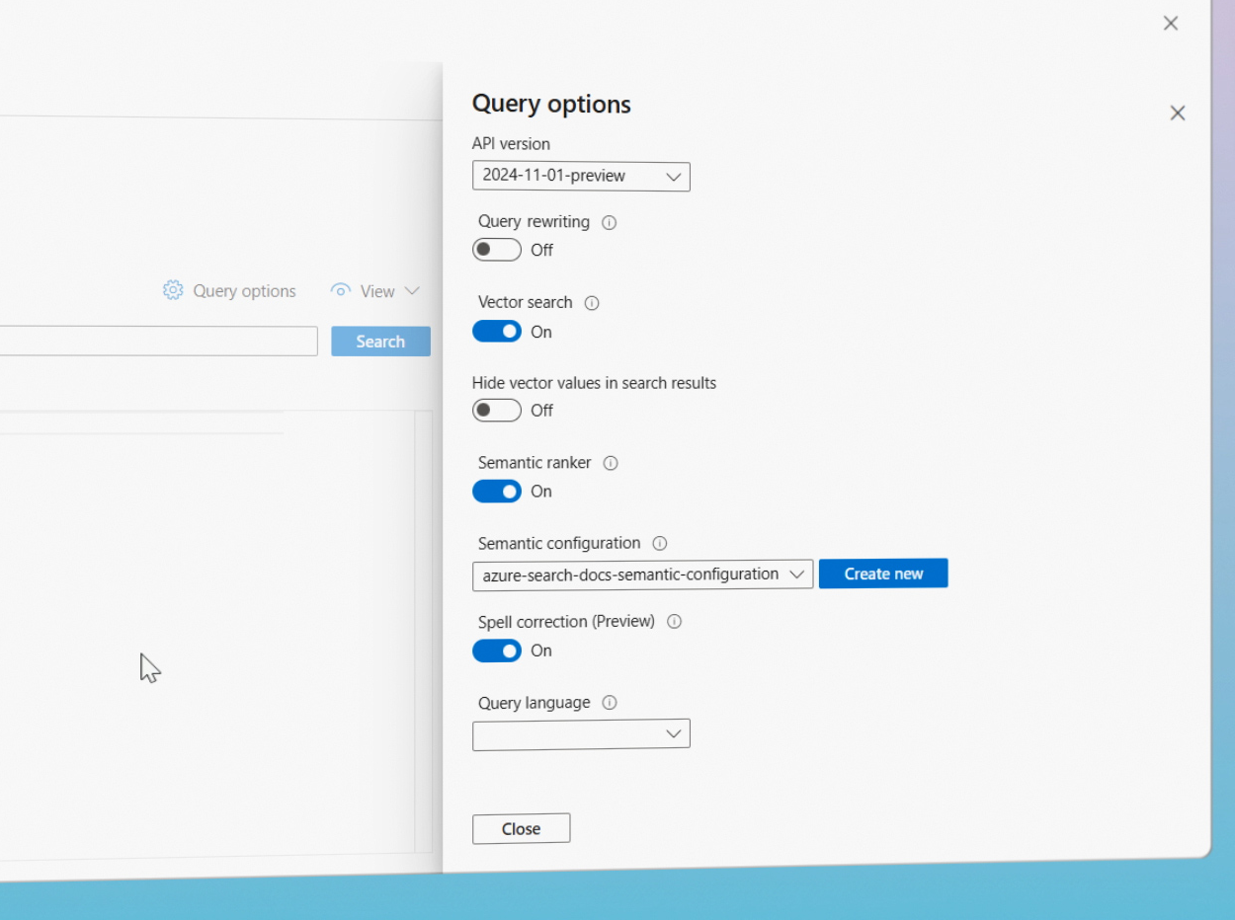
Query rewriting
Transforms queries to improve recall and relevance
Generates up to 10 alternate query versions
Benefits:
+5 to +8 points NDCG@3 for term-based queries.
Integrated into semantic ranker workflows.
Available at no extra cost
Notes:
https://youtu.be/2nxQzWiAg28?feature=shared

Slide 132
Data AI enrichment

Slide 133
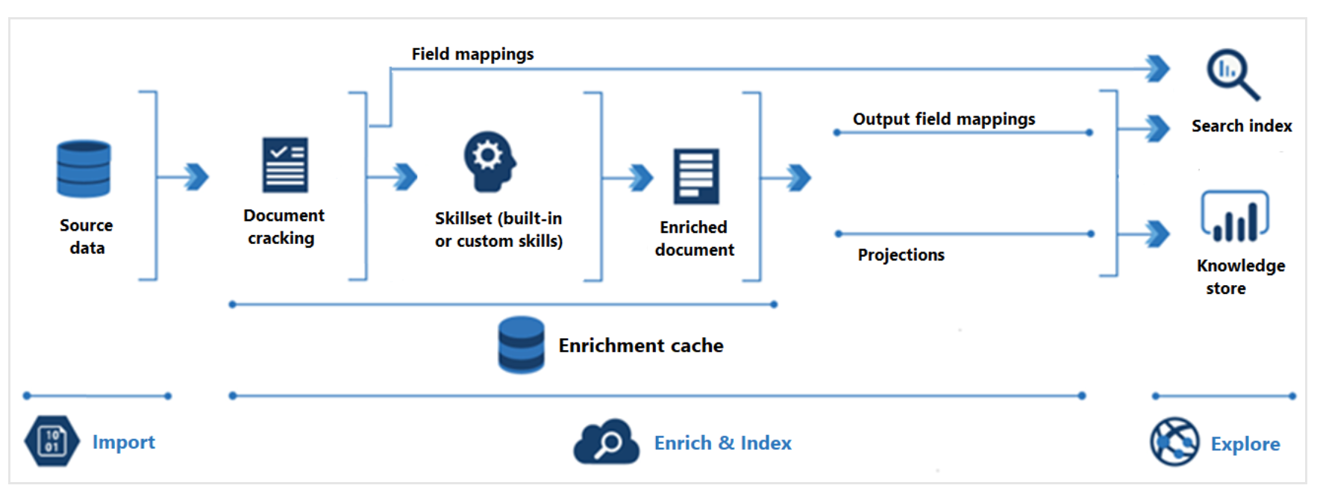
AI enrichment: why is it important?
AI enrichment integrates with Azure AI services (among other services) for content processing.
Transforms non-searchable or irrelevant raw content into searchable and structured data
Uses enrichment, analysis, and inference to create structure from unstructured data
Essential for data transformation in RAG scenarios, making data suitable and relevant for the Language Model
I.e., Chunking and Vectorization take place as part of this feature when using integrated Vectorization while indexing
Notes:
Let us now turn our attention to the concept of AI enrichment (AI enrichment concepts - Azure AI Search | Microsoft Learn) and its importance in data retrieval. AI enrichment is about integrating with services like the ones offered by Azure AI services and custom libraries needed to process content that, in its raw form, may not be searchable or may not present relevant information.
Through the process of enrichment, we employ analysis and inference to create searchable content and structure where none previously existed. This transformation of raw, unstructured data into a structured and searchable format is a crucial aspect of effective data retrieval.
Now, bringing this back to the context of RAG, or Retrieval-Augmented Generation, there are numerous scenarios that necessitate such transformation of data. The data needs to be not just accessible, but also suitable and relevant when presented to the Language Model.
And this is precisely where AI Enrichment skills come into play. They allow us to accomplish this transformation, making the data more usable and enhancing the effectiveness of our retrieval system. This way, we ensure that our Language Model works with the most relevant and structured data, thereby improving the overall quality and relevance of its outputs.
Chunking and Vectorization when included as part of the pull-indexers indexing pipeline takes place as part of this feature when using integrated Vectorization (Integrated Vectorization - Azure AI Search | Microsoft Learn)

Slide 134
AI enrichment general pipeline
Pull indexers pipeline (includes AI enrichment skillsets)
Notes:
AI enrichment in Azure AI Search is part of the indexing pipeline, so you can enable as long as the AI enrichment process is enabled in the region: Azure Products by Region | Microsoft Azure.
Depending on your data and the skills you've added to a skillset (Skillset concepts - Azure AI Search | Microsoft Learn), different types of processing may occur. Images can be forwarded to skills that perform image processing and text content is queued for text and natural language processing, among others. The processing generates "enriched documents" that collect the transformations as they occur.
The enriched content is temporary unless you save it. You can enable an enrichment cache to persist documents (Enable caching for incremental enrichment (preview) - Azure AI Search | Microsoft Learn) and skill outputs for reuse during future skillset executions. To get content into a search index, the indexer must have mapping information for sending enriched content to the target field. This involves setting the data path from source data to a search index and from enriched documents to an index.
Indexing is the next step where raw and enriched content is ingested into the physical data structures of a search index. This involves lexical analysis and tokenization.
The last step is Exploration. The output is a search index that you can query from a client app. Optionally, the output can also be a Knowledge Store consisting of blobs and tables in Azure Storage (Knowledge Store concepts - Azure AI Search | Microsoft Learn)
AI enrichment is useful for unstructured text, image content, or content that needs language detection and translation, among others. It can be used for full text search and data science applications. You can also create custom skills to provide external processing.
The AI Enrichment pipeline is supported by various Azure AI services and can be customized with built-in skills or custom skills depending on your needs.

Slide 135
AI enrichment components
IEnricher
IEnricher
Skill
Skillset
A reusable resource in Azure AI Search attached to a pull indexer
Consists of one or more skills for processing documents from a supported data source
Skills
Built-in or custom functionalities performing specific tasks
They are components of a skillset with defined context, inputs, and outputs
Skillset execution
Skills read from and enrich a document, adding structure with each execution
The output of an enriched document is mapped to an index after skillset execution
Skillset configuration
Enrichment settings are specified in a skillset and indexer
Skill dependencies can be set to execute skills in sequence
Notes:
Now we are discussing the concept of Skillsets and Skills in AI enrichment, crucial for developers working with Azure AI Search. A skillset is a reusable resource that contains one or more skills. These skills can be built-in functionalities from Microsoft or custom ones that you host externally. They process documents retrieved from an external data source.
Skills operate within a context and have specific inputs and outputs. They read from and write to an enriched document, adding structure and substance to it with each execution.
After a skillset has been executed, the enriched document's output is mapped to an index. When configuring enrichment, settings are specified in both the skillset and indexer.
Skills can be set to execute independently or sequentially, with the output of one skill feeding into another skill. This enables complex data processing workflows.

Slide 136



AI enrichment architecture enabled by built-in indexers
Internal
AI Search owned AI Service
Customer owned AI Service
Azure AI Service
Azure AI Service
Runs customer workloads for AI Skills
Sends AI Services billing calls to customer
Index output field mappings, mappings, enriched data, field mappings and/or index projections
Supported data store: OneLake, Azure Blob Storage, Azure SQL, Azure Cosmos DB, Azure Data Lake Gen2, etc.
Data cracking
/parsing
Internal
Content Processor Clusters
Sends Knowledge Store Projections
Vectorization during ingestion
Runs customer workloads for custom skill / custom embedding skill
Incremental Enrichment
Knowledge Store
Azure OpenAI
Customer owned Azure Storage
Customer owned Azure Storage
Enrichment Cache
Custom skill
Customer owned Azure Function
Azure AI Foundry Catalog
Customer owned Service Embedding models
Notes:
In the context of AI Enrichment, attaching a skillset to an indexer is a critical step. If an indexer operates without a skillset, it runs in the customer's deployed replicas, processing data in those nodes. Enabling private endpoints for an indexer requires setting a private environment variable in the definition.
When a skillset is enabled without private endpoints, Azure AI Search's internal content processor clusters manage the indexer and AI enrichment orchestration. These clusters interact with Azure AI Search's own AI Services to execute AI services skills internally, with the customer's AI service only being contacted for billing purposes.
For embedding and custom skill operations, the customer's Azure OpenAI service and Azure function or web app, respectively, are utilized.
If enrichment cache is enabled, it is created using a customer's Azure Storage, with the data being exclusively for AI Search system use. Similarly, if the Knowledge Store is enabled, a customer's Azure Storage account is used and outputs are sent to blobs or tables as per the customer's configuration.
Finally, once all skills have been processed, the enriched final outputs, including any mappings and index projections, are indexed in the AI search index.

Slide 137
Skills and skillsets

Slide 138
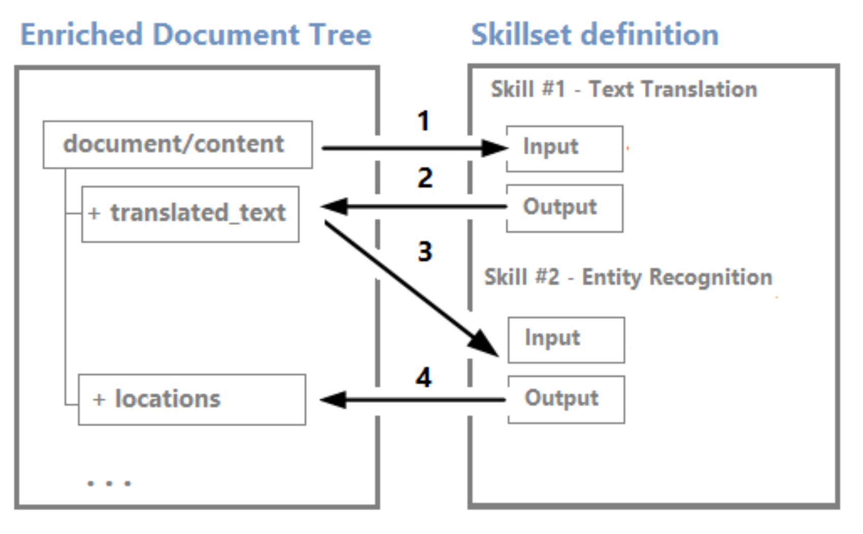
Create a skillset
AI enrichment occurs if you define a skillset
Document Cracking
Field Mappings
Skillset Execution
Output Field Mappings
Push into Index
Notes:
Thus far, we've discussed the concept of skills, the document processing pipeline, and how we can employ AI to unlock latent data within your content to enhance search experiences. Now, let's delve further into the execution of the Skillset within our pipeline.
Skillset concepts - Azure AI Search | Microsoft Learn

Slide 139
How to create a skillset
Skillset JSON definition
{
"name": "sample-skillset",
"description": "A sample skillset for processing documents",
"skills": [
{
"@odata.type": "#Microsoft.Skills.Vision.OcrSkill",
"name": "ocr",
"context": "/document/normalized_images/*",
"defaultLanguageCode": "en",
"detectOrientation": true,
"inputs": [
{
"name": "image",
"source": "/document/normalized_images/*"
}
],
"outputs": [
{
"name": "text",
"targetName": "ocr_text"
}
]
},
{
"@odata.type": "#Microsoft.Skills.Text.EntityRecognitionSkill",
"name": "entityrecognition",
"context": "/document/content",
"defaultLanguageCode": "en",
"inputs": [
{
"name": "text",
"source": "/document/content"
}
],
"outputs": [
{
"name": "organizations",
"targetName": "organizations"
}
]
}
],
"cognitiveServices": {
"@odata.type": "#Microsoft.Azure.Search.CognitiveServicesByKey",
"description": "cogsvc",
"key": "0123456789ABCDEF"
}
}
End-to-end code sample containing a skillset definition
🔗 End to end sample with Azure OpenAI Embeddings skill for integrated Vectorization
Notes:
In this example, the OcrSkill is used to extract text from images, and the EntityRecognitionSkill is used to identify and categorize entities within the text. The context field in each skill determines the part of the document that the skill will process. The inputs and outputs fields define the input data for the skill and where to place the results. The cognitiveServices field specifies the Cognitive Services resource to use for these skills. Please replace "key": "0123456789ABCDEF" with your actual Cognitive Services key.
The skillset can be created from the portal using JSON format, from the Azure portal: import and vectorize data wizard, import data wizard or programmatically.

Slide 140
Skill types
Azure AI services resource skills
Built-in skills with predefined inputs, outputs, and processing steps for operations such as text extraction, OCR, document layout, language detection, entity recognition, and more
Embedding skills
Connects to supported embedding models deployed to allow integrated Vectorization. These are some of them:
Azure OpenAI
AI Vision multimodal
AML (Models offered by the Azure AI Foundry model catalog)
Utility skills
Executes only on Azure AI Search, primarily iterating on nodes in the enrichment cache for operations like content extraction, text split, text merging, etc.
They are not dependent on AI Services
Custom skills
Wraps external code designed by the user, enabling extensibility of the AI enrichment pipeline through custom Web API or Azure Machine Learning model integration
Notes:
Skills reference - Azure AI Search | Microsoft Learn
Skills are the ones that allow AI enrichment to occur.
Azure AI Search provides a range of skills for external processing during indexing. These skills are organized into four main categories: Azure AI resource skills, Azure OpenAI skills, utility skills, and custom skills.
Azure AI resource skills: These are built-in skills that wrap API calls to an Azure AI resource, with predefined inputs, outputs, and processing steps. These skills, based on pretrained models from Microsoft, are billable at larger volumes and allow for operations such as text extraction, language detection, entity recognition, sentiment analysis, and translation, among others.
Embedding skills: These skills connect to supported embedding model deployments, enabling integrated Vectorization. They are billed at the pay-as-you-go rate.
Utility skills: These skills execute only on Azure AI Search, primarily iterating on nodes in the enrichment cache. Most of these skills, which include conditional skills, content extraction, text merging, and text splitting, among others, are non-billable.
Custom skills: These skills wrap external code designed, developed, and deployed by the user. They allow extensibility of an AI enrichment pipeline by making an HTTP call into a custom Web API or integrating with an Azure Machine Learning model. They are not billed unless the solution uses a metered Azure service.

Slide 141







Skills: AI services, Azure OpenAI & custom
Built-in skills
Doc Layout
Custom skills
Key Phrase extraction
Location entity extraction
Sentiment analysis
Your custom skill goes here!
Organization entity extraction
Persons entity extraction
Language detection
Face detection
Celebrity recognition
Image tag extraction
Text Utilities
Landmark detection
Printed text recognition
Azure Databricks
Azure Machine Learning
Machine Learning VMs
Azure AI Foundry Embeddings
Azure OpenAI Embeddings
Azure AI Vision Multimodal
Embeddings
Notes:
Skills reference - Azure AI Search | Microsoft Learn
We utilize Microsoft's Azure AI services within our document processing pipeline. These services comprise robust, pre-trained machine learning models that Microsoft has developed to facilitate our customers' use of AI. Features such as computer vision, OCR, and text analytics (including key phrase extraction and entity identification), as well as our custom skills (like image normalization, location, and person identification), can be activated with just a few clicks in the Azure Portal. These capabilities, whether used individually or in combination, have the potential to unlock a wealth of information from your data.
AI Services skills are built-in but depend on the customer’s API key for billing purposes. Here is how to attach an AI service to a skillset: Attach Azure AI services to a skillset - Azure AI Search | Microsoft Learn
However, we understand that despite the power of our AI Services, they may not cater to every unique business use case. Consequently, we incorporate a feature that allows you to effortlessly integrate your custom skills into the document processing pipeline.

Slide 142
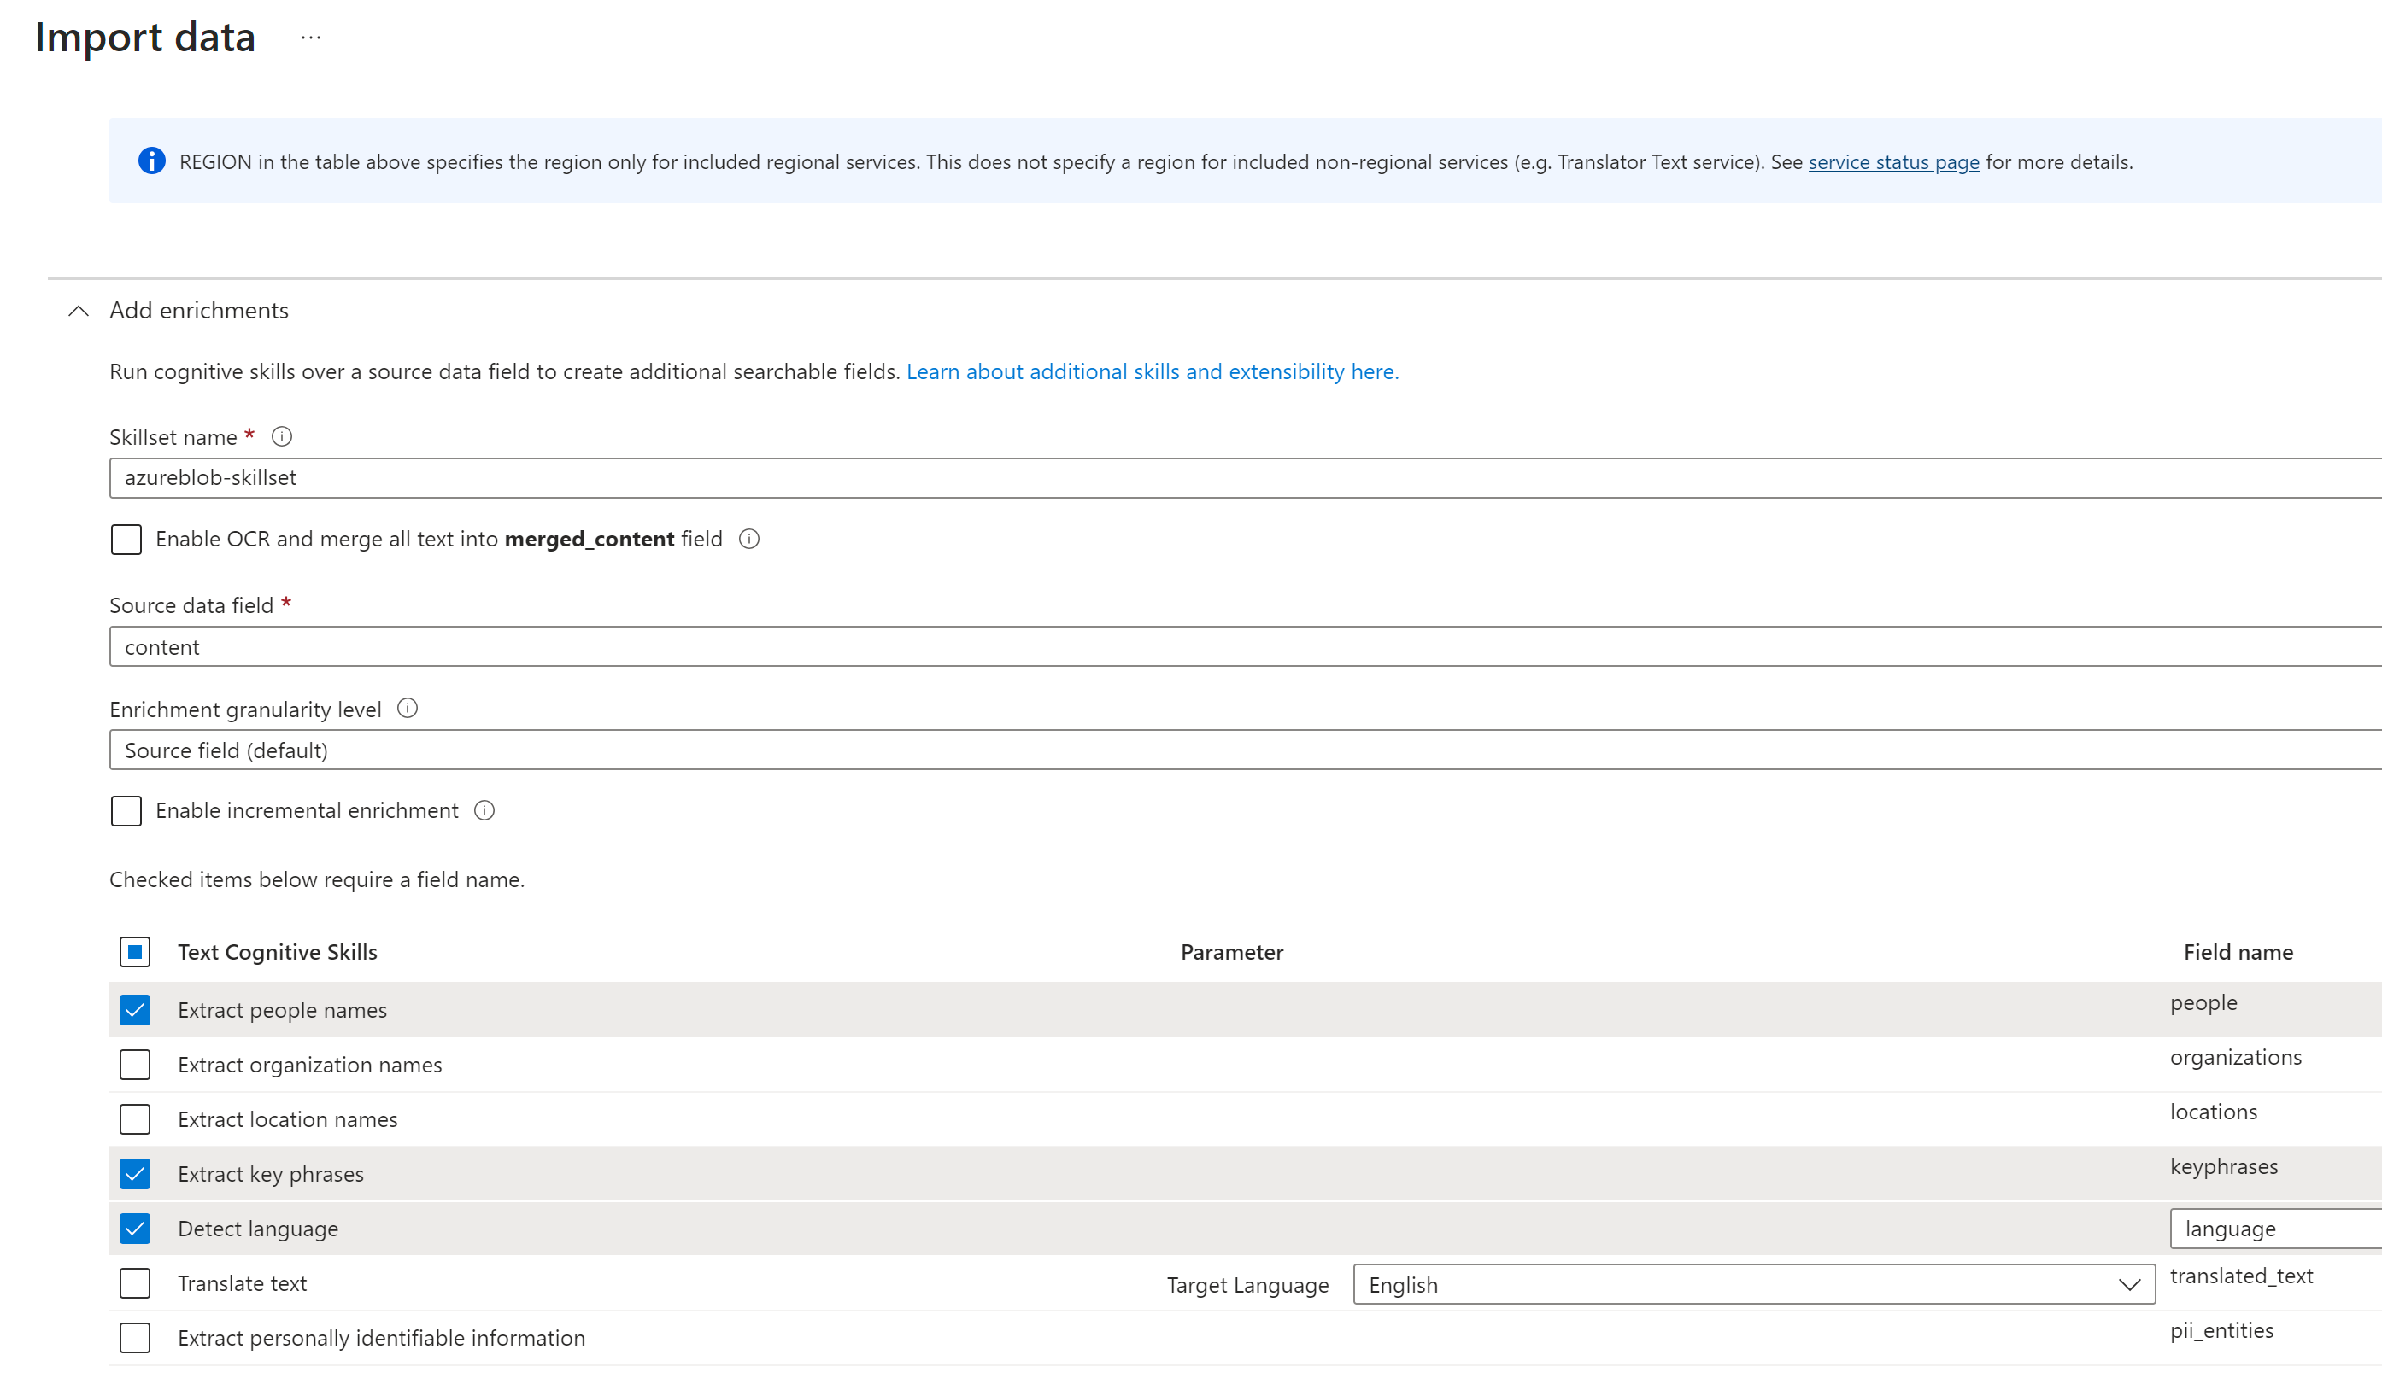
Adding built-in skills (1/2)
Enable in the Portal from the Import Data wizard
Built-in skill JSON definition and code sample
{
"@odata.type": "#Microsoft.Skills.Text.V3.EntityRecognitionSkill",
"name": "entityrecognition",
"context": "/document",
"description": "Recognize entities in text",
"defaultLanguageCode": "en",
"minimumPrecision": 0.5,
"inputs": [
{
"name": "text",
"source": "/document/content"
}
],
"outputs": [
{
"name": "organizations",
"targetName": "organizations"
},
{
"name": "persons",
"targetName": "persons"
},
{
"name": "locations",
"targetName": "locations"
}
]
}
🔗 End to end sample with Azure OpenAI Embeddings skill for integrated Vectorization
Notes:
As previously mentioned, the process of integrating built-in skills can be effortlessly accomplished with just a few clicks through the data import workflow experience available on the Azure Portal. Feel free to select as many or as few of these skills as you deem necessary while constructing your indexer for data ingestion. Whenever the indexer is activated, it will automatically apply these skills to any fresh content that you are incorporating.
Additionally, you always have the option to add skills in a programmatically manner. To your right, you will notice a code snippet demonstrating how you could activate the built-in skill 'EntityRecognitionSkill' as part of your document cracking pipeline.
Moreover, we've included an end-to-end sample, which provides a programming example for Integrated Vectorization. This sample encompasses the usage of the Azure OpenAI Embeddings skill.

Slide 143
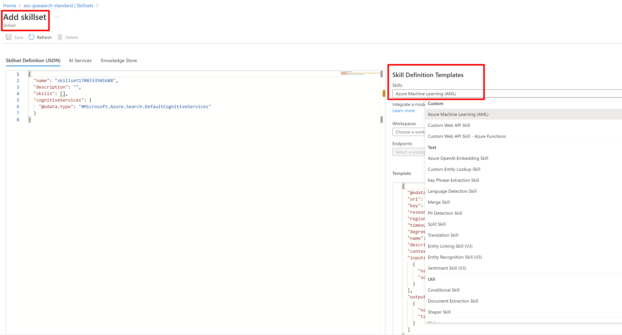
Adding built-in skills (2/2)
In the Azure portal from the AI search Skillsets templates
Notes:
You can also add skills by choosing the skill templates from the “Add Skillset” workflow in the Azure portal under your AI Search service, in that way you can create your own skillset easily, using JSON format.

Slide 144
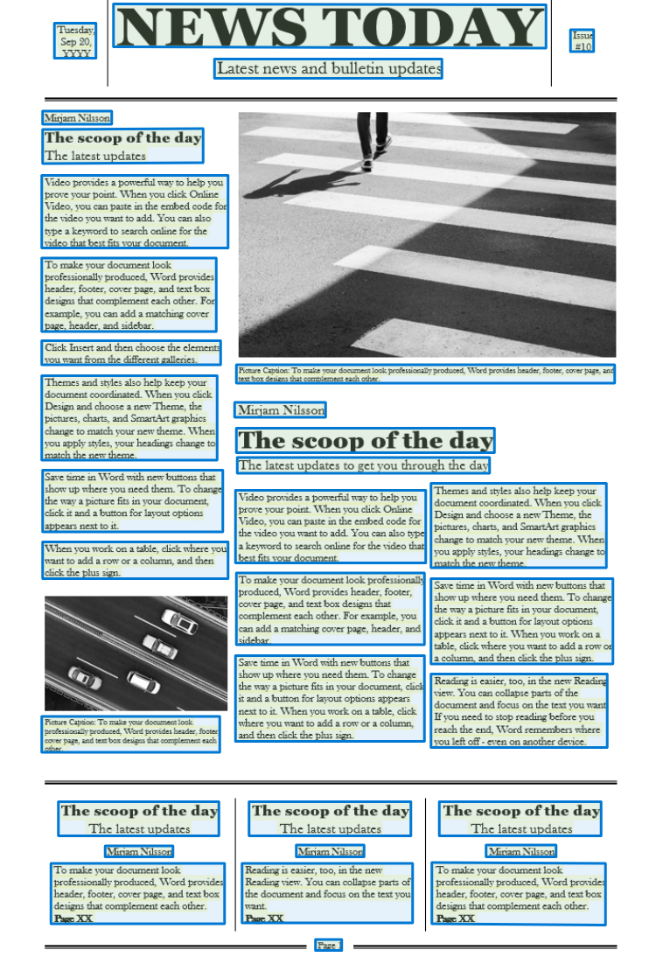

Custom skills
Original PDF
This custom skill output
{
"values": [
{
"recordId": "record1",
"data": {
“pageNumber": "1",
"content": "Tuesday, Sep 20, YYYY\nNEWS TODAY\nLatest news and bulletin updates\nIssue #10\nMirjam Nilsson\nThe scoop of the day The latest updates\nVideo provides a powerful way to help you prove your point……."
"errors": null,
"warnings": null
}
]
}
🔗 Repository of pre-built custom skills
Custom skill running in Azure Function called from AI enrichment
Configured through skillset
Calling AI Document Intelligence service
Notes:
We have made adding custom skills to your document cracking pipeline really easy. You can build your custom skill in any way you like, ML, python, regex, etc., You just provide a secure endpoint and the skill can be included as a step in your document cracking pipeline.
Custom skills may be our other AI services (like AI Document Intelligence (previously Form Recognizer), Personalizer, etc.,) or they can be unique to your business needs. Examples may be custom classifiers or domain specific entities or even text summarization. We have provided a GitHub repository with several custom skills templates to jump start your development efforts at: Azure-Samples/azure-search-power-skills: A collection of useful functions to be deployed as custom skills for Azure Cognitive Search (github.com)
Here is a specific sample of how to implement a custom skill to call AI document intelligence: Build a Form Recognizer custom skill for Azure Cognitive Search - Training | Microsoft Learn

Slide 145
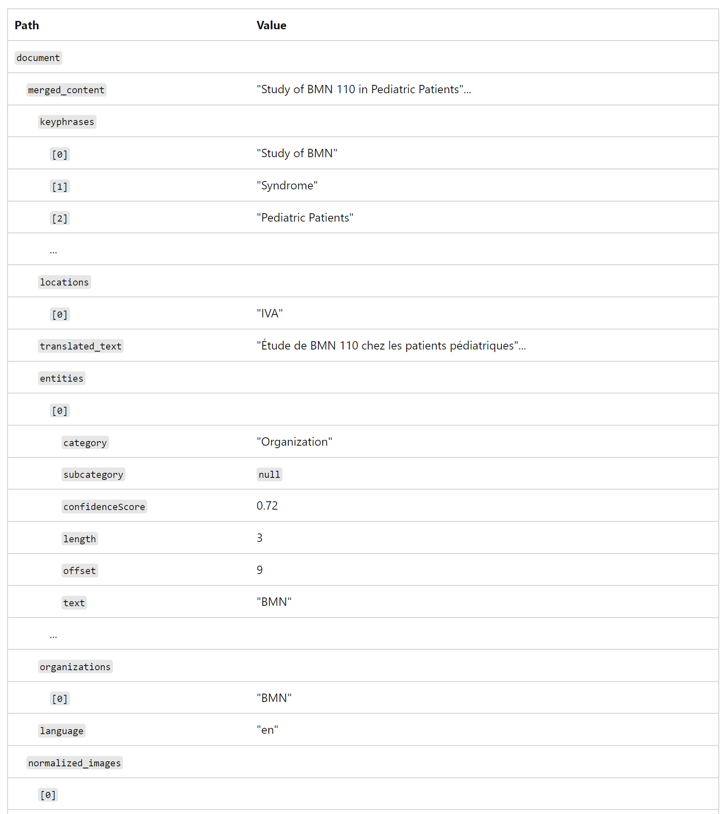
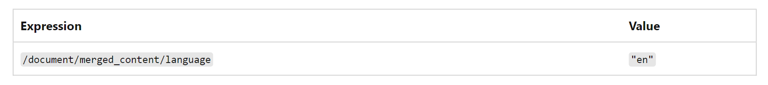
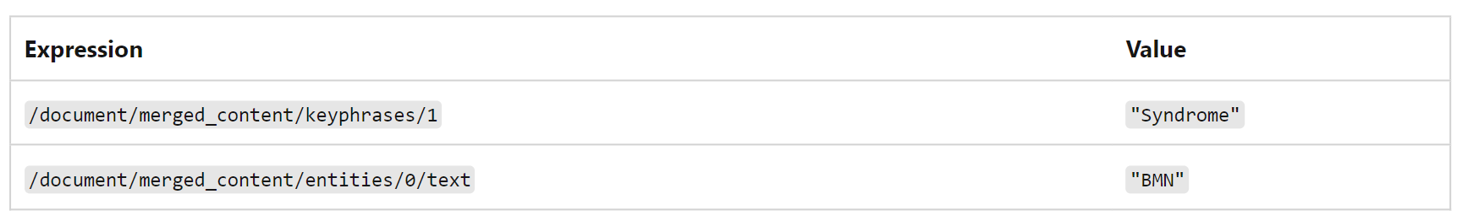
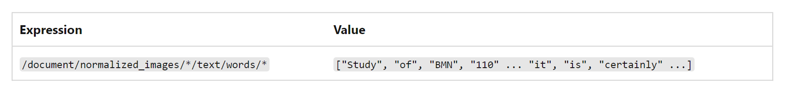
Skill context and reference language
🔗 Skill context and reference language
Expression language constructs paths to nodes in an enriched document
The data working set starts from raw data and is progressively enriched with each skill iteration's output data
Data is internally organized in a tree-like structure for querying and indexing
Simple paths can be expressed with tokens separated by slashes
Object properties and specific elements of an array can be accessed via their respective paths
Arrays can be enumerated using ‘*’, and literal values can be used as skill inputs
Notes:
Skill context and input annotation reference language - Azure AI Search | Microsoft Learn
Let’s discuss the concept of Skill Context and Input Annotation Language when using AI enrichment in Azure AI Search. This feature uses an expression language to construct paths to nodes in a document that has been enriched.
The data working set is initially the raw data from the source. As each skill iteration's output data is applied, the working set is progressively enriched and organized in a tree-like structure. This structure facilitates efficient querying and indexing.
Simple paths through the enriched document can be expressed using path sections in the existing document structure separated by slashes. For accessing the properties of nodes or specific elements of an array, we append the property name or numeric index to the path.
We also have the ability to enumerate an array of values using the ‘’*”. We can also use literal values as inputs to skills by prefixing the value with an equal sign.
We can see to the right an example of a tree based on source content that we can manipulate, and examples of some of the expressions, referring to specific values or to arrays, to be able to transform any section of the tree.
Here’s a link to the full reference for the language to use for more complex AI enrichment skillset configurations depending on your business need.

Slide 146
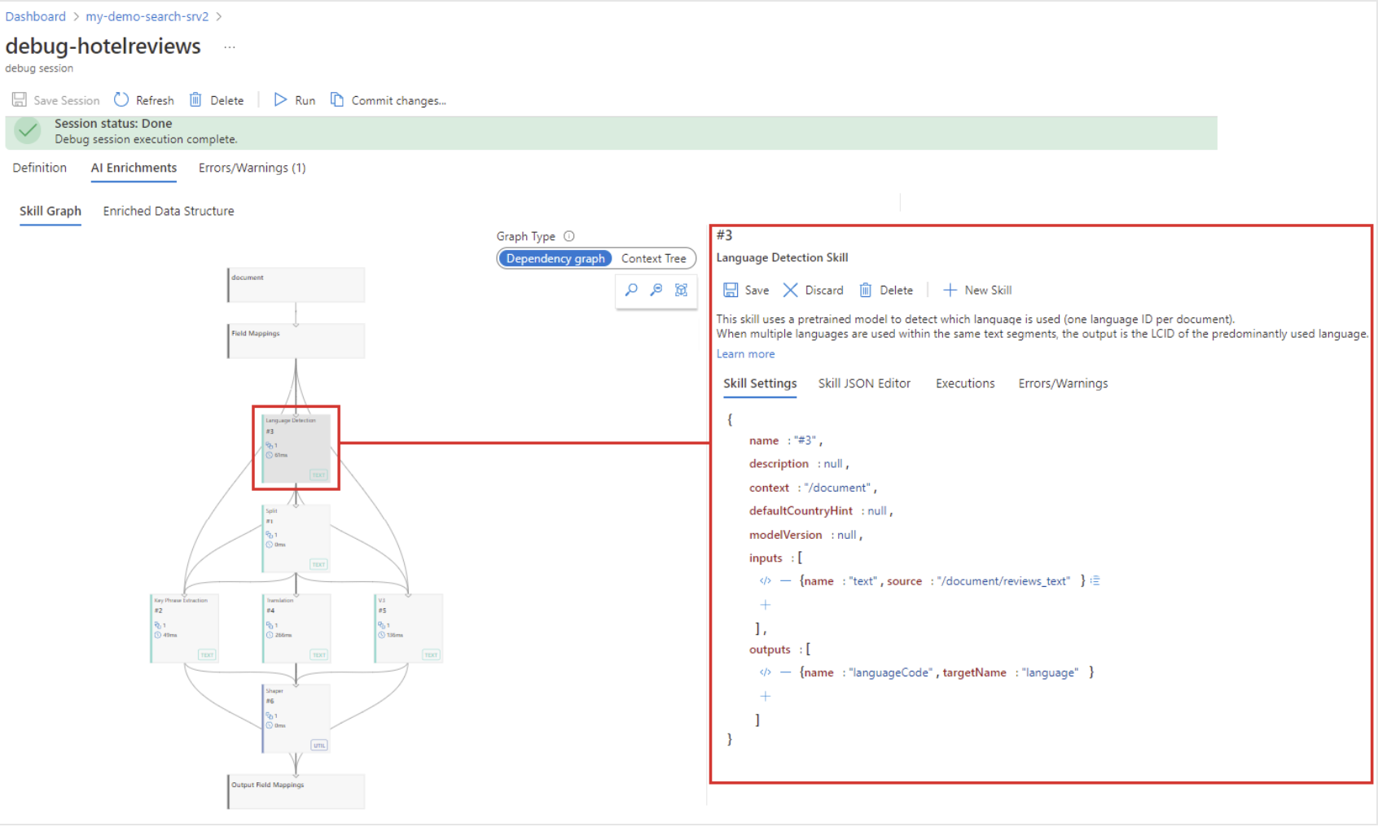
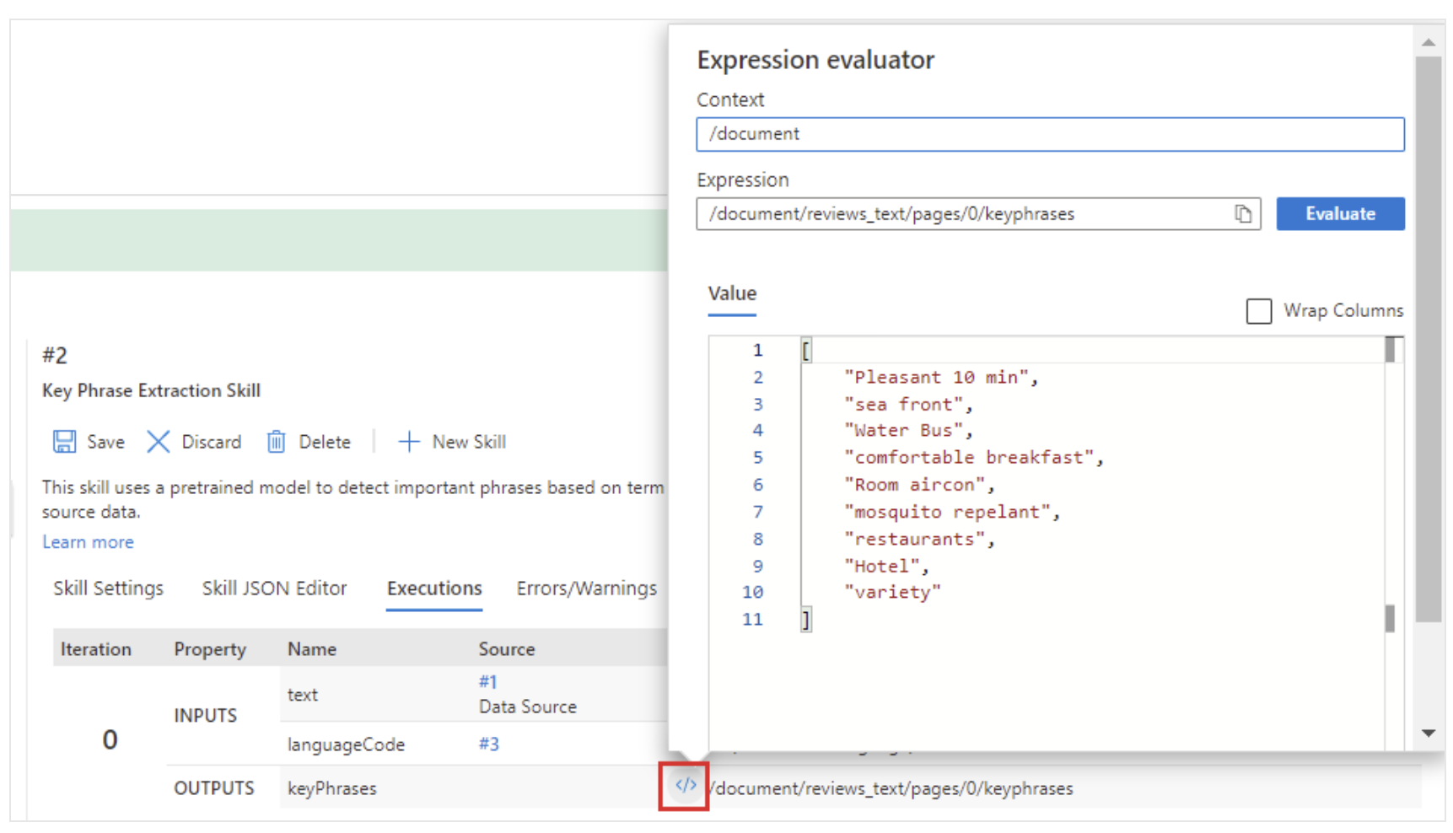
Debug sessions
Debug sessions is a visual editor available from the Azure portal in AI Search that works with an existing skillset, exposing the structure and content of a single enriched document
When a session is started, a copy of the skillset, indexer, and a data source is created with all session state saved to a new blob container
Changes made within the session do not affect the published skillset unless committed
The Skill Graph provides a visual hierarchy of the skillset and its order of execution
The Enriched Data Structure pane shows the document's enrichments through the skillset
🔗 How to debug a skillset
Notes:
Now, as part of AI enrichment, let’s discuss a feature in Azure AI Search known as Debug Sessions, used to debug our skillsets (built-in skills). This feature acts as a visual editor, allowing us to expose the structure and content of a single enriched document, making it interactive and real-time.
When you initiate a debug session, Azure AI Search creates a copy of your skillset, indexer, and a data source, storing all session state in a new blob container. Any changes you make during this session are isolated and won't affect the published skillset unless you decide to commit them.
The visual editor consists of several important components. The Skill Graph visually represents the hierarchy of your skillset and the order of execution. You can see the dependencies and parallel execution capabilities here.
The Enriched Data Structure pane gives you a comprehensive view of the document's enrichments provided by the skillset.
Finally, the Expression Evaluator comes in handy when you need to edit the path and test the results before making any updates to the inputs or context of a skill or projection. This tool gives you full interactive access for testing skill context, inputs, and checking outputs.
You can see visually the tree and inputs/outputs as depicted here as part of the skill graph. You can also see the expression evaluator that helps changing paths and values to make sure you’re using the right data to enrich.
Custom skills have to be debugged as any other function you’re debugging separately, locally. Here’s also a link of how to debug as skillset.

Slide 147

AI enrichment—knowledge store
IEnricher
IEnricher
Skill
Document cracking
Skillset:
Extensible enrichment pipeline
Source Data
Enriched Documents
Search Index
Properties:
Secondary storage for AI-enriched content in Azure AI Search
Allows flexible access to content and ability to shape data
Content is accessible to any tool/app/process that supports Azure Storage
Comprises of Azure Table Storage, Azure Blob Storage or both
Content can be reused and adjusted according to changes
Changes in source data or skillset are updated each time the indexer and skillset run
Not responsible for deleting projections, owner should delete if no longer needed
Content can be consumed by any client applications capable of accessing an Azure Storage account
Projections
Knowledge Store
Notes:
Now let’s talk about Knowledge Store (Knowledge Store concepts - Azure AI Search | Microsoft Learn): This feature allows users to project their information tree into both tabular and object forms.
The Knowledge Store utilizes the same document processing pipeline as Azure AI Search and enables data projection into Azure Blob or Azure Table storage. Importantly, this isn't a binary choice - you can use the same pipeline to populate both your search index and your Knowledge Store. There's no need to orchestrate or schedule additional feeds, as this can all be handled seamlessly through your Azure AI Search indexers.
Once your data is projected into the Knowledge Store, its usage is entirely up to you. You can build ML models, create powerful dashboards, initiate workflow automation, or conduct human validation of business rules/logic, create a backup of your data to rebuild your index later on without reprocessing skills. The possibilities are only limited by your needs and imagination.

Slide 148
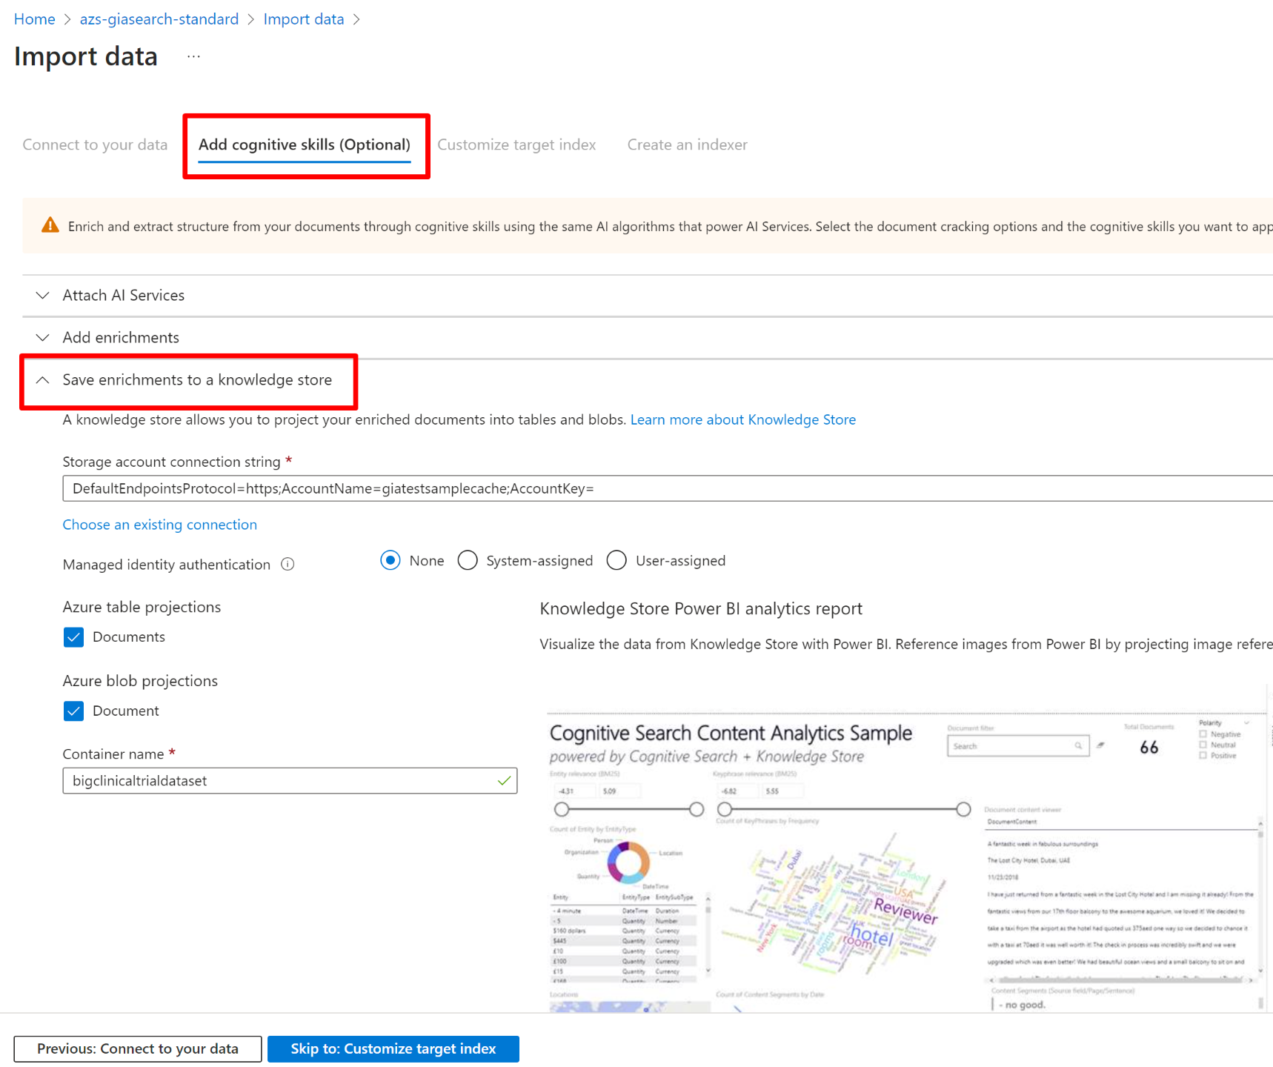
Knowledge store
Knowledge Store JSON definition (within Skillset)
"knowledgeStore": {
"storageConnectionString": "{{storage-connection-string}}",
"projections": [
{
"tables": [
{ "tableName": "hotelReviews1Document", "generatedKeyName": "Documentid", "source": "/document/tableprojection" },
{ "tableName": "hotelReviews2Pages", "generatedKeyName": "Pagesid", "source": "/document/tableprojection/pages/*" },
{ "tableName": "hotelReviews3KeyPhrases", "generatedKeyName": "KeyPhrasesid", "source": "/document/tableprojection/pages/*/keyPhrases/*" }
],
"objects": []
},
{
"tables": [
{
"tableName": "hotelReviews4InlineProjectionDocument", "generatedKeyName": "Documentid", "sourceContext": "/document",
"inputs": [
{ "name": "name", "source": "/document/name"},
{ "name": "reviews_date", "source": "/document/reviews_date"},
{ "name": "reviews_rating", "source": "/document/reviews_rating"},
{ "name": "reviews_username", "source": "/document/reviews_username"},
{ "name": "reviews_title", "source": "/document/reviews_title"},
{ "name": "reviews_text", "source": "/document/reviews_text"},
{ "name": "AzureSearch_DocumentKey", "source": "/document/AzureSearch_DocumentKey" }
]
},
{
"tableName": "hotelReviews5InlineProjectionPages", "generatedKeyName": "Pagesid", "sourceContext": "/document/reviews_text/pages/*",
"inputs": [
{ "name": "Sentiment", "source": "/document/reviews_text/pages/*/sentiment"},
{ "name": "LanguageCode", "source": "/document/language"},
{ "name": "Keyphrases", "source": "/document/reviews_text/pages/*/keyphrases"},
{ "name": "TranslatedText", "source": "/document/reviews_text/pages/*/translated_text"},
{ "name": "Page", "source": "/document/reviews_text/pages/*" }
]
},
{
"tableName": "hotelReviews6InlineProjectionKeyPhrases", "generatedKeyName": "kpidv2", "sourceContext": "/document/reviews_text/pages/*/keyphrases/*",
"inputs": [
{ "name": "Keyphrases", "source": "/document/reviews_text/pages/*/keyphrases/*" }
]
}
],
"objects": []
}
]
}
Configuring Knowledge Store from Azure portal
Notes:
You can enable the Knowledge Store from the Azure portal when using the import data wizard or programmatically through the skillset definition.
Here’s a quick start: Quickstart: Create a Knowledge Store in the Azure portal - Azure AI Search | Microsoft Learn

Slide 149
AI enrichment— incremental enrichment (cache)
IEnricher
IEnricher
Skill
Document cracking
Skillset:
Extensible enrichment pipeline
Source Data
Enriched Documents
Search Index
Properties:
Uses cached data for cost-effective skillset execution
Processes only new/updated content
Reuses existing enrichments
Adjusts to data source and skill updates
Automates cache management
Allows prioritization of new documents
Projections
Incremental Enrichment
Notes:
AI Incremental Enrichment is a process that uses cached enrichments during skillset execution, thereby only charging for processing new and altered skills and documents. This mechanism reduces overall costs as storage expenses are lower than image extraction and AI processing.
Caching: Enabled indexer evaluates updates to determine if existing enrichments can be retrieved from the cache. The refreshed results are also written back to the cache, search index or Knowledge Store.
Limitations: Incremental enrichment should be avoided with the SharePoint Online indexer (Preview) as the cache can become invalid under certain conditions.
Cache Configuration: Each indexer has a unique cache identifier stored in a blob container in your Azure Storage account.
Cache Management: The cache's lifecycle is managed by the indexer. Modifications to the cache property or connection string result in the existing cache being deleted on the next indexer run.
Cache Optimization: Parameters can be used to control document prioritization, bypass skillset checks and data source validation, and force skillset evaluation.
Re-cache Documents: Specific documents can be reprocessed using Reset Documents (preview).
Changes: The cache can be invalidated by changes in the pipeline composition, data source updates, and skill updates.
APIs: REST API version 2020-06-30-Preview+ provides incremental enrichment through additional properties on indexers.

Slide 150
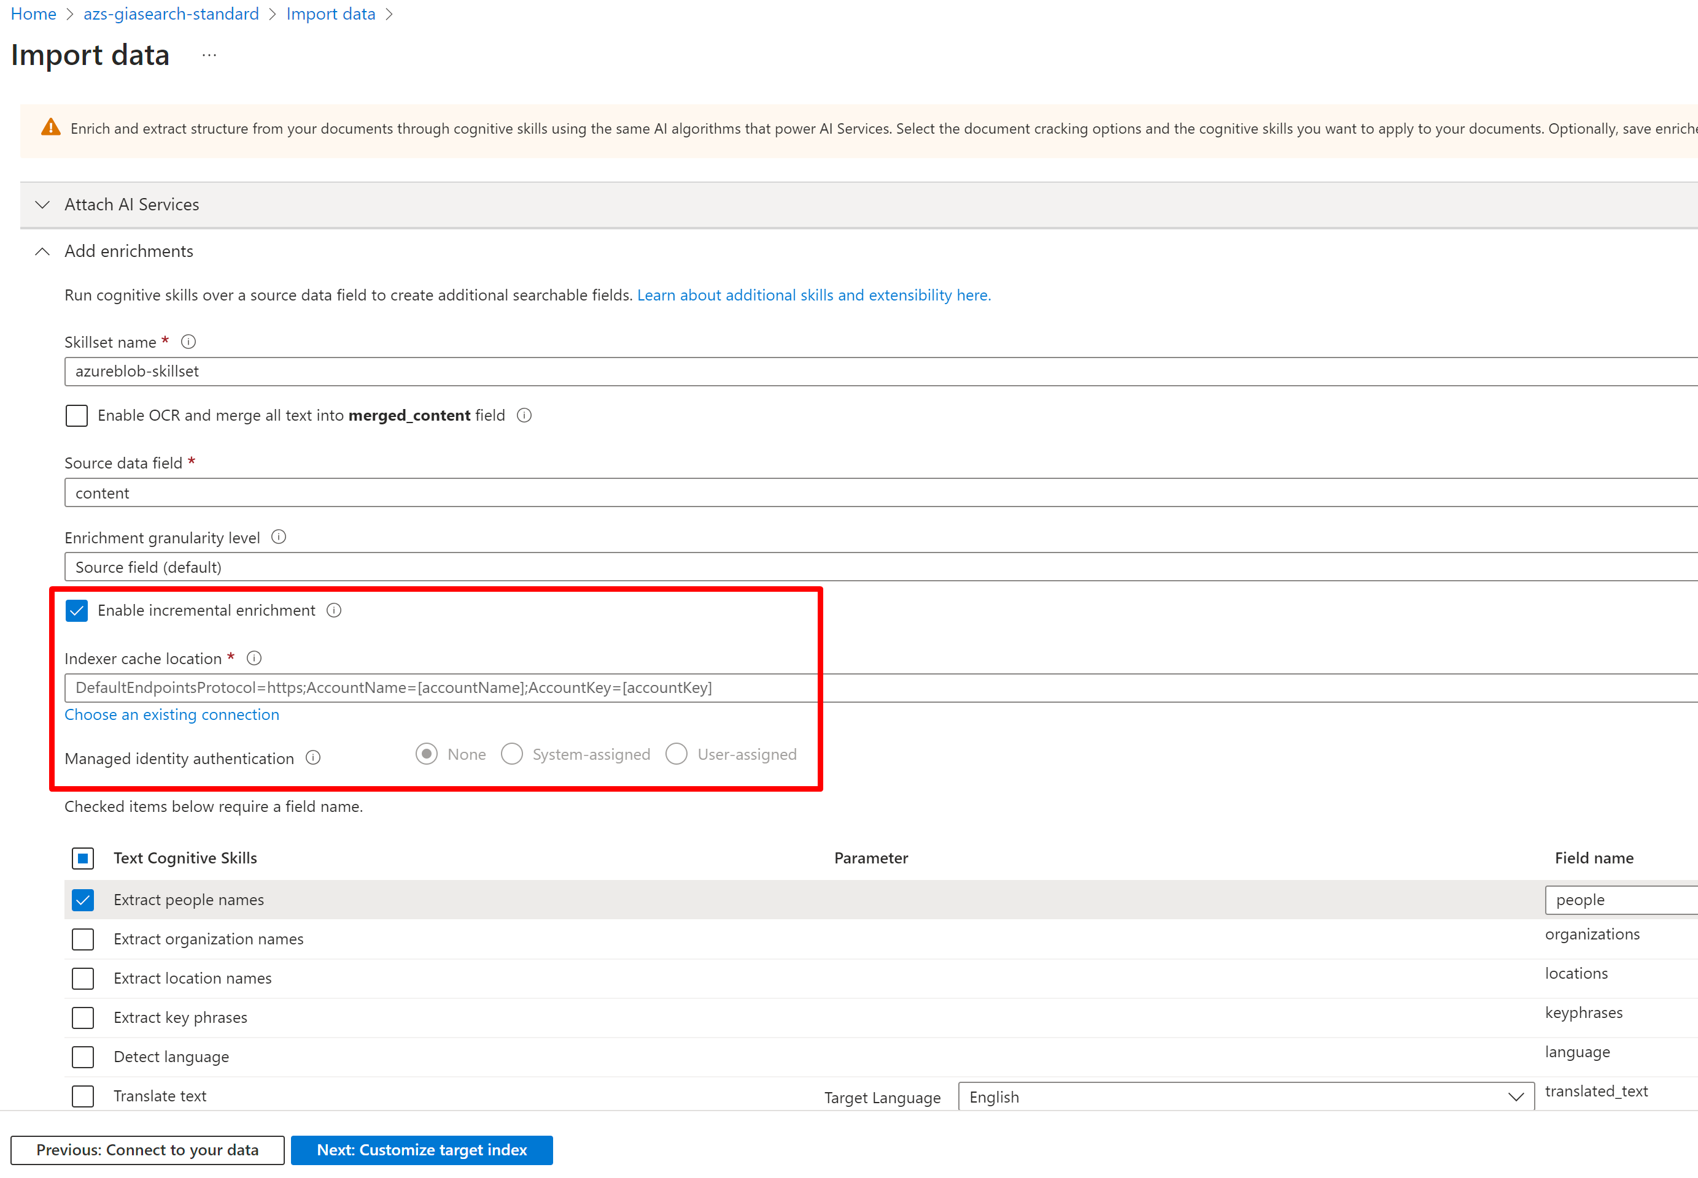
Incremental enrichment (cache)
Configuring enrichment cache from Azure portal
Incremental enrichment JSON definition
POST https://[service name].search.windows.net/indexers?api-version=2021-04-30-Preview
{
"name": "<YOUR-INDEXER-NAME>",
"targetIndexName": "<YOUR-INDEX-NAME>",
"dataSourceName": "<YOUR-DATASOURCE-NAME>",
"skillsetName": "<YOUR-SKILLSET-NAME>",
"cache" : {
"storageConnectionString" : "<YOUR-STORAGE-ACCOUNT-CONNECTION-STRING>",
"enableReprocessing": true
},
"fieldMappings" : [],
"outputFieldMappings": [],
"parameters": []
}
}
Notes:
Skills reference - Azure AI Search | Microsoft Learn
Skills are the ones that allow AI enrichment to occur.
Azure AI Search provides a range of skills for external processing during indexing. These skills are organized into four main categories: Azure AI resource skills, Azure OpenAI skills, utility skills, and custom skills.
Azure AI resource skills: These are built-in skills that wrap API calls to an Azure resource, with predefined inputs, outputs, and processing steps. These skills, based on pretrained models from Microsoft, are billable at larger volumes and allow for operations such as text extraction, language detection, entity recognition, sentiment analysis, and translation, among others.
Azure OpenAI skills: These skills connect to models deployed on Azure OpenAI, enabling integrated Vectorization. They are billed at the pay-as-you-go rate.
Utility skills: These skills execute only on Azure AI Search, primarily iterating on nodes in the enrichment cache. Most of these skills, which include conditional skills, content extraction, text merging, and text splitting, among others, are non-billable.
Custom skills: These skills wrap external code designed, developed, and deployed by the user. They allow extensibility of an AI enrichment pipeline by making an HTTP call into a custom Web API or integrating with an Azure Machine Learning model. They are not billed unless the solution uses a metered Azure service.

Slide 151
Hyperscale

Slide 152
Hyperscale: High-density multi-tenancy
Released as a GitHub repo with an OSS license
Cost-effective multitenancy: Maximize the number of tenants per service to decrease per tenant search costs
Reduced management overhead: Hyperscale proxy layer manages a fleet of services for up to millions of tenants handling data movement as each tenant grows.
In Summary
Tenant level data isolation supported in the proxy API.
All features of the data plane REST API
Unlimited tenant count.
Tenants can be as large as the maximum size of a search index.
Maintain tenants as they grow, moving them from shared indexes to dedicated once they reach a configured size threshold.

Slide 153
Repo access
This project will be launched as a limited private preview. We would like to engage with you and your customers directly to help us understand their requirements and get them started.
If you have a customer with a high number of tenants that you think would benefit from Hyperscale, please let us know by filling out the form at the following link: https://aka.ms/azshyperscale-signup

Slide 154
Current multi-tenant design patterns
Tenant per search service
Ideal for complex applications with extensive per tenant customization, such as an application development platform, or security requirements.
Each tenant (ie search service) can scale independently with no noisy neighbor problems.
Downsides:
Expensive since you are paying for a search service for every customer tenant.
Some management overhead for each search service.
Tenant per index
Ideal for applications where all data for a tenant can co-exist in the same index.
Can support up to 3000 tenants in an S3 HD search service.
Downsides:
S3 HD supports a maximum of 3000. Still a costly option where tenant count is high.
https://learn.microsoft.com/en-us/azure/search/search-modeling-multitenant-saas-applications

Slide 155
Cost of index-per-tenant approach
Example customer scenario:
50,000 tenants (maximum of 3000 tenants per S3 HD service)
50 single partition S3 HD services
3 replicas for high availability (reads and writes)
S3 price per SU per month in US: $1,962.24
Total cost: 50 * 3 * 1,962.24 = 294,336 per month or ~3.5M annually

Slide 156
Hyperscale multi-tenant design patterns
Pack tenants as tightly as possible to maximize cost efficiency while ensuring larger tenants get the resources they need.
Mixed-mode of multiple tenants per index, index per tenant, and search service
Configurable tenant pooling based on document count
Tenants moved between modes as they grow
Tenant placement managed by hyperscale proxy and all tenants accessible through a single API

Slide 157
Tenant pools
Dense Pool
Dedicated Tenant per Index Pool
Dedicated Tenant per Service Pool
Large number of small tenants. ~90%+
Evenly distribute tenants across physical indexes.
Small number of medium to large tenants. ~5-10%+
When tenants reach the set document limit they are moved by the worker roles in the Hyperscale proxy to dedicated tenant per index pool.
Very small number of the largest tenants with highest data volume and request traffic. <1%
Manually triggered tenant move to isolate largest tenants to their own search service.

Slide 158
Current limitations
No cross-tenant data operations
All tenants have the same schema
CMK for each tenant is not supported
No per-tenant network isolation (private endpoints or firewall)

Slide 159
Full text search

Slide 160
Finding a needle in a haystack
Users often only know topics or key ideas when they are searching
The exact text of a query may not match all the relevant documents
Query
Document
What is included in my Northwind Health Plus plan that is not in standard?
Northwind Health Plus offers more comprehensive coverage than Northwind Standard. This plan offers coverage for emergency services, both in-network and out-of-network, as well as mental health and substance abuse coverage. Northwind Standard does not offer coverage for emergency services, mental health and substance abuse coverage, or out-of-network services.
Less than 20% of the words in the answer match the original query

Slide 161
Full text search Azure AI Search approaches this problem with 4 key components
Query parser
Builds a structured representation of a search query. Enables more complex search types
Analyzers
Perform lexical analysis on search queries and indexed documents
Search index
An efficient data structure used to store and organize searchable terms extracted by analyzers
Scoring
Scores matching documents on how well they match the query using the index

Slide 162
Query parser
Deconstruct a query into separate subqueries
Spacious, air-condition* "Ocean view"
Term query. Searches for an individual term “spacious” in the index
Prefix query. Searches for all terms starting with “air-condition” in the index
Phrase query. Searches for the exact phrase “Ocean view” in the search index

Slide 163
More query types (1/2)
Wildcard
Match multiple (*) or single (?) wildcard characters in a query
Find documents with terms that only partially match a query
alphanumeric
alphabetical
alpha*
non-numerical
nonsensical
non*al
98072-1222
98052-1234
980?2*

Slide 164
More query types (2/2)
Fuzzy
Automatically expand query terms to include near matches with the fuzzy search operator (~)
“Autocorrect” typos of a few characters
university
universitl
unversity
niversity
...
university~

Slide 165
Analyzers (1/3)
Put term and phrase queries through a lexical analysis process
Example transformations include:
Reducing to the root forms of words
Breaking up composite words
Removing non-essential “stopwords” such as “the” or “and”
Lower casing upper case words
air-condition
air, condition
House
house
Running the marathon
run, marathon

Slide 166
Analyzers (2/3)
Control analyzer behavior with advanced customization
Example: Create specific rules for phone numbers
Remove (, ), and + from queries
Break up the phone number into groups of digits by spaces and hyphens
+1 (321) 555-0199
1,321,555,0199

Slide 167
Analyzers (3/3)
Language support
Over 20 languages have built-in analyzers
English | Arabic | Armenian | Irish | Malay | Russian | Thai
Bangla | Basque | Bulgarian | Italian | Marathi | Serbian | Turkish
Catalan | Chinese | Croatian | Japanese | Norwegian | Slovak | Ukrainian
Czech | Danish | Dutch | Kannada | Persian | Slovenian | Urdu
Estonian | Finnish | French | Korean | Polish | Spanish | Vietnamese
Galician | German | Greek | Latvian | Portuguese | Swedish
Gujarati | Hebrew | Hindi | Lithuanian | Punjabi | Tamil
Hungarian | Icelandic | Indonesian | Malayalam | Romanian | Telugu

Slide 168
Index
Documents are stored in an inverted index, or a sorted list of all terms from the documents
Queries can be efficiently matched against this index to find the original documents
Document ID | Hotel Name | Description
1 | Hotel Atman | Spacious rooms, ocean view, walking distance to the beach.
2 | Playa Hotel | Comfortable, air-conditioned rooms with ocean view.
Term | Document List
ocean | 1,2
room | 1,2
beach | 1

Slide 169
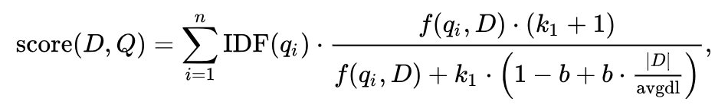
Scoring
Documents are assigned a relevance score based on the BM25 ranking algorithm, which is influenced by 3 key factors:
Term frequency: The more occurrences of the search term indicate higher relevance
Inverse document frequency: The rarer a term across documents, the more important it is
Field length: terms found in shorter fields (fewer words) are more likely to be relevant than terms in longer fields (more words)

Slide 170
Pricing and planning

Slide 171
How to Deploy
Azure Resource Manager
Use an Azure Resource Manager (ARM) template in the Azure portal. An ARM template defines the infrastructure and configuration for your project. You describe your intended to create the deployment.
Only those properties included in the template are used in the deployment. If more customization is required, such as setting up network security, you can update the service as a post-deployment task.
To customize an existing service with the fewest steps, use Azure CLI or Azure PowerShell. If you're evaluating preview features, use the Management REST API.
Bicep
Bicep is a domain-specific language (DSL) that uses declarative syntax to deploy Azure resources. Bicep offers the best authoring experience for your infrastructure-as-code solutions in Azure.
Using Terraform, you create configuration files using HCL syntax. After you create your configuration files, you create an execution plan that allows you to preview your infrastructure changes before they're deployed. Once you verify the changes, you apply the execution plan to deploy the infrastructure.
Terraform
Notes:
Let's dive deeper into the transformative power of AI, which is reshaping our world in three distinct dimensions: the Individual, the Function, and the Industry.
For Every Individual:
Collaborate More Effectively: AI tackles core team challenges by automating routine tasks and providing real-time insights, allowing people to focus on strategic problem-solving and decision-making.
Find Information Faster: Look, AI isn't just crunching numbers in the background. It's learning from your behavior, your preferences, and it's using that intelligence to sift through the noise. What you get is the information you actually need, right when you need it, empowering you to make decisions in real-time.
Enable Creativity and Focus: Here's the deal—AI isn't the artist; you are. What AI does is take care of the routine, the mundane, the stuff that eats up your day. That gives you—the human—the freedom to focus on what really matters: innovation, creativity, the big ideas. So, in essence, AI is clearing the space for human creativity to flourish.
In Every Function:
Help Sellers Spend More Time with Customers: After AI clears the deck for your creative genius, what's next? For Sales, it's about relationships, not just transactions. AI takes care of the routine tasks—like data entry, lead scoring, you name it—freeing you up to do what you do best: connect with people. And don't just take my word for it; a 2023 study by USC showed that sales agents using AI closed 61% more deals. That's not incremental; that's transformative (source).
Deliver Meaningful Marketing Engagements: With AI, we're not just throwing darts in the dark. We're using data-driven insights to understand each customer's unique journey. This enables marketers to craft strategies that resonate on a personal level, building loyalty that lasts.
Shift the Advantage from Attackers to Defenders: In the realm of cybersecurity, AI is the game-changer we've been waiting for. It's not just about defense; it's about taking the initiative, learning from the environment, and adapting faster than the threats can evolve.
Across Every Industry:
Deliver More Personalized Healthcare: In healthcare, AI goes beyond general diagnostics. By analyzing individual patient data, it allows healthcare providers to offer treatments that are specifically tailored to improve patient outcomes. It's about enhancing the quality of life, one patient at a time.
Enable Safer Finance: In the financial sector, AI does more than just flag suspicious transactions. It analyzes transaction patterns in real-time, helping to prevent fraud before it happens. This ensures the integrity of every transaction, making the financial landscape safer for everyone involved.
Make Retail More Sustainable: In retail, AI isn't just about sales; it's about sustainability. By optimizing supply chains and reducing waste, we're not only saving costs but also contributing to a more sustainable future. It's responsible business for a world that needs it.
Enable Efficient Manufacturing: In manufacturing, AI is more than just automation. By analyzing production data, it identifies bottlenecks and optimizes workflows. This reduces downtime and increases efficiency, making our manufacturing processes smarter and more effective.
So, as you can see, AI is not just a technology; it's a catalyst for change, a force multiplier that's enabling us to do more than we ever thought possible.

Slide 172
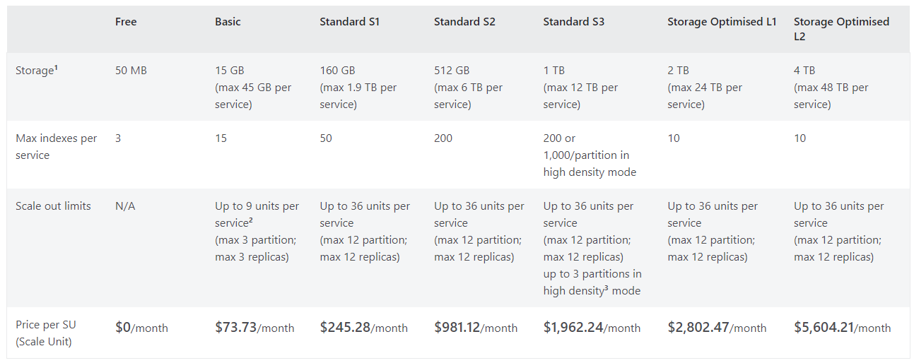
Capacity concepts and impact on cost
Capacity of a search service is based on:
Partitions: Provides storage and improved I/O for reads and writes. Data is divided among the number of partitions configured for your service.
Replicas: Helps load balance queries and scale up request throughput. Each replica has a full copy of an index.
Multiple replicas are required for an SLA:
2 replicas needed for read SLA
3 replicas needed for read and write SLA
Sample cost estimation:
Customer has 300GB of index data and wants to ensure they have a read/write SLA.
—
They choose the S1 service tier with 2 partitions and 3 replicas. 2P x 3R = 6 total search units.
Monthly charges would be 6SUs x $245.28 = $1,471.68
See the Azure AI Search pricing page for details:
https://azure.microsoft.com/en-us/pricing/details/search/

Slide 173
Pricing for additional features
Custom Entity Lookup Skill
Label documents containing text from a custom, user-defined list of words and phrases. Available for all Basic, Standard, and Storage-Optimized tiers.
0–1M text records $1 per 1,000 text records
1M–3M text records $0.75 per 1,000 text records
3M–10M text records $0.30 per 1,000 text records
10M+ text records $0.25 per 1,000 text records
Document Cracking: Image Extraction
Extracts content from a file within the enrichment pipeline. Text extraction is free. Image extraction is billed during the initial document cracking step and when invoking the Document Extraction skill.
0–1M images $1 per 1,000 transactions
1M–5M images $0.80 per 1,000 transactions
5M+ images $0.65 per 1,000 transactions
Semantic Ranker
Uses AI models to improve the relevance of the search results by finding content that is semantically similar to query terms. Not available for free tier services.
First 1,000 requests per month free
$1 per 1,000 additional requests

Slide 174
Supported storage configurations
Partition count | Basic | S1 | S2 | S3 | L1 | L2
1 | 15 | 160 | 512 | 1024 | 2048 | 4096
2 | 30 | 320 | 1024 | 2048 | 4096 | 8192
3 | 45 | 480 | 1536 | 3072 | 6144 | 12288
4 |  | 640 | 2048 | 4096 | 8192 | 16384
5
6 |  | 960 | 3072 | 6144 | 12288 | 24576
7
8
9
10
11
12 |  | 1920 | 6144 | 12288 | 24576 | 49152
Services created after April 3, 2024
Services created after May 17, 2024

Slide 175
Capacity planning
Review service limits at each tier to determine which SKU supports the number of indexes you need.
Select your SKU by starting with the storage you’ll need:
Start with Basic if the projected workload is small or unknown
Start with Standard tier for medium to large scale indexing and query workloads
Start with Storage Optimized tier for very large workload where query throughput is low and latency expectations are relaxed. Example scenarios would be archival, e-discovery, or internal business applications
Determine how the size of the data source translates to the index by indexing a sample set of data and projection storage consumption to the full set.
You’ll get much better results if your index schema, enrichment pipeline, and embedding models are all configured as close to your production application as possible
Configure replicas for high availability and scale to support query volume.
Perform performance testing using the target queries per second (QPS) load you expect in your production application
Monitor storage, service limits, query volume, and latency in the portal.
During performance testing and when running your application in production, the portal shows you queries per second, throttled queries, and search latency. All these values can help you decide if you selected the right tier

Slide 176
Security and compliance

Slide 177
Security focus
Azure AI Search
Inbound
Network Traffic
Data at Rest
Outbound
Network Traffic

Slide 178

At Rest: E@R with customer managed keys
Authenticate to Key Vault using an AAD application or managed identity
Azure Key Vault
Search platform layer
Synonym maps
Indexes
Indexer & data source definition
Skillset
Definition
Platform level encryption with customer managed key
Storage layer
Encryption by default with a Microsoft managed key

Slide 179





Inbound network traffic: Firewall with IP restrictions
Deny Internet
ER Private Peering
ER Gateway
On-premises
App
service
Azure AI Search
Virtual Network (10.0.0.0/16)
Azure AI Search
Virtual Network
IP Restrictions for Azure AI Search
Firewall only allows traffic from the list of IPv4 addresses and/or ranges you provide
Easy to configure and available at no additional cost

Slide 180

Inbound network traffic: Azure Private Link
Deny Internet
Deny Internet
Private Link
ER Gateway
10.0.0.5
ER Private Peering
On-premises
VM
Private Endpoint
Azure AI Search
Virtual Network (10.0.0.0/16)
Azure AI Search
Virtual Network
Private Link for Azure AI Search
Private access from Virtual Network resources, peered networks and on-premises networks
Predictable private IP addresses for your search service
Notes:
Azure Private Link enables you to access your search service without exposing your index to the internet. You use a Private Endpoint in your vnet to connect to your service via a private link. In this example, you could have your app service in the same Vnet and only that service would be able to reach the search service.

Slide 181
Inbound API: Role-based authentication
Disable the ability to use connection strings and API keys to access Azure AI Search
Grant access based on a user’s identity and their role
Eliminate unnecessarily broad permissions requirements
General index
Has reader role
User
Azure AI Search
Access granted
Missing reader role
Private index
Access denied

Slide 182
Inbound: Multi-tier architecture
Deny Internet
Private Link
10.0.0.5
Web & Mobile
Application
Your Search API
Private Endpoint
Azure AI Search
VNet1
VNet2
Azure AI Search
Virtual Network
Tightly control and limit direct access to your search service
Perform security trimming in your search API
Store secrets in Azure Key Vault and rotate on a schedule

Slide 183


Outbound network traffic: Firewalls with IP restrictions
Managed identity
Storage trusted service
IP whitelisting
Service Tags
Azure AI Search
Data Sources
Azure AI Search
Indexer
Storage
SQL
CosmosDB
Service Tag:
AzureCognitiveSearch
Azure AI Search
Virtual Network
IP Restrictions for Azure AI Search Data Sources
Azure AI Search indexers can connect to data sources with IP restrictions
Use managed identity to connect to your data sources without having to pass a connection string or service key

Slide 184
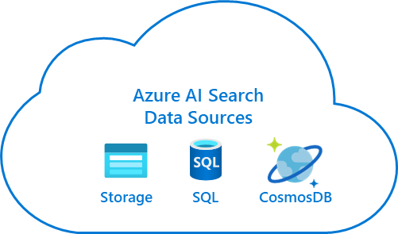
Outbound network traffic: Azure Private Link
Deny Internet
Create private link connections to
the following resources:
Indexer Data Sources:
Storage Account (blob, table, ADLS Gen2, file)
Cosmos DB for NoSQL
SQL Server Database
Database for MySQL (preview)
SQL Managed Instance (preview)
Skillset Execution:
App Service or Azure Function hosting a custom skill
Azure Open AI service via integrated Vectorization
AI Services via AI enrichment
CMK:
KeyVault
10.0.0.5
Private Link
E@R with Customer Managed Key
Azure Key Vault
10.0.0.6
Azure AI Search
Indexer
Private endpoint
Azure AI Search
Virtual Network
Your Private Data Sources
Outbound Private Endpoints for Azure AI Search
Azure AI Search can use Private Endpoint to connect to your secure resources
Connect to data sources without having to expose them to the internet

Slide 185



Inbound or outbound: Authentication without credentials
Eliminate credential management using Entra ID based authentication
Create an identity for Azure AI Search directly in Entra ID using system-assigned managed identity, or provision one yourself as a user-assigned managed identity
Azure Storage
Managed Identity
Azure AI Search
Identity has access to storage
Connect securely without any keys

Slide 186
Data residency & privacy
Microsoft Compliance Boundary
Azure OpenAI
AI enrichment
Index Usage & Querying
Data Indexing
End-user
Search Service
Customer owned storage
ARM Template
Service Provisioning
RP
Data remains in the selected region
Logs contains metadata, OII
All communications across internal clusters are sent over HTTPS. Communication within clusters (e.g., within stamp controller clusters or within search clusters) use Azure network isolation
Azure AI Search does not storage any customer data, therefore, any data under AI Search is used to train models

Slide 187
Compliance
ISO 27001
FedRAMP (High/moderate)
HIIPAA HITRUST (9.2)
SOC 2 (Type 2)
PCI DSS Level 1
Provides a framework for policies and procedures that include all legal, physical, and technical controls
Provides a standardized approach for assessing, monitoring, and authorizing cloud service providers
An organization governed by representatives from the healthcare industry
Is a restricted use report intended to report on controls relevant to Security, Availability, Confidentiality, Processing Integrity, and Privacy system attributes
Is required for any organization that stores, processes, or transmits payment and cardholder data

Slide 188
Responsible AI
Azure AI Search publishes a Responsible AI Transparency Note intended to help you understand how our AI technology works, the choices system owners can make that influence system performance and behavior, and the importance of thinking about the whole system, including the technology, the people, and the environment.
Intro and basics
The general overview of the purpose and high-level scenarios that the AI system addresses within the host product.
Capabilities
Any explanation of the system behavior and available choices system owners can make that influence system performance and behavior within the context of more specific use case examples.
Limitations
A view of the technical limitations, operational factors, and ranges of choices to aid in thinking about the whole system, including the technology, the people, and the environment.
RAI Note Link: https://learn.microsoft.com/en-us/legal/search/transparency-note

Slide 189
L400
Security Updates
From Gia for Build update –
Remove this slide after added to the right part of the WIP L400 deck, before publishing.

Slide 190
Document-Level Security Support for Entra ID POSIX-style ACLs and RBAC
Preview
Schema:
permissionFilter fields with values userIds, groupIds, rbacScope + permissionFilterOption="enabled"
Indexing methods (REST API 2025-05-01-preview +):
Push API → upload docs with ACL / RBAC container values in those fields
ADLS Gen2 indexer → auto-extracts POSIX ACLs + container RBAC into same fields
Refresh changed permissions:
– 1-5 blobs ➜ touch file(s) (update Last-Modified)
– Hundreds ➜ POST /indexers/{name}/resetdocs (preview)
– Container-wide ➜ POST /indexers/{name}/resync { "options": ["permissions"] }
Query enforcement:
– Client token (x-ms-query-source-authorization)
– Service adds security filter → returns only authorized docs
Limits: 32 IDs per ACL field • ≤ 5 distinct rbacScope values / index
Notes:
https://learn.microsoft.com/en-us/azure/search/search-document-level-access-overview

Slide 191

Document-level Security: Support for Entra ID POSIX-style ACLs and RBAC (High-Level Diagram)
Preview
User 1
User 2
User 3
Queries for company policies and gets contents of doc1, doc2, doc3, doc4, doc5
Queries for company policies and gets contents of doc2, doc4
Queries for company policies and gets contents of doc1,doc2, doc3
Azure AI Search indexing and AI enrichment pipeline
ADLS Gen2 Container
ADLS Gen2 Indexer
(pull mechanism)
Chat bot UX
Azure AI Search Index
RAG orchestrator/agent
User 1 has read access over doc1, doc2, doc3 (ACLs)
User 2 has read access over doc2, doc4 (ACLs)
User 3 has read access over container (RBAC role)
All doc1, doc2, doc3, doc4, doc5 are in ADLS Gen2 container and have the context for company policies.
Push REST API support for Entra ID POSIX-style ACLs, and permissions metadata copy (ACLs and RBAC container) using pull mechanism (indexer) for ADLS Gen2 data source.
Other data source security systems can be preserved via security trimming filters.
Notes:
https://learn.microsoft.com/en-us/azure/search/search-document-level-access-overview

Slide 192


Document-level Security: Support for Entra ID POSIX-style ACLs and RBAC (Low-Level Diagram) - Workflow with ADLS Gen2 indexer
Preview
User Permission Store Microsoft Graph
List of Container RBAC Roles Assigned to User
1st Party Preauth between Graph – Azure Search
User context via OBO token
Invoke/TransitiveMemberOf
1st Party Preauth between Graph – Azure Search
User context via OBO token
Invoke/TransitiveMemberOf
List of GroupIDs
CheckAccess
Built-in Indexing pipeline
User Permission Service
Entra ID
Gets User OBO token
ADLS Gen2 Indexer: Gets ACLS: UserId/GroupId gets Container RBAC roles
User query
Azure Data Lake Storage Gen2
RAG APP
UX
Document Index in Azure Search with access control information
Azure Search API Frontend
Data source configuration for ACLS and/or container RBAC/roles.
/resync
/resetdocs
Azure Search Backend Search Engine
User Query + Security Filter
User query + User OBO token
User query
Get list of unique container RBAC scope
End User
Container info in Index
Low-level diagram for what the workflow looks like for document-level permissions. This showcases the pull mechanism (ADLS Gen2 indexer). Customers can also push their system POSIX-style ACL system permissions metadata, if Entra ID is the authorization system
Keep permissions fresh with the same mechanism: update a single document lastModifiedStamp, call /resetdocs for a small set of blobs or /resync (options: permissions) to refresh ACL/RBAC across the entire container—no content re-crawl needed.
Notes:
https://learn.microsoft.com/en-us/azure/search/search-document-level-access-overview
https://learn.microsoft.com/en-us/azure/search/tutorial-adls-gen2-indexer-acls

Slide 193
Document-level Security: Support for Entra ID POSIX-style ACLs and RBAC permissions workflow
Request
RBAC Is the required role assigned?
Container RBAC Role/Scope | ACL GroupID | ACL UserID | Permission Resolution
Yes | Yes | Yes | Yes
Yes | Yes | No | Yes
Yes | No | Yes | Yes
Yes | No | No | Yes
No | Yes | Yes | Yes
No | Yes | No | Yes
No | No | Yes | Yes
No | No | No | No
Yes
No
ACLs Does the principal have the required permissions?
Access granted
Yes
No
Access denied

Slide 194
Indexer ACL/RBAC container metadata copy
Preview
{
"name" : "my-adlsgen2-acl-index",
"fields": [
{
"name": "name", "type": "Edm.String",
"searchable": true, "filterable": false, "retrievable": true
},
{
"name": "AzureSearch_DocumentKey", "type": "Edm.String",
"searchable": true, "filterable": false, "retrievable": true
"stored": true,
"key": true
},
{
"name": "UserIds", "type": "Collection(Edm.String)",
"permissionFilter": "userIds",
"searchable": true, "filterable": false, "retrievable": true
},
{
"name": "GroupIds", "type": "Collection(Edm.String)",
"permissionFilter": "groupIds",
"searchable": true, "filterable": false, "retrievable": true
},
{
"name": "RbacScope", "type": "Edm.String",
"permissionFilter": "rbacScope",
"searchable": true, "filterable": false, "retrievable": true
}
],
"permissionFilterOption": "enabled"
}
I want to copy my documents permissions metadata as I index documents located in ADLS Gen2 or any Entra-based POSIX-Style ACL system
Index definition
Notes:
https://learn.microsoft.com/en-us/azure/search/tutorial-adls-gen2-indexer-acls

Slide 195
Indexer ACL/RBAC container metadata copy
Preview
{
"name" : "my-adlsgen2-acl-datasource",
"type": "adlsgen2",
"indexerPermissionOptions": ["userIds", "groupIds", "rbacScope"],
"credentials": {
"connectionString": "ResourceId=/subscriptions/<your subscription ID>/resourceGroups/<your resource group name>/providers/Microsoft.Storage/storageAccounts/<your storage account name>/;"
},
"container": {
"name": "parks",
"query": null
}
}
I want to copy my documents permissions metadata as I index documents located in ADLS Gen2 or any Entra-based POSIX-Style ACL system
Data source definition
Notes:
https://learn.microsoft.com/en-us/azure/search/tutorial-adls-gen2-indexer-acls

Slide 196
Query request preserving ACLs/RBAC roles
Preview
I want that my end user can only see the ACL/RBAC permissions as copied in the index.
POST {{endpoint}}/indexes/{{indexName}}/docs/search?api-version={{apiversion}}
api-key: {{apikey}}
Content-Type: application/json
x-ms-query-source-authorization: <token>
{
"search": "*",
"queryLanguage": "en-us",
"queryType": "simple",
"count": true
}
Notes:
https://learn.microsoft.com/en-us/azure/search/tutorial-adls-gen2-indexer-acls

Slide 197
Performance and monitoring

Slide 198

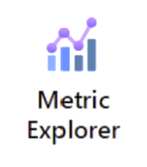


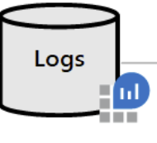
Monitoring with AI Search
End-user
Search Service
Azure Monitor
Azure monitor in AI Search is intended to monitor the service health, it does not to monitor individual user access to content on the search service.

Slide 199
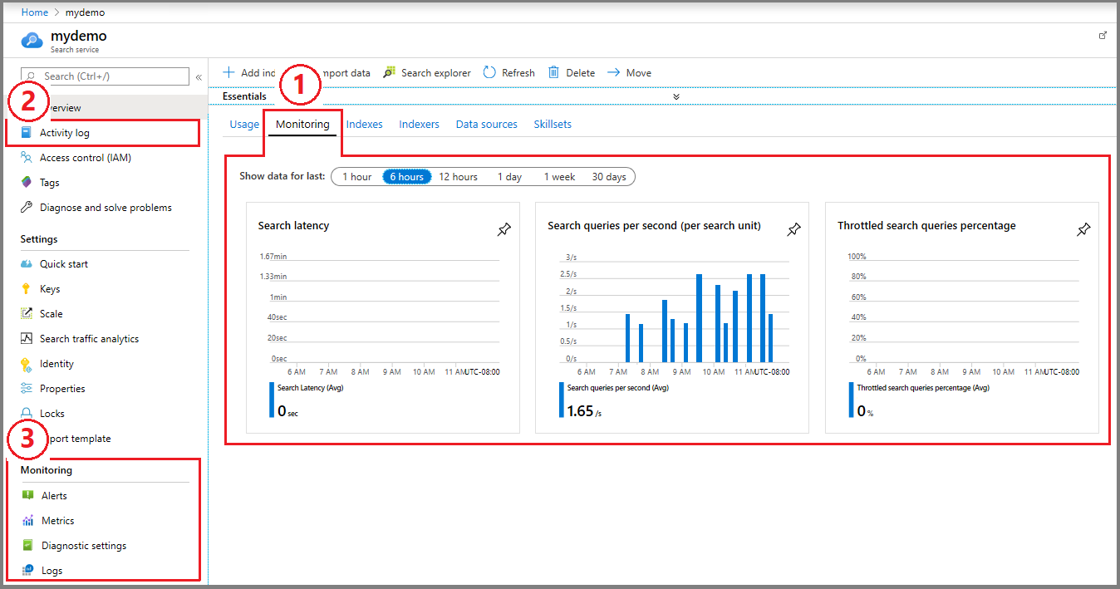
Monitoring with AI Search—metrics
Metrics enabled by default with every subscription
Azure Monitor collects platform metrics as soon as you start using the service
Metric ID | Unit | Description
DocumentsProcessedCount | Count | Total number of documents successfully processed in an indexing operation by an indexer.
SearchLatency | Seconds | Average search queries latency executed on the search service.
SearchQueriesPerSecond | CountPerSecond | Provides the total, maximum, minimum and average amount of search queries executed during the selected time in the search service
SkillExecutionCount | Count | Total number of skill executions processed during an indexer operation.
ThrottledSearchQueriesPercentage | Percent | Percentage of the search queries that were throttled from the total number of search queries that executed during a one-minute interval.

Slide 200
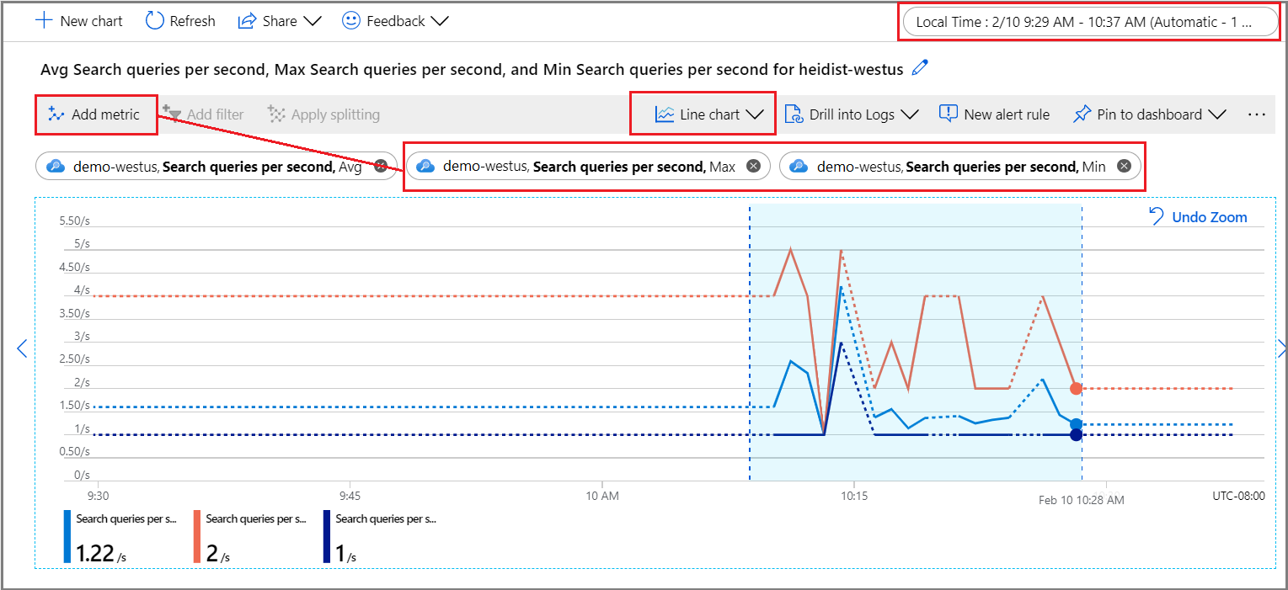
Explore metrics in the portal
Open metrics explorer from the Monitoring menu so that you can layer, zoom in, and visualize data to explore trends or anomalies. Learn more about metrics explorer by completing this tutorial on creating a metrics chart.
Under the Monitoring section, select Metrics to open the metrics explorer with the scope set to your search service.
Under Metric, choose one from the dropdown list and review the list of available aggregations for a preferred type. The aggregation defines how the collected values will be sampled over each time interval.
In the top-right corner, set the time interval.
Choose a visualization. The default is a line chart.
Layer additional aggregations by choosing Add metric and selecting different aggregations.

Slide 201
Monitoring with AI Search—logs
Activity logs are collected free of charge, with no configuration required.
Data retention is 90 days, but you can configure durable storage for longer retention.
Activity logs reflect control plane activity, such as service creation and configuration, or API key usage or management.
If you would like to capture data plane operations, then you should enable Diagnostic logs resource logs to capture indexing and query operations on the search service itself.
This feature is billable (see the Pricing model for details). Here mode tails on how to enable it using the portal.

Slide 202
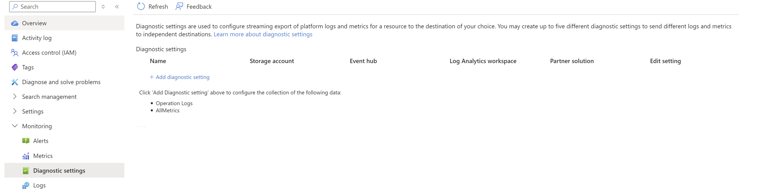
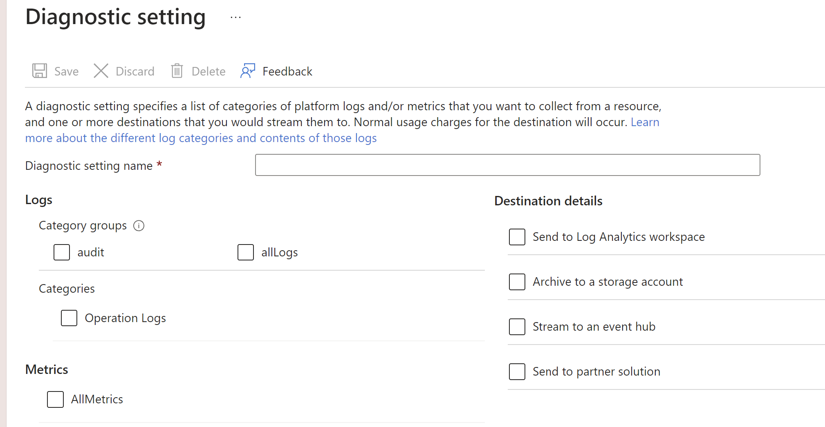
Enabling diagnostic settings
2
1
3
The "Audit" category group is a subset of the "All" category group, but the Azure portal and REST API consider them separate settings. Selecting the "All" category group does collect all audit logs even if the "Audit" category group is also selected.
Logs and Metrics can be sent to the following destinations:
Destination | Description
Log Analytics workspace | Metrics are converted to log form. Sending them to the Azure Monitor Logs store (which is searchable via Log Analytics) helps you to integrate them into queries, alerts, and visualizations with existing log data.
Azure Storage account | Archiving logs and metrics to a Storage account is useful for audit, static analysis, or back up. Compared to using Azure Monitor Logs or a Log Analytics workspace, Storage is less expensive, and logs can be kept there indefinitely.
Azure Event Hubs | When you send logs and metrics to Event Hubs, you can stream data to external systems such as third-party SIEMs and other Log Analytics solutions.
Azure Monitor partner solutions | Specialized integrations can be made between Azure Monitor and other non-Microsoft monitoring platforms. Integration is useful when you're already using one of the partners.

Slide 203
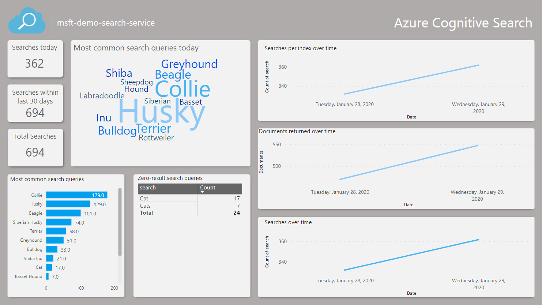
Dashboard to visualize resource Logs
Find the Azure AI Search Power BI App in the Power BI Apps marketplace and install it into a new workspace or an existing workspace. The app is called Azure AI Search: Analyze Logs and Metrics.
After installing the app, select the app from your list of apps in Power BI.
Select Connect to connect your data.
Input the name of the storage account that contains your logs and metrics. By default, the app will look at the last 10 days of data, but this value can be changed with the Days parameter.
Select Key as the authentication method and provide your storage account key. Select Private as the privacy level. Click Sign In and to begin the loading process.
Once the data refresh has completed, select Azure AI Search Report to view the report.

Slide 204
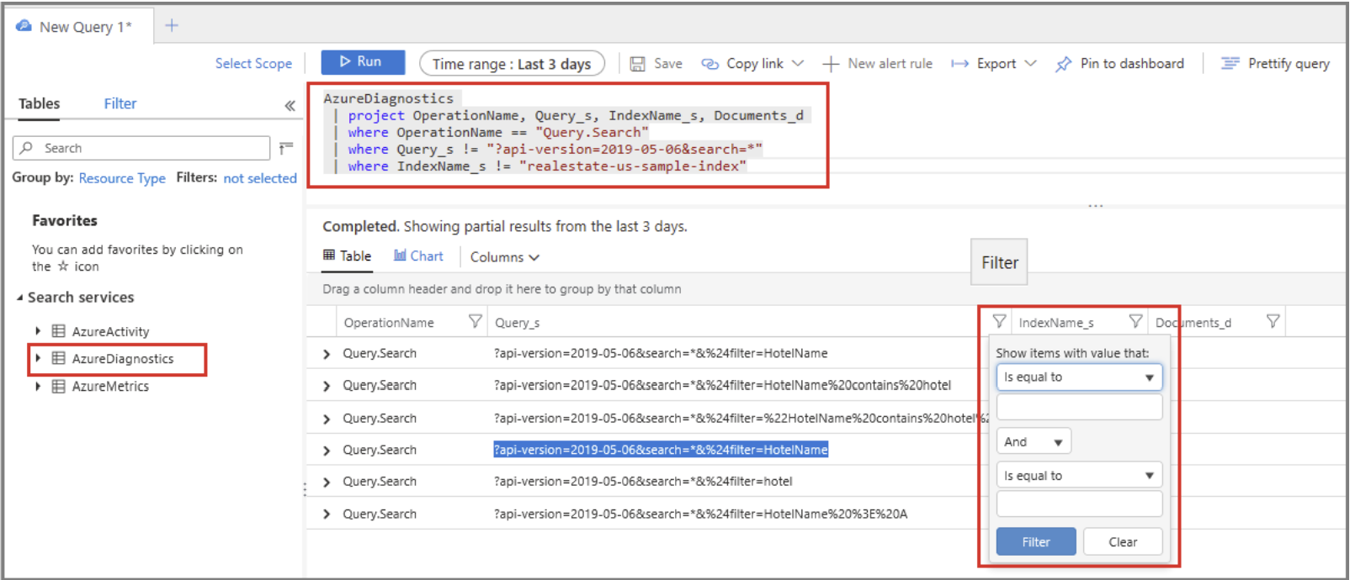
Exploring queries
When you enable resource logging, the system captures query requests in the AzureDiagnostics table. Here is shared some query example to explore query and index operations
Return query strings entered by users:
AzureDiagnostics | project OperationName, Query_s, IndexName_s, Documents_d | where OperationName == "Query.Search" | where Query_s != "?api-version=2020-06-30&search=*" | where IndexName_s != “your-index-name"
Identify long-running queries:
AzureDiagnostics | project OperationName, resultSignature_d, DurationMs, Query_s, Documents_d, IndexName_s | where OperationName == "Query.Search" | sort by DurationMs

Slide 205
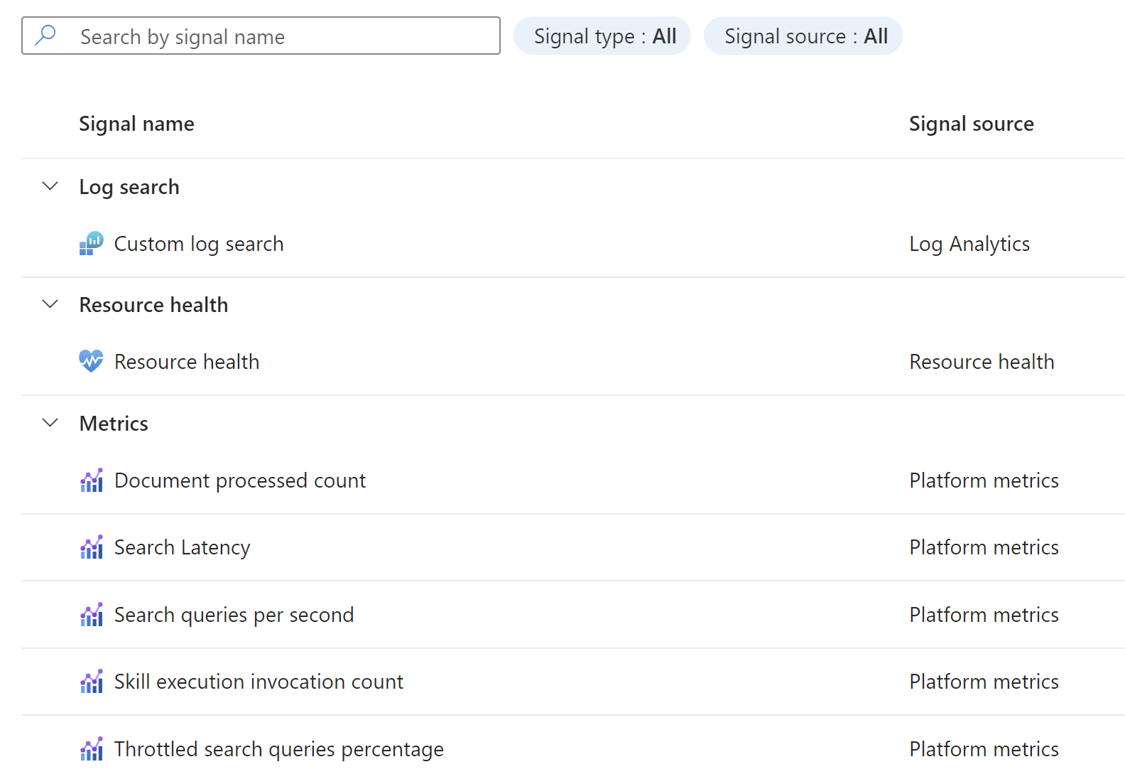

Monitoring with AI Search—alerts
For a search service, it’s common to create a metric alert for search latency and throttled queries. If you know when queries are dropped, you can look for remedies that reduce load or increase capacity.
Current available signals in AI Search:

Slide 206


Useful performance guidelines
Performance benchmark: Azure AI Search provides a guideline on how to benchmark performance which could be a useful guide for estimating potential performance under similar configurations. However, these benchmarks in no way guarantee a certain level of performance from your service. Performance benchmarks—Azure AI Search | Microsoft Learn
Tips for better performance: Some of the main factor that could impact your service performance are Index composition, query design and service capacity (tier, partition and replica number). A collection of tips and best practices that are often recommended for boosting performance are shared here Performance tips—Azure AI Search | Microsoft Learn.

